Slide 1

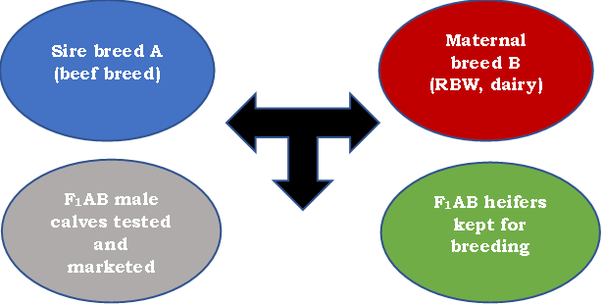
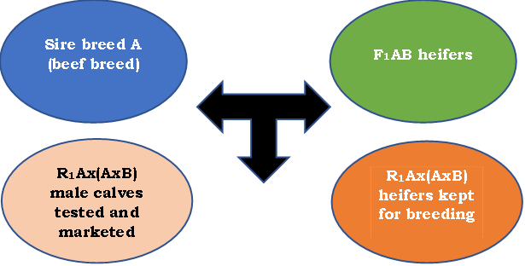
BACK-CROSSING SCHEMES USED TO CREATE BEEF SYNTHETIC BREEDS
ACADEMY OF AGRICULTURAL AND FORESTRY SCIENCES "GHEORGHE IONESCU ȘIȘEȘTI"
RESEARCH AND DEVELOPMENT INSTITUTE FOR BOVINE
ABSTRACT:
Authors: Dinu Gavojdian, Ioana Nicolae
The objectives of the present study were the following: i) to develop synthetic beef breeds, adapted to the Romanian climate, while taking advantage of the heterosis effects, throughout the use of back-crossing schemes; ii) to test breed complementarity between Romanian Black and White (RBW) dairy cows and Belgian Blue, Aberdeen Angus, Limousin and Charolais beef specialized breeds; iii) to increase dairy farms returns throughout the production of calves with better fattening attributes and higher marketing value. The live body weights of the back-cross calves at the age of 210 days were on average of 339.8±5.1 kg in R₁ Belgian Blue x (F₁ Belgian Blue x RBW), 312.4±3.3 kg in R₁ Charolais x (F₁ Charolais x RBW), 296.2±2.9 kg in R₁ Limousin x (F₁ Limousin x RBW) and of 244.0±3.5 kg in R₁ Aberdeen Angus x (F₁ Aberdeen Angus x RBW). By applying well designed crossbreeding schemes, it is possible to increase meat production at dairy farms level and implicitly the economic returns.
RESULTS AND DISCUSSION:
The average daily gains and marketing live weights at 7 months of age for the R₁ Belgian Blue 50% x (F₁ Belgian Blue 25% x Romanian Black and White 25%) crossbreed calves were of 1373.3 g/day and 339.8 kg, respectively. The high growth performances have led to obtaining an overall selling price per calf of 992.2 EUR/calf, and after subtracting the production costs of 678.5 EUR/head, to an estimated profit of 313.7 EUR/calf produced and sold.
In R₁ Charolais 50% x (F₁ Charolais 50% x RBW 50%) crossbreed calves, the average daily gains were of 1307.7 g/day and the live weights at 7 months of age of 312.4 kg. The overall growth performance of the R₁ Charolais sired calves has led to obtaining an overall selling price per calf of 912.2 EUR, and after subtracting the production costs, to an estimate profit of 233.7 EUR/calf.
The R₁ Limousin 50% x (F₁ Limousin 50% x RBW 50%) crossbreed calves registered average daily gains of 1220.1 g/day, which has led to a marketing average live weight of 296.2 kg at the age of 7 months and to a selling price of 864.9 EUR, which in turn has led to obtaining an estimated profit of 186.4 EUR per calf sold.
More modest average daily gains were registered for the R₁ Aberdeen Angus 50% x (F₁ Aberdeen Angus 50% x RBW 50%), of 960.3 g/day, which lowered the marketing live weights at the age of 7 months, leading to average live weights of 244.0 kg, and subsequently lower selling prices of 712.4 EUR, which in return has led to a decrease of the estimated profits to 33.9 EUR per calf.
Crossbreeding schemes applied to obtain the first generation heifers (F₁, left) and the back-crossing (R₁, right), using Belgian Blue, Aberdeen Angus, Charolais and Limousin beef sire breeds
CONCLUSIONS:
The growth rates of the back-cross calves obtained and tested in this study were comparable to those recorded in beef specialized breeds raised under semi-intensive production systems.
Application of the back-crossbreeding schemes can increase meat production at farm level and improve incomes, given the higher selling price of crossbreed calves compared to dairy-veal calves.
Crossbreeding offers a number of biological advantages, such as hybrid vigour (heterosis effects) and the high degree of complementarity between dairy and beef breeds.
REFERENCES:
DG-AGRI, EU agricultural outlook for the agricultural markets and income 2017-2030, 2017, Source: https://agriculture.ec.europa.eu/system/files/2018-07/agricultural-outlook-2017-30_en_0.pdf
Eurostat, Agricultural production - livestock and meat, 2022, Source: https://ec.europa.eu/eurostat/statistics-explained/index.php?title=Agricultural_production
FAO, HOW to feed the world, High Level Expert Forum - Global agriculture towards 2050, 2009, Rome – Italy, Source: https://www.fao.org/fileadmin/templates/wsfs/docs/Issues_papers/HLEF2050
CONFERINTA ANIVERSARA ICAR ed. III
Bucuresti, 30 mai 2024

