Slide 1
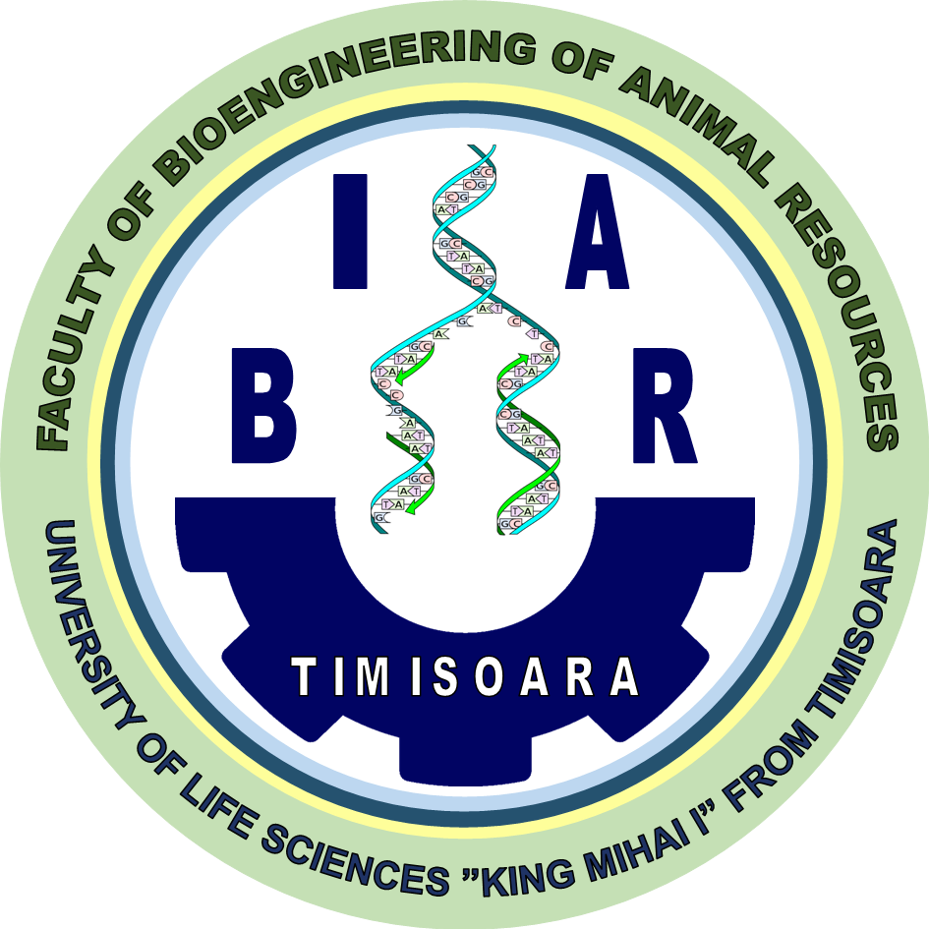
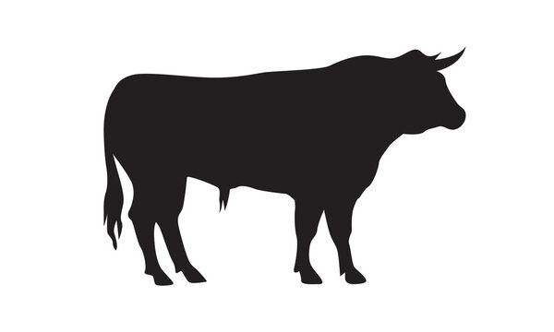
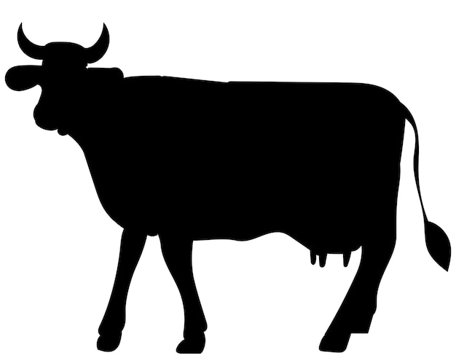
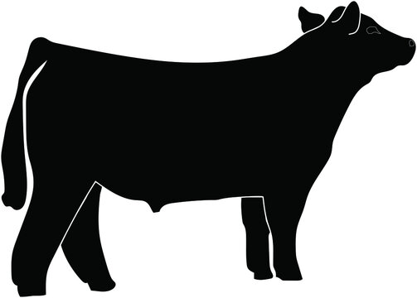
CONFERINȚA NAȚIONALĂ “ANIVERSAREA ICAR”
Ediția IV – 29 mai 2025
EFFECT OF ANIMAL GENDER ON THE BEEF PRODUCTION INDICES AT SLAUGHTER IN ABERDEEN ANGUS BREED
Ludovic Toma Cziszter^{1,2}, Iosif-Adrian Ban², Radu Ionel Neamț¹, Elena Erina Silvia²,
Andreea Ștefania Anton¹, Alexandru Eugeniu Mizeranschi¹, Simona Baul²,
Ciprian Valentin Mihali¹, Daniela Elena Ilie¹
¹Research Department, Research and Development Station for Bovine Arad, Arad 310059, Romania
²Department of Animal Production Engineering, University of Life Sciences ‘King Mihai I’ from Timișoara, 300645 Timișoara, Romania
INTRODUCTION
Due to the specific hormones that affect the general metabolism of animals, the animal gender determines important differences in regard with the beef production indices. Testosterone, the male sexual specific hormone, intensifies the growth process and protein accretion, increasing the feed conversion capacity compared to females. The aim of this study was to assess the effect of animal gender (male, female, and steer) on the beef production indices at slaughter in Aberdeen Angus cattle.
MATERIALS AND METHODS
Data was collected in year 2024 from a private slaughterhouse that sacrifices and cuts Aberdeen Angus purebred and hybrid cattle. A total of 1090 cattle were slaughtered in years 2021, 2022, and 2023.
The information collected consisted in animal gender, birth date, weighing date, breed (Aberdeen Angus purebred or hybrid), age at slaughtering (months), liveweight, cattle type (A-bulls under 24 months of age, B-bulls over 24 months of age, C-steers, D-females under 30 months of age, E-females over 30 months of age and culled), total carcass weight as well as left and right half-carcass, SEUROP conformation class of carcasses, killing-out percentage, and class of fat cover.
The studied indicators were: age at slaughtering, liveweight at slaughtering, total carcass weight, left and right half-carcass weight, killing-out percentage, carcass conformation class, and fat cover class.
The main studied effect was animal gender with three levels: males (n=124), females (n=313), and steers (n=653).
A statistical model was employed, Main Effect ANOVA, using STATISTICA software to assess effect of gender on the beef production indices mentioned above. Other factors were included into the model, to be taking into account for correction, namely animal genotype (purebred or hybrid), and year (2021, 2022, and 2023).
RESULTS
Beef indices | Averages ± SEM |  |  | Differences and significance
 | Males (M) | Females (F) | Steers (S) | M vs. F | M vs. S | F vs. S
Age at slaughtering (months) | 19.38 ± 0.47 | 25.91 ± 0.82 | 19.83 ± 0.11 | -6.53*** | -0.45^{ns} | 6.08***
Liveweight (kg) | 573.24 ± 2.73 | 564.18 ± 3.05 | 625.08 ± 1.34 | 9.06^{ns} | -51.84*** | -60.90***
Carcass weight (kg) | 320.20 ± 1.69 | 300.63 ± 1.82 | 342.83 ± 0.79 | 19.57*** | -22.63*** | -42.20***
Left half-carcass weight (kg) | 160.46 ± 0.84 | 150.72 ± 0.92 | 172.01 ± 0.40 | 9.74*** | -11.55*** | -21.29***
Right half-carcass weight (kg) | 159.74 ± 0.87 | 149.91 ± 0.91 | 170.82 ± 0.40 | 9.83*** | -11.08*** | -20.91***
Killing-out percentage (%) | 55.86 ± 0.22 | 53.29 ± 0.16 | 54.88 ± 0.09 | 2.57*** | 0.98*** | -1.59***
Conformation class | 4.95 ± 0.03 | 4.51 ± 0.05 | 5.00 ± 0.01 | 0.44*** | -0.05^{ns} | -0.49***
Fat cover class | 2.78 ± 0.05 | 3.37 ± 0.04 | 3.56 ± 0.02 | -0.59*** | -0.78*** | -0.19*
ns - non-significant p>0.05; * - significant p<0.05; ** - distinctly significant p<0.01; *** - very significant p<0.001
CONCLUSIONS
Liveweight at slaughtering of females was similar to those of males, due to the fact that they were 6 months older.
Steers were slaughtered at similar age with males, but with higher liveweight. Also, steers had higher liveweight at slaughter than females.
Combination of age and liveweight at slaughtering resulted in significant differences between animal gender regarding carcass weight and killing-out percentage.
Males and steers produced carcasses classified in class R for conformation, while females’ carcasses were classified lower, between R and O+.
Animal gender had an effect on fat cover of carcass. The highest fat cover of carcasses was obtained in steers, followed by females and the lowest was observed in males.
In conclusion all studied beef traits at slaughtering were significantly influenced by animal gender.

