Slide 1
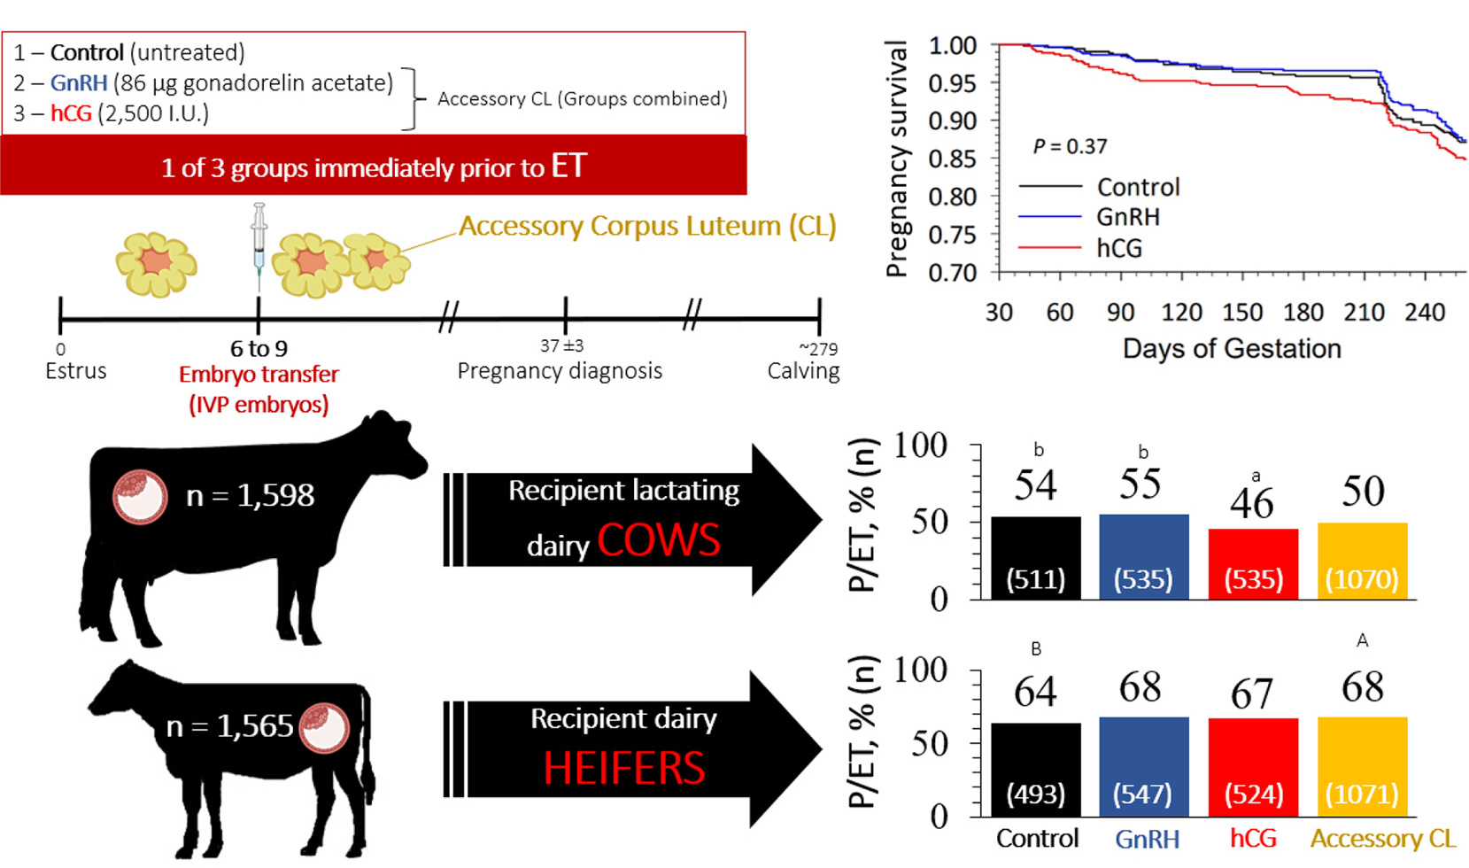
CONFERINȚA NAȚIONALĂ “ANIVERSAREA ICAR”
Ediția IV – 29 mai 2025
ACCESSORY CORPUS LUTEUM IN CATTLE ASSISTED REPRODUCTION
Silviu-Ionuț Borș, Adina-Mirela Ariton, Ioana Poroșnicu, Vasile Vintilă
INTRODUCTION: In dairy cows, current methods for managing reproduction still need improvement. Future advancements will require new strategies to minimize additional interventions and maintain acceptance among veterinarians. As a result, the development of new therapies in dairy cows’ reproduction poses a significant challenge for improving reproductive performances. In recent years, there has been an increasing interest in inducing accessory corpus luteum in dairy cows, but the results have been controversial. It is still uncertain whether this strategy, injecting gonadotropin-releasing hormone (GnRH) or human chorionic gonadotropin (hCG) early in the luteal phase following artificial insemination, can be utilized as a herd management tool to enhance reproduction. Overall, our research supports the idea that giving GnRH agonists during the days 7–14 after AI to repeat breeder cows increases their fertility and farm profitability.
MATERIALS AND METHODS
Study 1: Economics of treatment with GnRH agonist 7–14 days after artificial insemination in repeat breeder lactating dairy cows (Borș et al., 2023)
Every Thursday, at 2 weeks intervals, the repeat breeder (RB) dairy cows from the E group 7–14 days after AI, were subjected to transrectal ultrasonography to evaluate the ovarian structure. The cows which presented a corpus luteum (CL) and at least one follicle more than 7 mm in diameter received one dose of 100 μg GnRH agonist, (dephereline: gonadorelin acetate [6-DPhe]; Gonavet Veyx, Veyx-Pharma GmbH) to induce ovulation and accesoryCL formation (Borș et al., 2023).
Every Thursday, at 2 weeks intervals, the RB cows from the C group 7–14 days after AI, were not subjected to any therapy or ultrasound evaluation. In 1 week, the cows were included in the E group and the next one in the C group (Borș et al., 2023).
Study 2: Impact of Season and OvSynch + GnRH on Day 5 After Artificial Insemination (AI) on the Heat Detection and Conception Rates of Cooled High-Yielding Holstein Cows (Borș et al., 2025).
From January 2022 to December 2022, approximately all the cows were included in the G0 group, which received no treatment.
For the period from January 2023 to December 2023, each cow in the herd received a single dose of GnRH (dephereline: gonadorelin acetate [6-DPhe]; Gonavet Veyx, Veyx-Pharma GmbH, Schwarzenborn, Germany) on day 5 after AI to induce ovulation and aCL formation (G5 group).
Study 3:The accessory Corpus luteum in embryo transfer procedure (el Azzi et al., 2023).
Recipients were randomly assigned to receive GnRH, hCG, or no treatment (control) immediately before ET on days 6 to 9 of the estrous cycle.
RESULTS AND DISCUSSIONS
Independent variables for each group and effects on the different classes on each dependent variable (Borș et al., 2023)
The accessory Corpus luteum in embryo transfer procedure (el Azzi et al., 2023)
Treatment groups | C group (n = 90) | E group (n = 98) | Total (n = 188)
Independent variable
Parity | 2.3 (±1.3) | 2.5 (±1.4) | 2.4 (±1.3)
DIM | 185.3 (±41.8) | 176 (±35.7) | 179 (±38.4)
Milk yield (kg) | 40.8 (±7.6) | 42.7 (±6.4) | 42.1 (±6.8)
Number of services | 3.8 (±1.1) | 3.8 (±1) | 3.8 (±1)
BCS | 3.3 (±0.1) | 3.4 (±0.1) | 3.3 (±0.1)
Dependent variable
No. pregnant | 34 | 48 | 82
No. open | 56 | 50 | 106
Pregnant rate (%) | 37.8^{b} | 49ª | 43.6
Accessory CL (%) | 14.4^{b} | 58.2ª | 37.2
Cumulative pregnancy rate (%) | 55.5^{b} | 64.3ª | 60.1
Pregnancy loss (%) | 6 | 7.9 | 7.1
Culling rate (%) | 18.9 | 18.4 | 18.6
CONCLUSIONS
Treatment with GnRH or hCG applied early during the luteal phase has the ability to induce aCL formation in both cows and heifers (Borș et al., 2023; Borș et al., 2025; El Azzi et al., 2023);
We recommend implementing this therapy 7-14 days after AI in repeat breeder dairy cows. It is conclusive, can be done once a week, and has a significant economic impact on the dairy farm (Borș et al., 2023);
This treatment is not recommended to be used in dairy farms in the management of the reproductive activity of the herd (Borș et al., 2025);
When treatments inducing aCL formation were combined (GnRH + hCG), heifers tended to have greater P/ET than controls (67.7 vs. 63.5%, respectively; El Azzi et al., 2023);
In assisted reproduction, the aCL formation is not recommended for use in cows during embryo transfer procedures (El Azzi et al., 2023).
SELECTIVE REFERENCES
Borş, S.I., Borş, A., Abdoon, A.S.S., Economics of treatment with GnRH agonist 7-14 days after artificial insemination in repeat breeder lactating dairy cows, 2023, Reprod. Domest. Anim., 58(7):929-934, doi: 10.1111/rda.14368.
Borş, S.I., Vintilă, V., Borş, A., Floriștean, V.C., Impact of Season and OvSynch + GnRH on Day 5 After Artificial Insemination (AI) on the Heat Detection and Conception Rates of Cooled High-Yielding Holstein Cows, 2025, Animals (Basel), 9;15(6):777, doi: 10.3390/ani15060777.
El Azzi, M.S., Cardoso, J.L., Landeo, R.A., Pontes, J.H.F., de Souza, J.C., Martins, J.P.N., Effect of inducing accessory corpus luteum formation with gonadotropin-releasing hormone or human chorionic gonadotropin on the day of embryo transfer on fertility of recipient dairy heifers and lactating cows, 2023, JDS Commun, 2,4(2):155-160, doi: 10.3168/jdsc.2022-0286.

