Slide 1
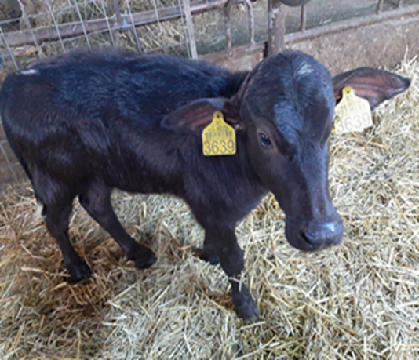
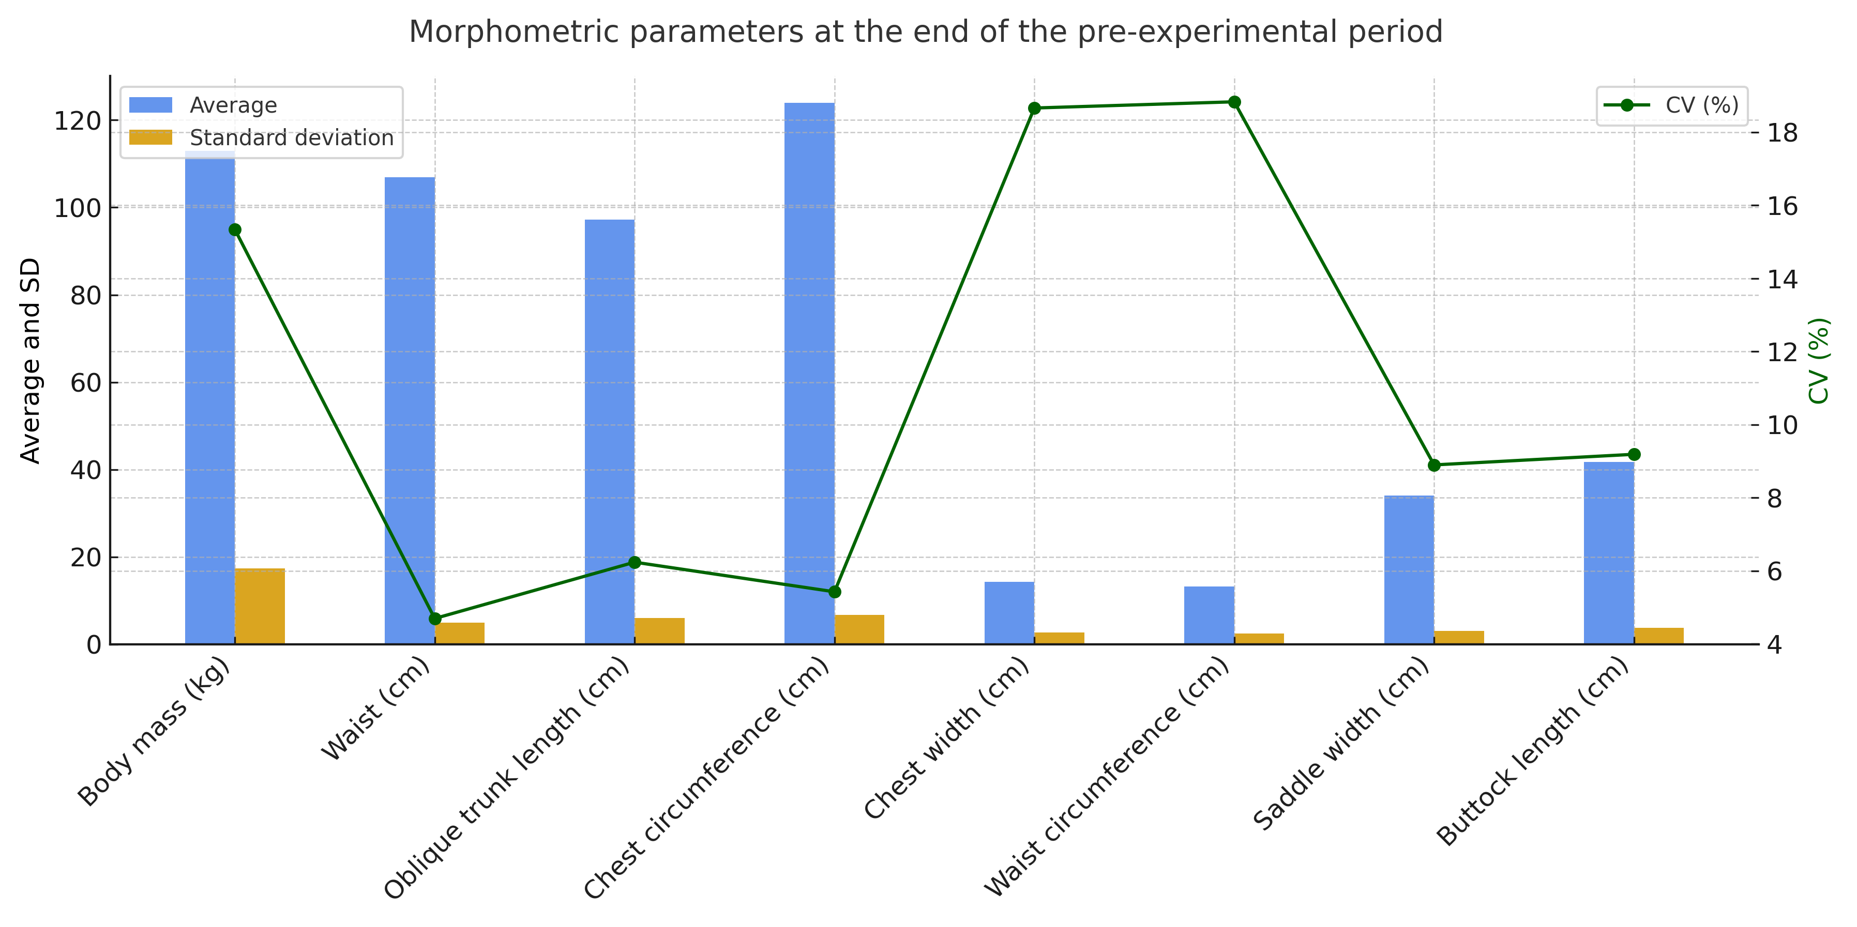
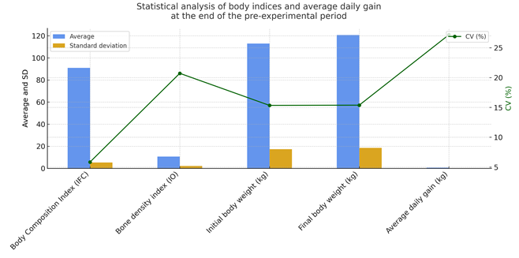
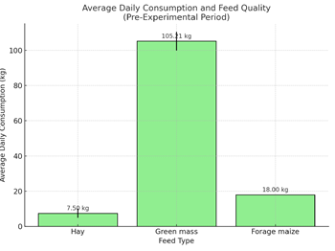
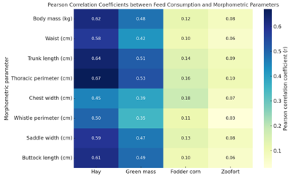
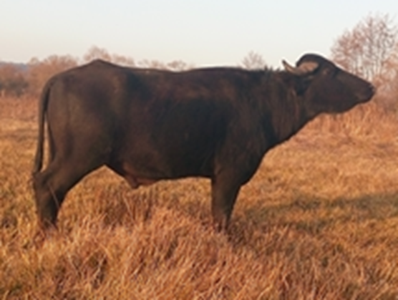
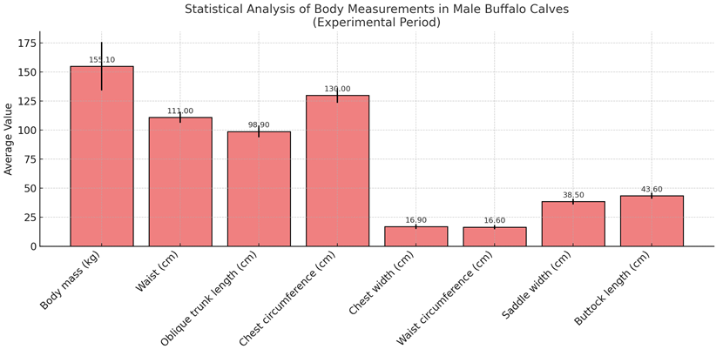
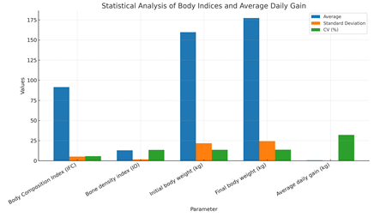
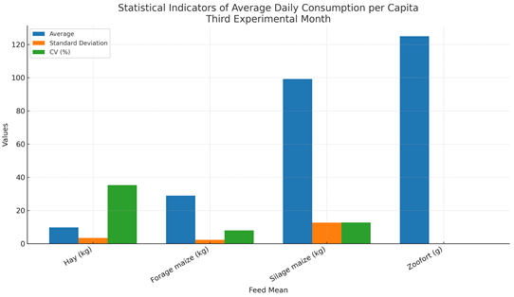
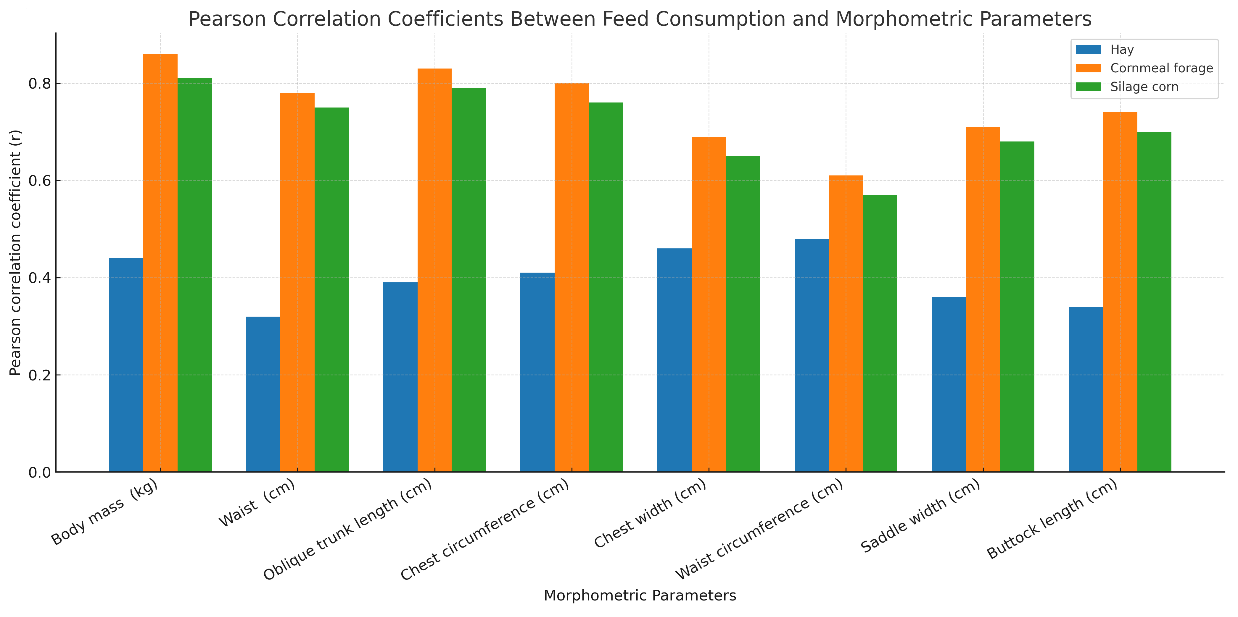
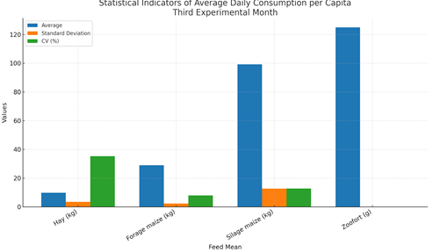
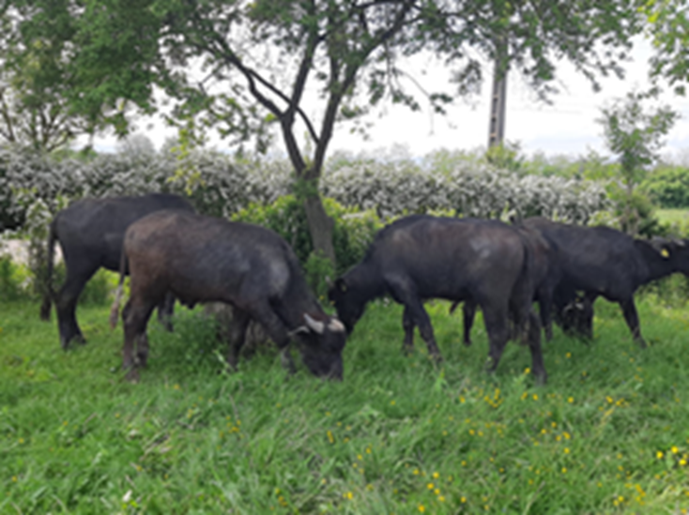
CONFERINȚA NAȚIONALĂ “ANIVERSAREA ICAR”
Ediția IV – 29 mai 2025
RESEARCH ON THE RELATIONSHIP BETWEEN THE CALENDAR PERIOD OF CALVING OF ROMANIAN BUFFALO BREEDS AND THE AVERAGE DAILY GROWTH RECORDED
REMUS CHIOREAN¹, MĂDĂLINA MOLDOVAN¹, ADRIAN BOTA¹
¹ SCDCB ȘERCAIA, Campului, no 2, Sercaia, Romania, 0268245890, scdcb.sercaia@yahoo.com
INTRODUCTION: The Romanian buffalo (Bubalus bubalis) is valued for its adaptability and productive traits. Although herd numbers declined, interest in conservation is rising. This study examines how the calving calendar affects average daily gain in male calves, alongside body development, morphometric indices, and feeding regimes. Using monthly measurements and statistical analysis, it aims to optimize growth and nutrition strategies, contributing to improved productivity and efficiency in buffalo farming.
MATERIAL AND METHOD: The study involved 10 male Romanian buffalo calves born between April and September 2022 at SCDCB Șercaia. Calves were selected based on calving period, uniform development, feed intake, and health status. Raised in similar semi-intensive conditions, they received a balanced diet of hay, green mass, corn silage, fodder maize, and Zoofort. Over 105 days, monthly body measurements and daily feed intake were recorded. Growth parameters and morphometric indices were analyzed statistically to assess the influence of calving period on average daily gain and development.
RESULTS AND DISCUSSION: Body Mass and Morphometric Development of Romanian Buffalo Calves from Calving to Weaning – Pre-experimental
EvaluationThis study assessed the evolution of body mass and morphometric development in 10 male Romanian buffalo calves from birth to weaning (90–120 days), under a semi-intensive feeding regime. The average body mass gain during this period was 34.2 kg, with a standard deviation of 5.06 kg and a coefficient of variation (CV) of 14.79%, reflecting moderate inter-individual variability. The maximum gain was 45 kg in 100 days, corresponding to an average daily gain (ADG) of 0.45 kg/day, exceeding the group mean of 0.38 kg/day.
This variability was attributed to calving season (April–September), nutritional accessibility (especially green fodder), maternal factors, and individual genetic potential.At the end of the 15-day pre-experimental period, calves averaged 113.0 kg in body weight, with good uniformity in linear traits such as withers height (CV = 4.7%), chest circumference (CV = 5.43%), and trunk length (CV = 6.24%), indicating a harmonious physical development. Greater variation was observed for chest width and whistle circumference (CV ≈ 18%), highlighting differences in skeletal robustness and musculature.The Body Composition Index (IFC) averaged 90.99 (CV = 5.85%), while the Bone Index (IO) showed higher variability (mean = 10.67; CV = 20.72%), reflecting diversity in limb development. The average daily gain during this phase was 0.55 kg/day (CV = 27.19%), consistent with literature data for other buffalo breeds.Feeding was based primarily on green mass (~105 kg/head/day), hay (7.5 kg/head/day) and forage corn (18 kg/head/day), with constant administration of mineral supplement (Zoofort). A strong positive correlation was found between hay consumption and key morphometric traits (e.g., thoracic perimeter r = 0.67, trunk length r = 0.64, body weight r = 0.62, p < 0.05–0.01), emphasizing the structural role of roughage in early skeletal-muscular development. Green mass consumption also showed positive, though milder correlations.The results support the genetic and adaptive potential of the Romanian Buffalo breed under balanced nutrition and highlight the importance of structured fiber intake in achieving harmonious body development. These findings provide a solid foundation for subsequent experimental assessments focused on growth dynamics and optimization of early feeding strategies.
CONCLUSIONS: The growth of 10 male Romanian buffalo calves from calving to slaughter is influenced by the calving calendar. The average body mass gain from calving to weaning was 34.2 kg, with moderate variability. The age at slaughter ranged from 11.5 to 15.5 months, with an average body mass of 177.6 kg at slaughter, showing medium to high variability. Calves born in spring (April–May) had higher body masses at slaughter compared to those born later in the year, suggesting that the calving period affects growth potential. Optimizing the calving calendar, along with proper green fodder utilization and nutrition, could improve growth performance in the fattening phase.

