Slide 1
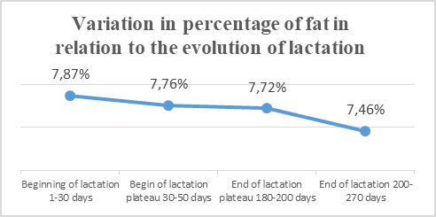
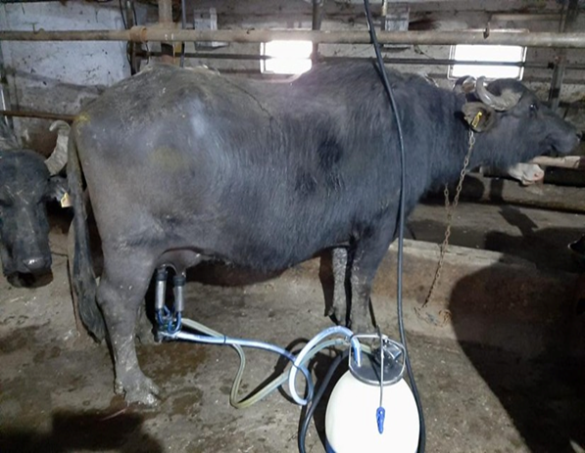
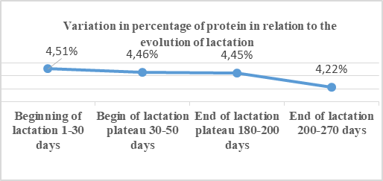
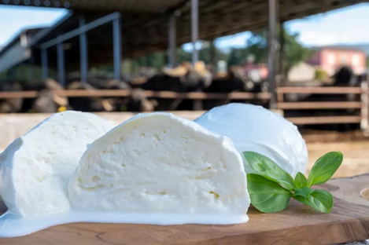
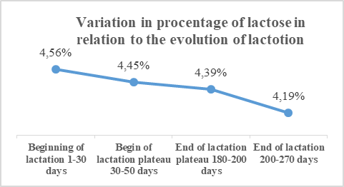
CONFERINȚA NAȚIONALĂ “ANIVERSAREA ICAR”
Ediția IV – 29 mai 2025
DYNAMICS OF THE CHEMICAL COMPOSITION OF MILK FROM ROMANIAN BUFFALOES COWS DEPENDING ON THE LACTATION CURV
MĂDĂLINA MOLDOVAN¹, REMUS CHIOREAN¹, ADRIAN BOTA¹
¹SCDCB ȘERCAIA, Campului, no 2, Sercaia, Romania, 0268245890, scdcb.sercaia@yahoo.com
INTRODUCTION: The domestic buffalo (Bubalus bubalis) produces milk rich in fat, protein, and minerals, ideal for high-quality dairy products. Milk composition varies with lactation stage, influencing its quality and value. This study analyzes fat, protein, and lactose content in Romanian buffalo milk across lactation phases, supporting better use of this indigenous genetic resource.
MATERIAL AND METHOD: The study was conducted on a batch of 20 Romanian Buffaloes in different lactation stages (from the first to the fourth lactation), in order to evaluate milk composition variation depending on lactation stage. All animals were kept under similar feeding and housing conditions at the Research and Development Station for Buffalo Raising in Șercaia. A semi-intensive rearing system was applied: during summer, the buffaloes were grazed on pasture, while in winter they were fed with silage and coarse fodder. Milk was collected twice a week during both morning and evening milkings, and samples were analyzed immediately after collection. Physico-chemical analyses (fat, protein, lactose) were performed using the EKOMILK-Ultra device. The data were grouped by lactation stages: Phase 1: beginning of lactation (1–30 days), Phase 2: plateau phase (30–50 days), Phase 3: end of plateau (180–200 days), Phase 4: end of lactation (200–270 days). Results were expressed as percentages (%) and statistically processed by calculating the mean and standard deviation.
RESULTS AND DISCUSSION: The fat content in Romanian buffalo milk showed significant variation depending on the lactation stage, following the lactation curve. The highest value was recorded at the beginning of lactation (1–30 days), with an average of 7.87 ± 0.05%, reflecting the high nutritional demand of newborn calves and intense activity of alveolar epithelial cells. During the plateau phase (30–50 days), a slight decrease to 7.76 ± 0.33% was observed, influenced by increased milk volume and physiological dilution. In the late plateau (180–200 days), fat content continued to decrease slightly to 7.72 ± 0.37%, associated with the progressive decline in secretory activity. The lowest level was recorded at the end of lactation (200–270 days), averaging 7.46 ± 0.07%, due to reduced prolactin levels and metabolic redirection away from milk production. These changes reflect physiological adaptations of the mammary gland and are consistent with findings from other studies. In advanced lactation, fat composition also shifts, with decreased short-chain and polyunsaturated fatty acids (e.g., butyric, linoleic, and α-linolenic acids), affecting both the nutritional value and technological properties of buffalo milk.
The protein content of Romanian Buffalo milk showed significant variations depending on the lactation stage, reflecting physiological and metabolic changes. The highest value was recorded in the early lactation phase (1–30 days), averaging 4.51 ± 0.07%, due to the nutritional needs of newborn calves and high secretory activity of the mammary gland. A slight decrease was observed during the plateau phase (30–50 days), with an average of 4.46 ± 0.09%, corresponding to stabilized milk production. In the late plateau (180–200 days), protein levels remained relatively constant (4.45 ± 0.36%) but showed greater individual variability. The lowest content was found at the end of lactation (200–270 days), with a mean of 4.22 ± 0.18%, as milk production declined and metabolic priorities shifted toward maintenance functions. These results underline the physiological adaptation of milk synthesis across lactation stages and its implications for dairy processing.
Lactose, the primary carbohydrate in buffalo milk, ensures energy supply for newborn calves and supports gut microbiota development. Technologically, it is vital for fermentation processes. In this study, lactose content showed moderate variation across lactation. The highest level (4.56 ± 0.16%) was recorded in the first 30 days, reflecting the high secretory activity of the mammary gland postpartum. A slight decrease followed in the plateau phases 4.45 ± 0.17% (30–50 days) and 4.39 ± 0.07% (180–200 days) as metabolic priorities shifted. The lowest value (4.19 ± 0.03%) occurred during late lactation (200–270 days), highlighting the progressive decline in glandular activity. These changes are physiologically normal and are influenced by factors such as gestation, hormonal balance, and energy redistribution. The results align with existing literature, confirming a gradual decrease in lactose synthesis as lactation advances.
Evolution of lactose content (%) depending on the stage of lactation
LACTOSE%
Beginning of lactation 1-30 days | Begin of plateau 30-50 days | End of plateau 180-200 days | End of lactation 200-270 days
X±Sx | X±Sx | X±Sx | X±Sx
4.56±0.16 | 4.45±0.17 | 4.39±0.07 | 4.19±0.03
CONCLUSIONS: In Romanian buffaloes, milk fat, protein, and lactose content gradually decrease during lactation. Maximum values were recorded in the first 30 days, followed by a steady decline toward the end of lactation (200–270 days). These changes reflect physiological adaptations and reduced mammary activity. Monitoring these trends is essential for maintaining milk quality and optimizing farm management strategies.

