Slide 1

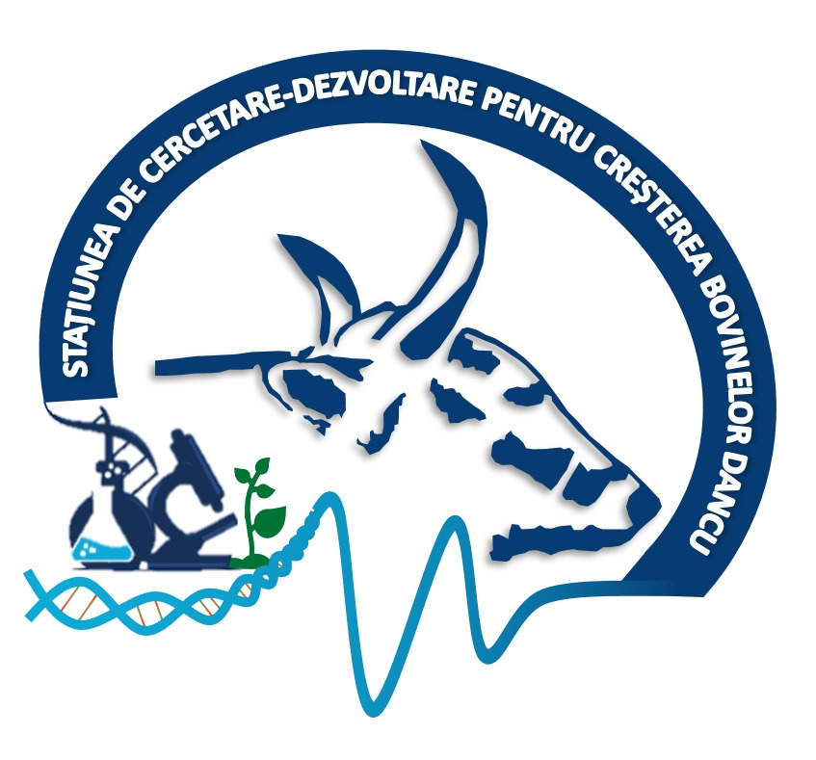

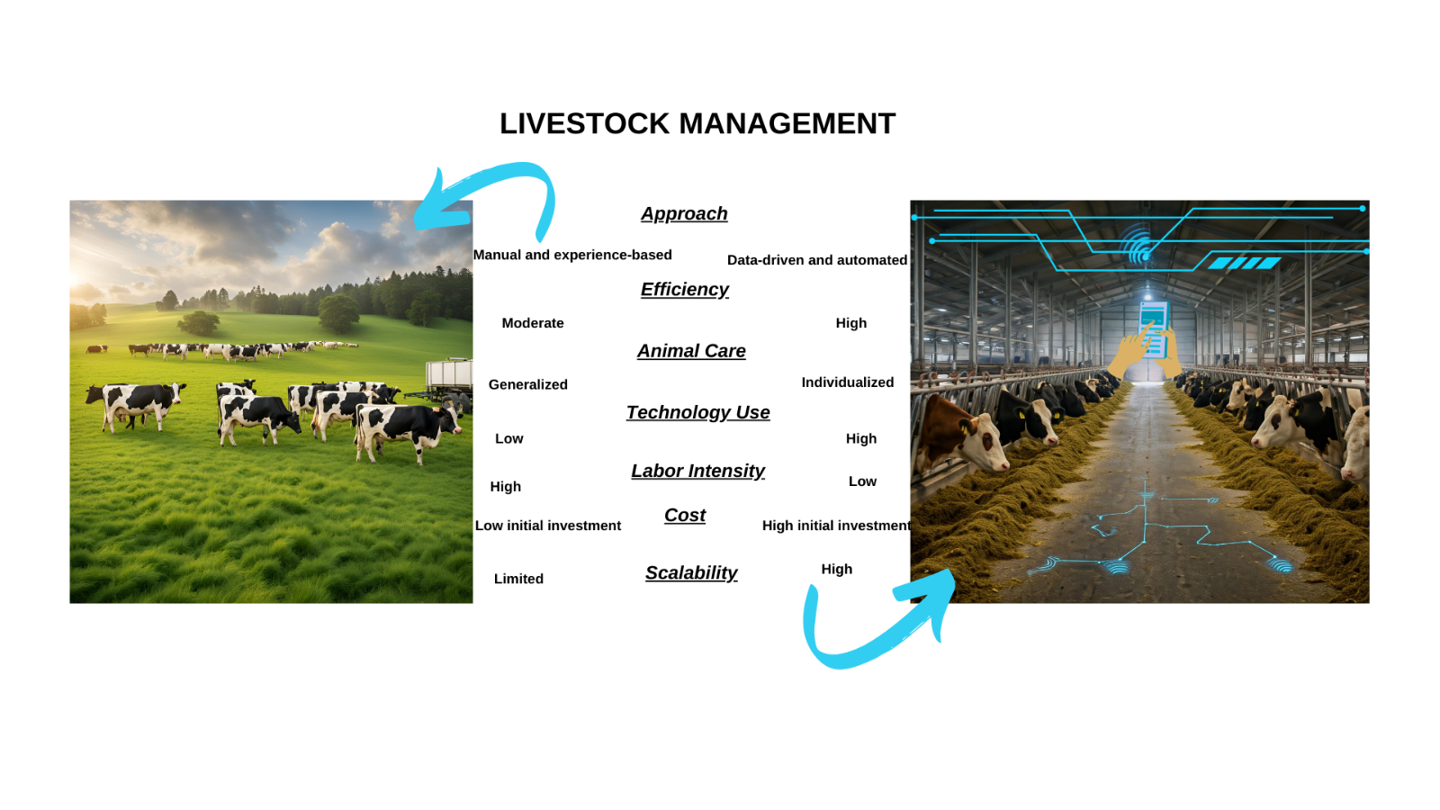
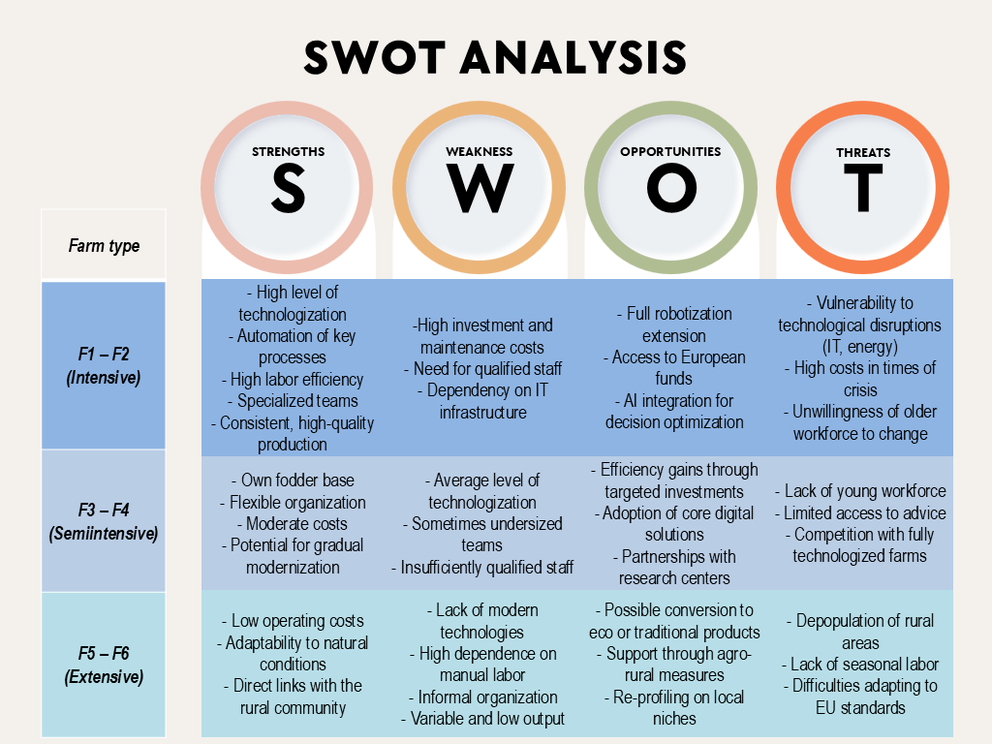
CONFERINȚA NAȚIONALĂ “ANIVERSAREA ICAR”
Ediția IV – 29 mai 2025
MODERN MANAGEMENT STRATEGIES TO REDUCE LABOR DEPENDENCY ON DAIRY FARMS
SĂNDULEANU CĂTĂLINA; NECULAI-VĂLEANU ANDRA-SABINA; POROȘNICU IOANA; AMARIȚII GABRIELA
INTRODUCTION
Romania's livestock sector, especially dairy farms, faces a significant challenge: a shortage of specialized labor. This affects both large intensive farms and smaller rural ones, worsened by workforce migration. The dairy sector is at a critical juncture, facing threats to productivity, competitiveness, and sustainability due to rising labor dependency.
Economic efficiency, food security, and the sustainability of farms increasingly depend on their ability to adapt to new socio-economic and technological conditions. This labor situation requires urgent exploration of solutions to reduce reliance on manual work while improving operational efficiency and farm performance.
The paper offers insights into transforming Romanian farms into sustainable, efficient, resilient agricultural systems.
Figure 1 Livestock Management
Table 1. General characterization of the analyzed farms
MATERIAL AND METHOD
This paper was based on an applied study conducted on six dairy farms in the north-eastern region of Romania, strategically selected to cover a variety of farming systems - intensive, semi-intensive and extensive. The main objective of this research was to assess the impact of modern management strategies and digital technologies on the organization of daily farm activities, human resource efficiency and productivity in the context of reduced labour dependency.
Data collection was mainly through field visits and direct observation, supplemented by semi-structured interviews with farm managers and staff involved in day-to-day activities. Technological sheets and internal farm documents were also used to validate data on work organization, livestock structure and investments in modern equipment.
RESULTS AND DISCUSSIONS
The differences between the six farms analysed (F1-F6) clearly highlight the direct relationship between the level of technologization and the degree of specialization of the staff. Addressing labor dependency requires exploring technological solutions and optimizing the management of human capital. Effective labor management is vital for enhancing productivity, ensuring consistency, improving employee retention, and maximizing returns on labor investments, a significant farm expense. As farms grow and rely on non-family employees, structured human resource management is essential. Poor management can undercut the benefits of advanced technologies.
Labor efficiency varies directly proportional to the level of technologization. On F1 and F2 farms, average labor time/man/day for key activities is significantly lower due to automation. Mechanized feeding and push robots (F2) reduce the time required by 30-40% compared to traditional methods. Monitoring sensors like SenseHub™ on the F2 farm have allowed early health problem detection and optimal insemination timing, cutting productivity losses by up to 25% and boosting gestation rates. Additionally, management software like Afimilk in F1 and F2 aids prompt decision-making on treatments and animal selection. Automatic feeding systems and push robots in F2 have also raised feed intake by over 15%, significantly enhancing daily milk production. Farmers have experienced clear benefits from digital and automated technologies, such as a 30-40% reduction in labor needs, fewer diseases from improved hygiene, enhanced production predictability, and stabilized work teams due to less physical effort.
CONCLUSIONS
The Romanian dairy sector faces a labor crisis from an aging workforce, emigration, skills gaps, and farm fragmentation, threatening productivity and sustainability. Modernization with better management and technologies like automation and Precision Livestock Farming (PLF) could enhance efficiency and animal welfare. Our study demonstrates that technologies such as automated milking systems, automated feeding, and sensor-based monitoring can deliver quantifiable benefits, including significant reductions in labor requirements, potential increases in milk yield, and opportunities for improved animal health management. Modern human resourses management practices, including structured training and standard operating procedures, are equally important for optimizing workforce performance and ensuring operational consistency. Addressing labor dependency and ensuring the future resilience of Romanian dairy farming requires strategic investments in human capital, infrastructure, and institutional capacity. Policies that support the sector's diversity and transition toward greater efficiency and sustainability are essential. Ignoring these systemic challenges could lead to decline, threatening rural economies and food security. The integration of management and technology tailored to the context is critical for overcoming obstacles and unlocking the sector's potential.

