Slide 1
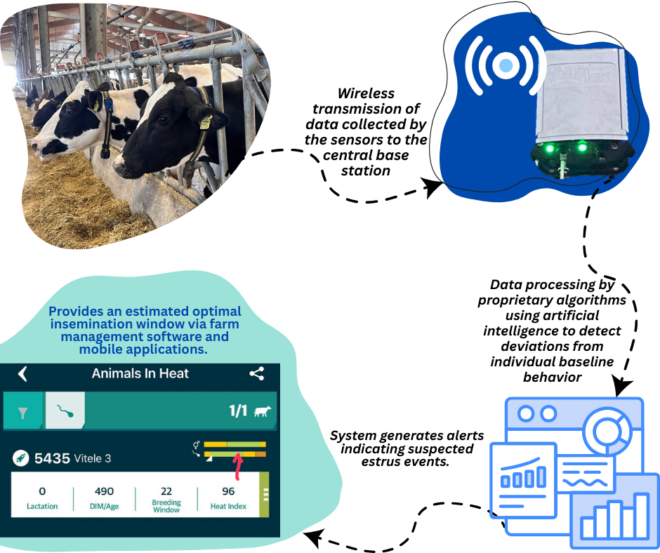
CONFERINȚA NAȚIONALĂ “ANIVERSAREA ICAR”
Ediția IV – 29 mai 2025
Precision Livestock Farming and Reproductive Biotechnologies – Modern Solutions for Optimizing Reproductive Management and Ensuring National Food Security
NECULAI-VALEANU ANDRA-SABINA^{1,2,3}; SANDULEANU CATALINA^{1,2,3,4}; AMARITII GABRIELA⁴
¹ Research and Development Station for Cattle Breeding Dancu, sos. Iași-Ungheni no. 9, 707252, Iași, România
² Romanian Academy – Iasi Branch, Bulevardul Carol I, nr. 8, 700505, Iași, România
³Academy of Romanian Scientists, Strada Ilfov 3, 030167, București, România
⁴Faculty of Animal and Food Sciences, Iasi University of Life Sciences, Aleea Mihail Sadoveanu 8, 700489, Iași, România
INTRODUCTION
Beef and dairy systems are critical for global food security. As pressure on land and water resources increases, technologies like Precision Livestock Farming (PLF) are pivotal for sustainability. PLF uses smart sensors to monitor animal behavior, supporting timely decisions on reproduction and health. While traditionally adopted in pigs and poultry, dairy farming has seen rapid uptake. Reproductive efficiency remains a core challenge, particularly in high-yield herds. Missed estrus detection affects fertility and farm economics. Precision livestock farming and reproductive biotechnologies, including sexed semen, are vital tools in enhancing farm reproductive efficiency and sustainability. Integrating sensor-based monitoring systems can significantly improve breeding decisions and herd genetics, contributing to food security. This study evaluates the SenseHub® system, hypothesizing that sensor-based estrus detection enhances conception rates over conventional observation.
MATERIALS AND METHODS
Study Design: Conducted on 2 Romanian farms over 6 months (2024), involving 40 nulliparous dairy heifers.
PLF Technology: SenseHub® neck-mounted sensors tracked activity and rumination; alerts provided optimal insemination timing.
Reproduction Protocol: AI was performed by trained personnel using conventional semen within the system-recommended window.
Control: FSCR compared with historical data (2022–2023) using visual estrus detection on the same farms.
Analysis: Chi-square test assessed statistical significance (p < 0.05).
RESULTS
FSCR with SenseHub®: 65.0% (26/40 heifers).
Historical FSCR (visual detection): 52.5%.
Significance: Improvement was statistically significant (p < 0.05).
INSIGHTS
Improved estrus detection accuracy and insemination timing
Reduced labor and human error
PLF enables future integration with sexed semen strategies, maximizing genetic gains
Economic gains via reduced open days, fewer AI procedures, and faster entry into milk production
Schematic representation of the Allflex ecosystem
CONCLUSIONS
SenseHub® significantly improved FSCR in nulliparous dairy heifers. The system enhances reproductive precision, offering practical, economic, and strategic benefits for modern dairy farms. Widespread adoption of PLF may support sustainable production and contribute to Romania’s food security through improved reproductive management and genetic progress.
SELECTIVE BIBLIOGRAPHY
Bianchi et al. (2022) – Diffusion of precision livestock technologies in dairy farms. Animal, 16(11), 100650.
Morrone et al. (2022) – Overview of Industry 4.0 and PLF in animal production. Sensors, 22(12), 4319.
Neculai-Valeanu et al. (2025) – Leveraging digital tools for cattle health and welfare. Frontiers in Veterinary Science, 12.

