Slide 1
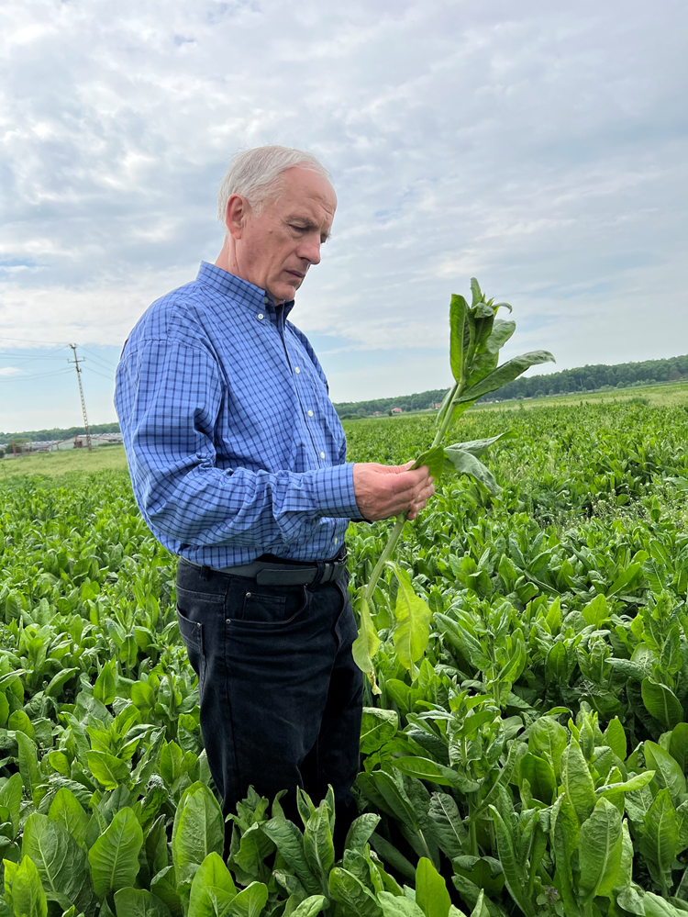
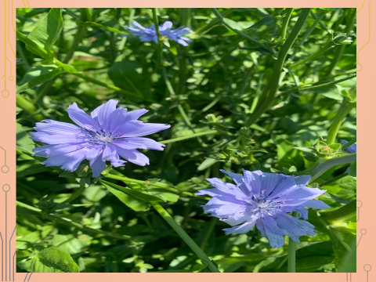
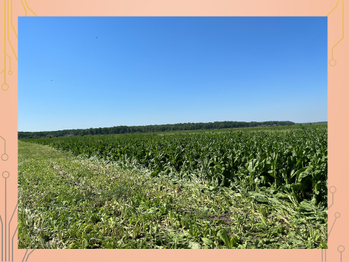
CONFERINȚA NAȚIONALĂ “ANIVERSAREA ICAR”
Ediția IV – 29 mai 2025
RESEARCH ON AGROTECHNICAL FEATURES OF CICHORIUM INTYBUS, PALATABILITY AS COWS’ FEEDSTUFF AND THE EFFECTS ON MILK PRODUCTION
Neamt Radu, Dragomir Neculai, Cziszter Ludovic, Saplacan Gheorghe, Mihali Ciprian, Mizeranschi Alexandru, Ilie Daniela, Saplacan Silviu, Neciu Florin
INTRODUCTION
Chicory is a perennial plant, drought resistant, adaptable to the current environmental changes. It has an increased protein and tannins content, which is why it does not induce meteoritis. It has a good abundance, dominance and persistence, both in pure culture and in mixtures with perennial grasses. Allows for high production of green mass, with a high degree of palatability and preferability. Exert a positive effect on milk production in cows.
MATERIAL AND METHODS
Evaluation of agrotechnical aspects
Surface 4 ha/botanical variant
The geo-botanical method- gridj 1m² - 5 grids / botanical variant
Evaluation of the botanical structure from phytocenosis –%
Reporting to the total participation
Evaluation of the zootechnical aspects
Animals- 30 dairy cows
Training interval– 10 days
Assessement interval– 20 days
Forage daily amount– 45 kg/day/botanical structure
Bout I - 7 A.M.
Bout II – 13 P.M.
Bout III – 19 P.M.
Consumability - the amount of consumed feed out of the total administered (%)
Preferability – voluntary forage consumption based on previously satiety condition
REZULTATE OBŢINUTE
Parameters | Emergence (%) | Persistence (%) | Production (t/ha) | No. of harvests | Palatability (%) | Preferability (%) | Effect in milk yield (% in 14 days interval)
Cicory | 87 | 88 | 37 | 4 | 94 | 83 | +19
Alfalfa | 88 | 76 | 42 | 3 | 89 | 78 | +18
Gramineous | 85 | 70 | 28 | 3 | 71 | 66 | -14
CONCLUSIONS
-good emergence, abundance, dominance and persistence;
-low permissiveness towards spontaneous flora;
-high degree of consumability and preferability;
-positive impact on milk production;
-positive impact on feeding behavior;
-does not impair the health of cows
Acknowledgements
This work was supported by a grant of the Romanian Ministry of Agriculture and Rural Development, project ADER 9.1.3. / 2019 project.

