Slide 1

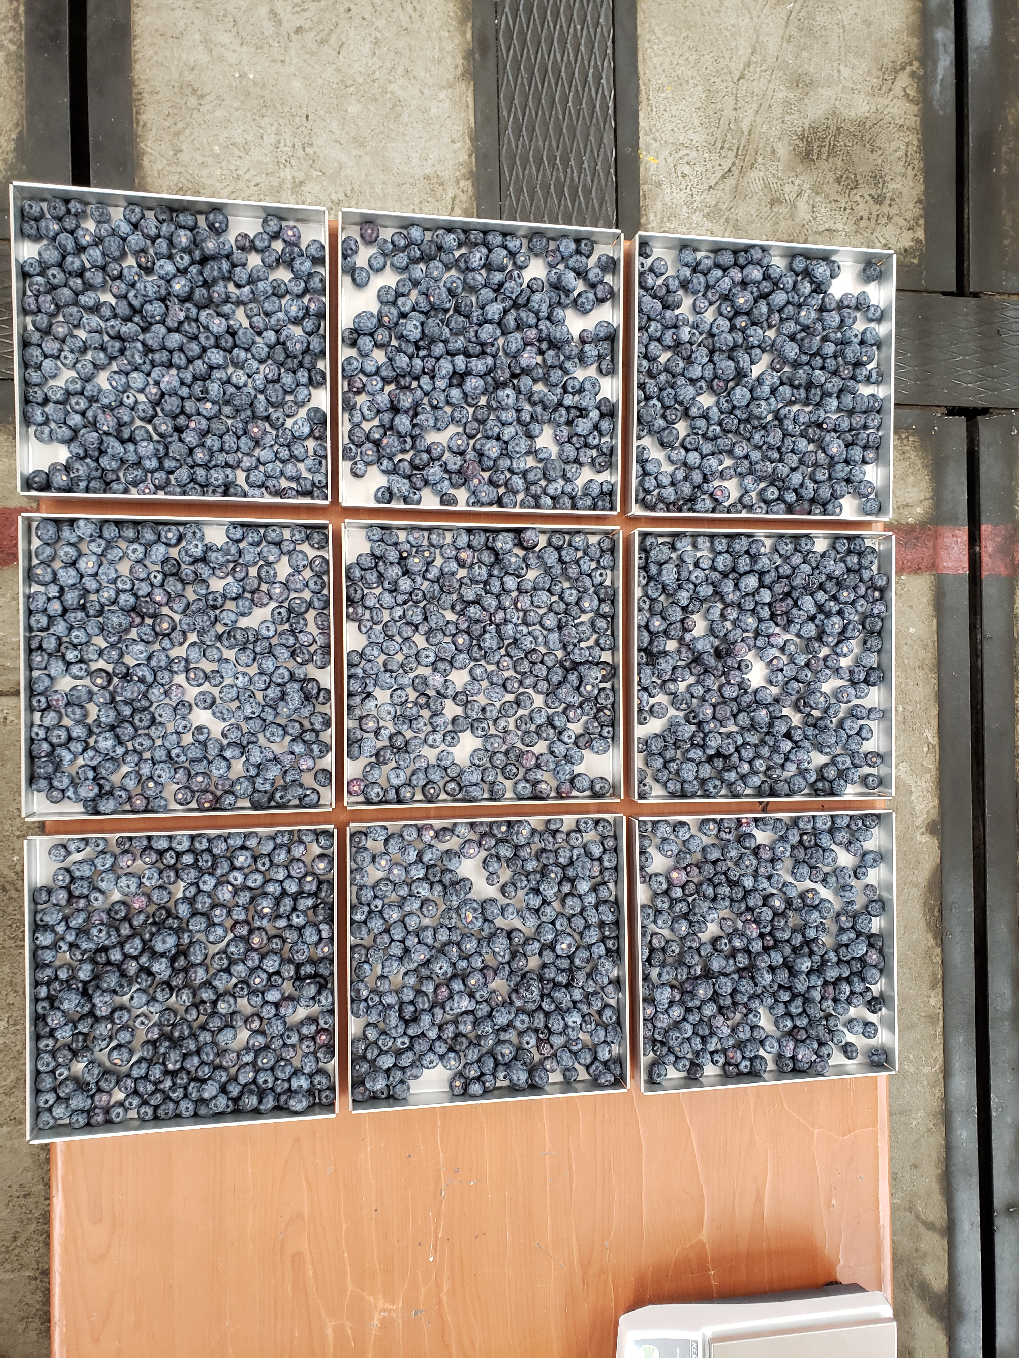
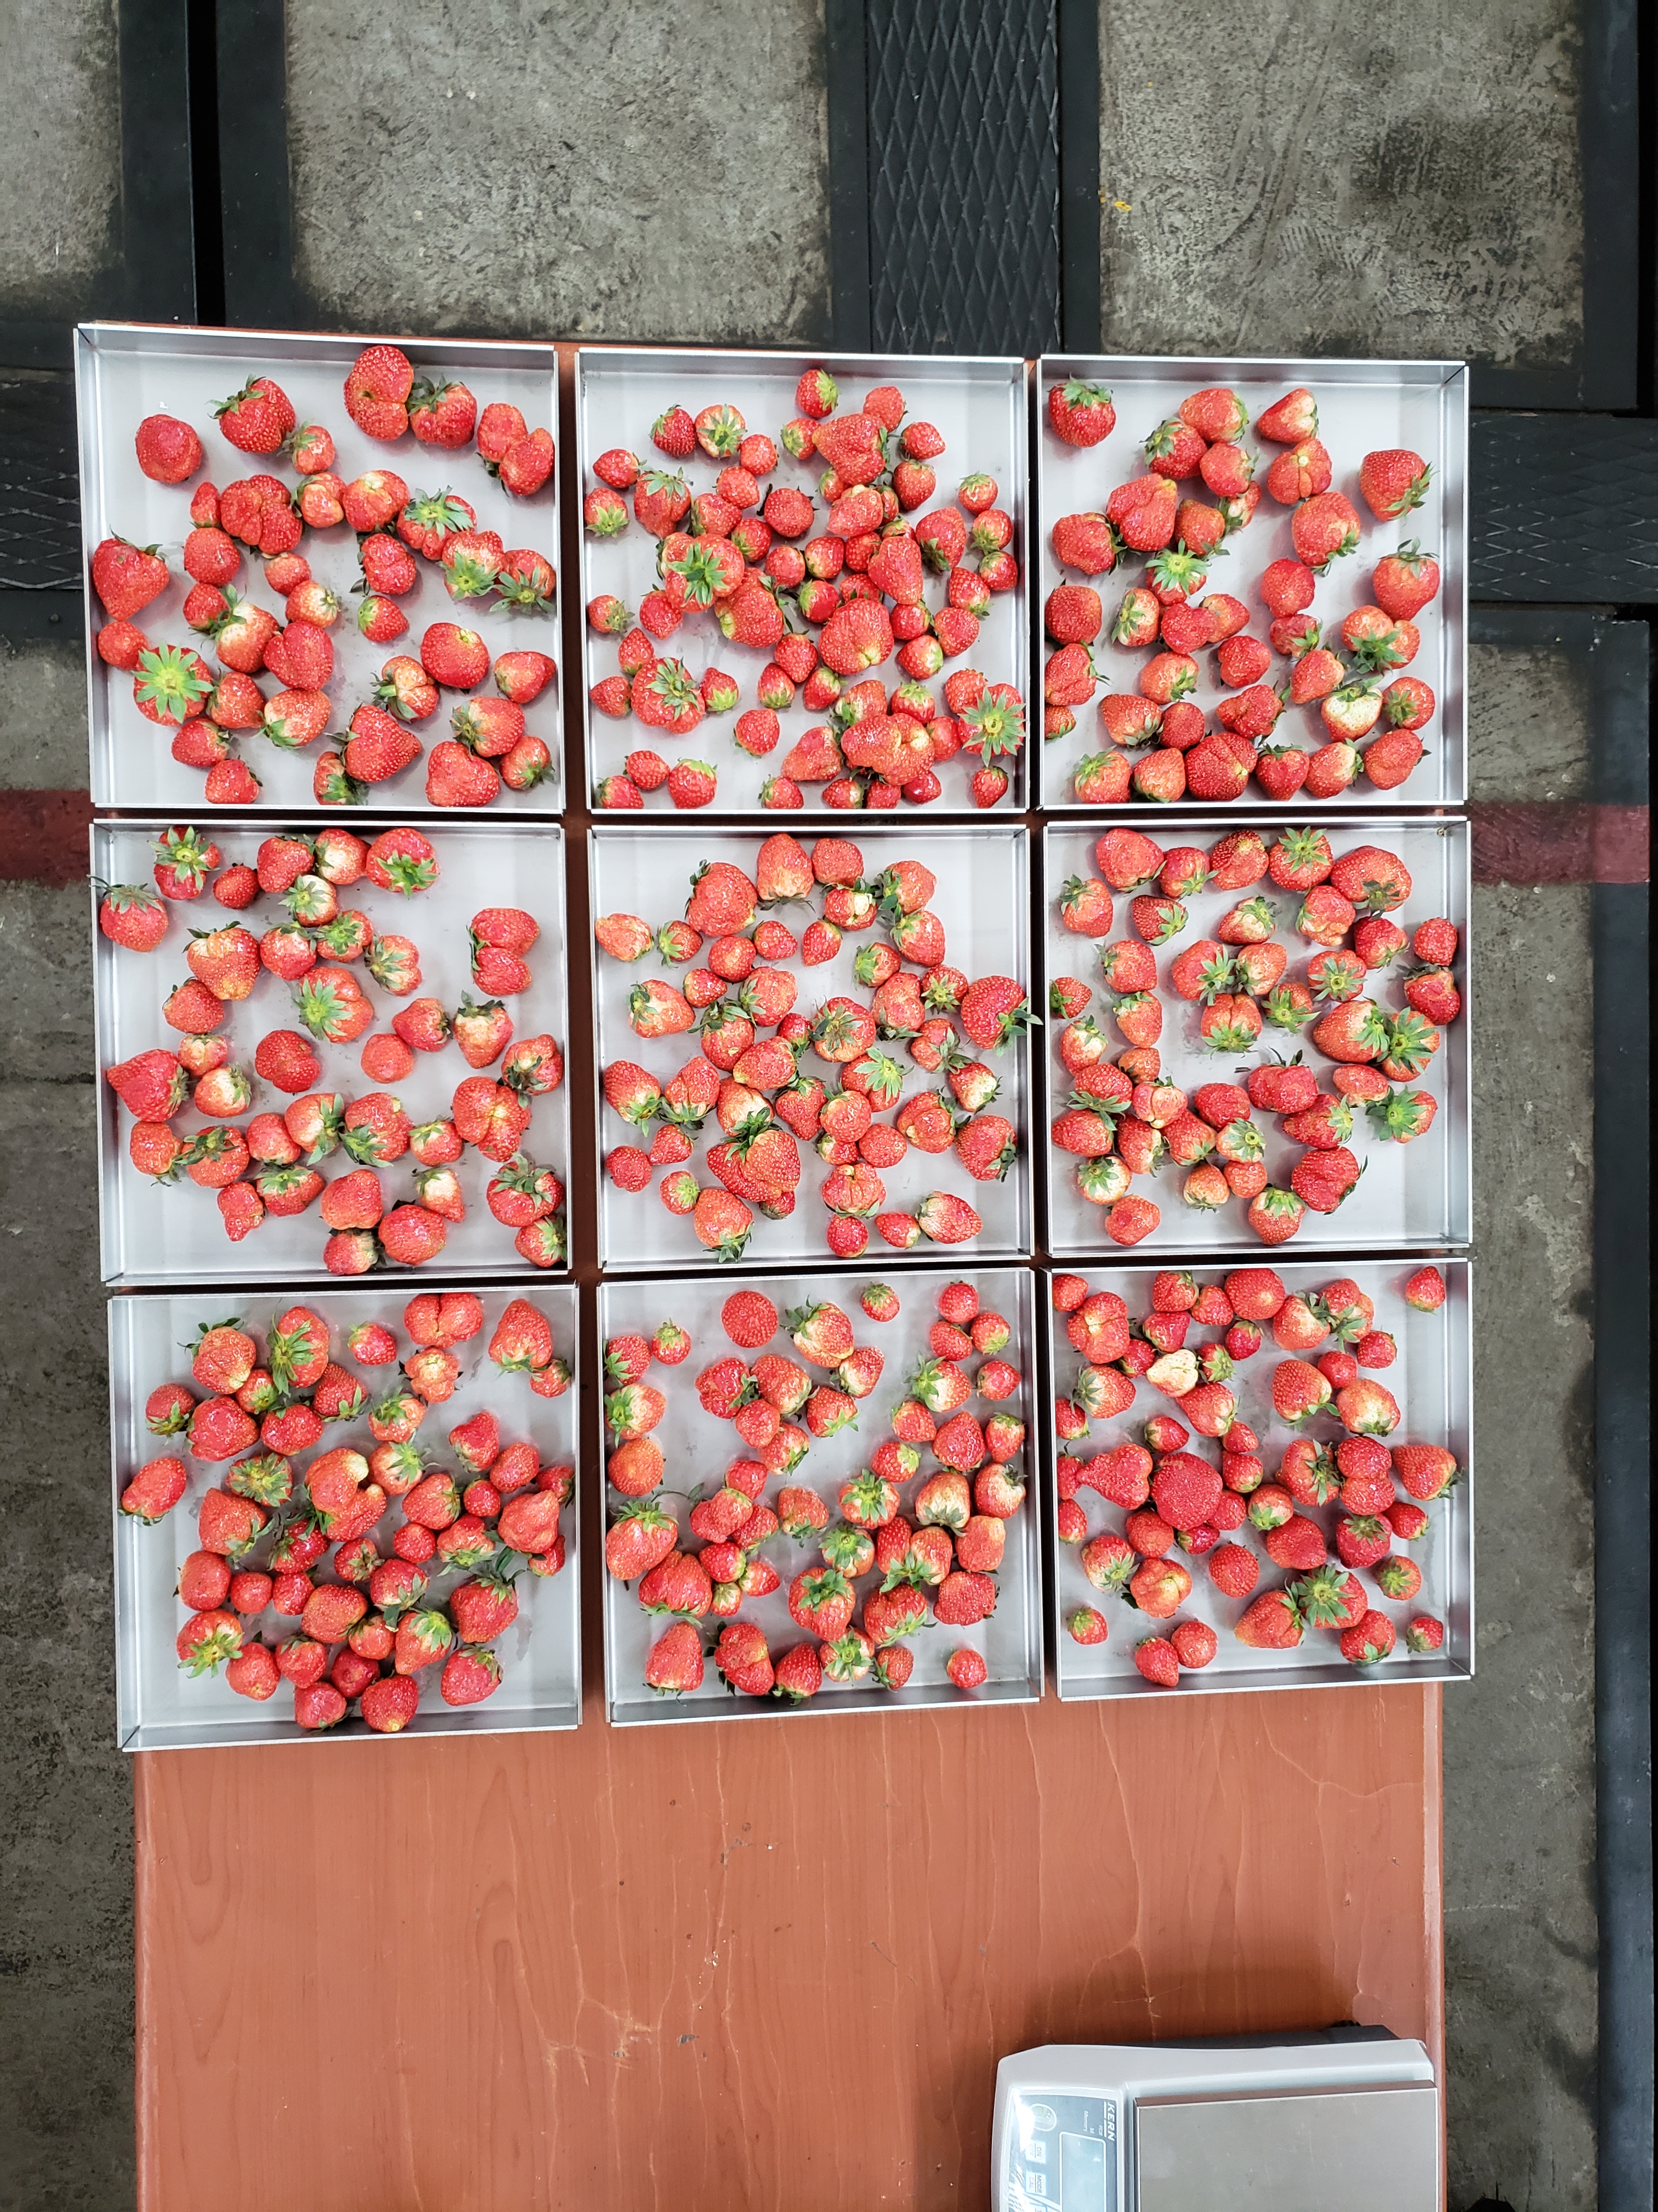
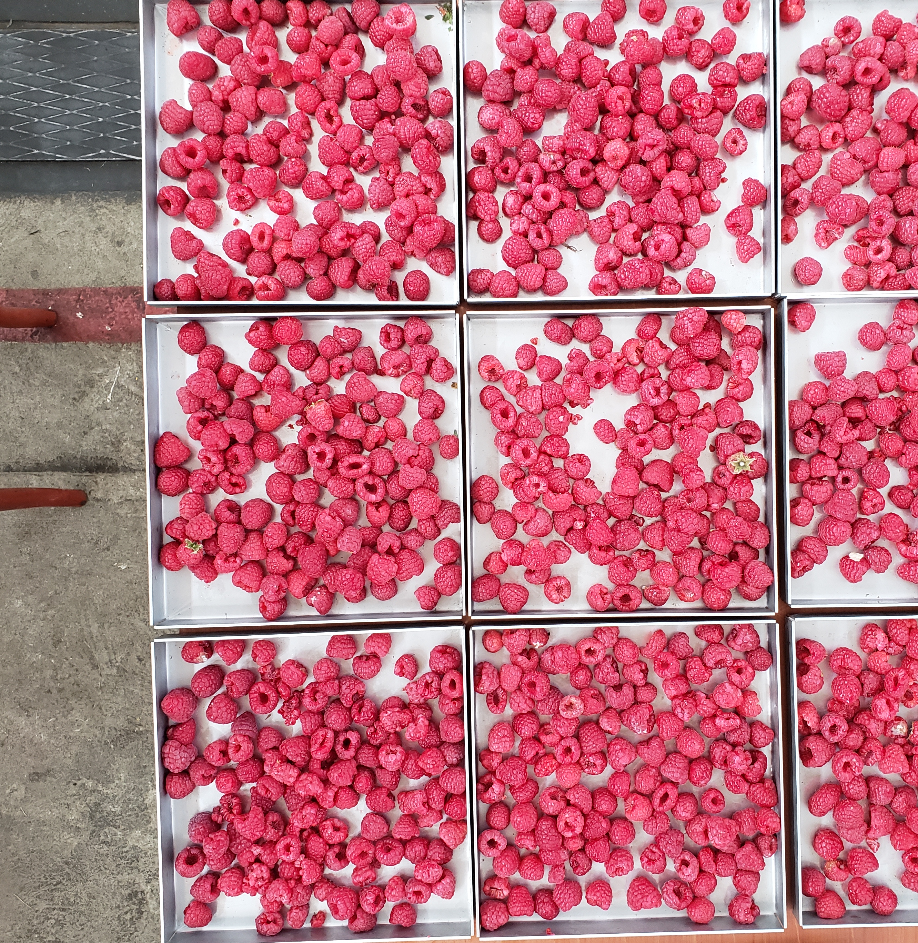
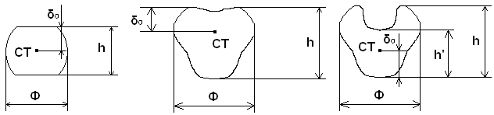
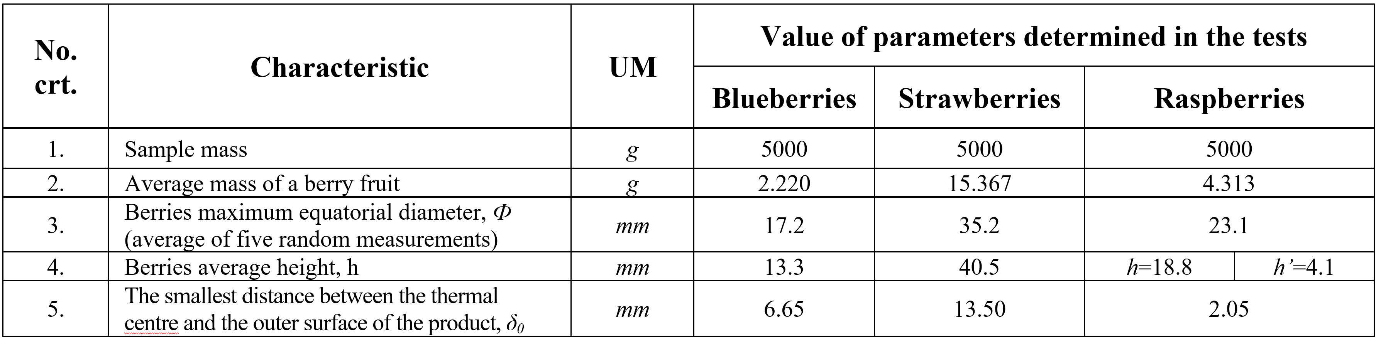
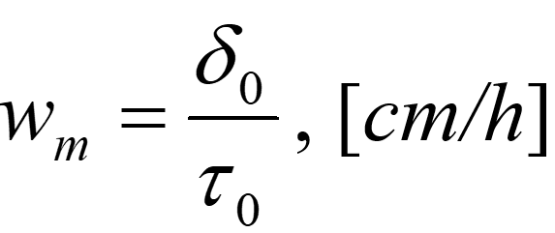
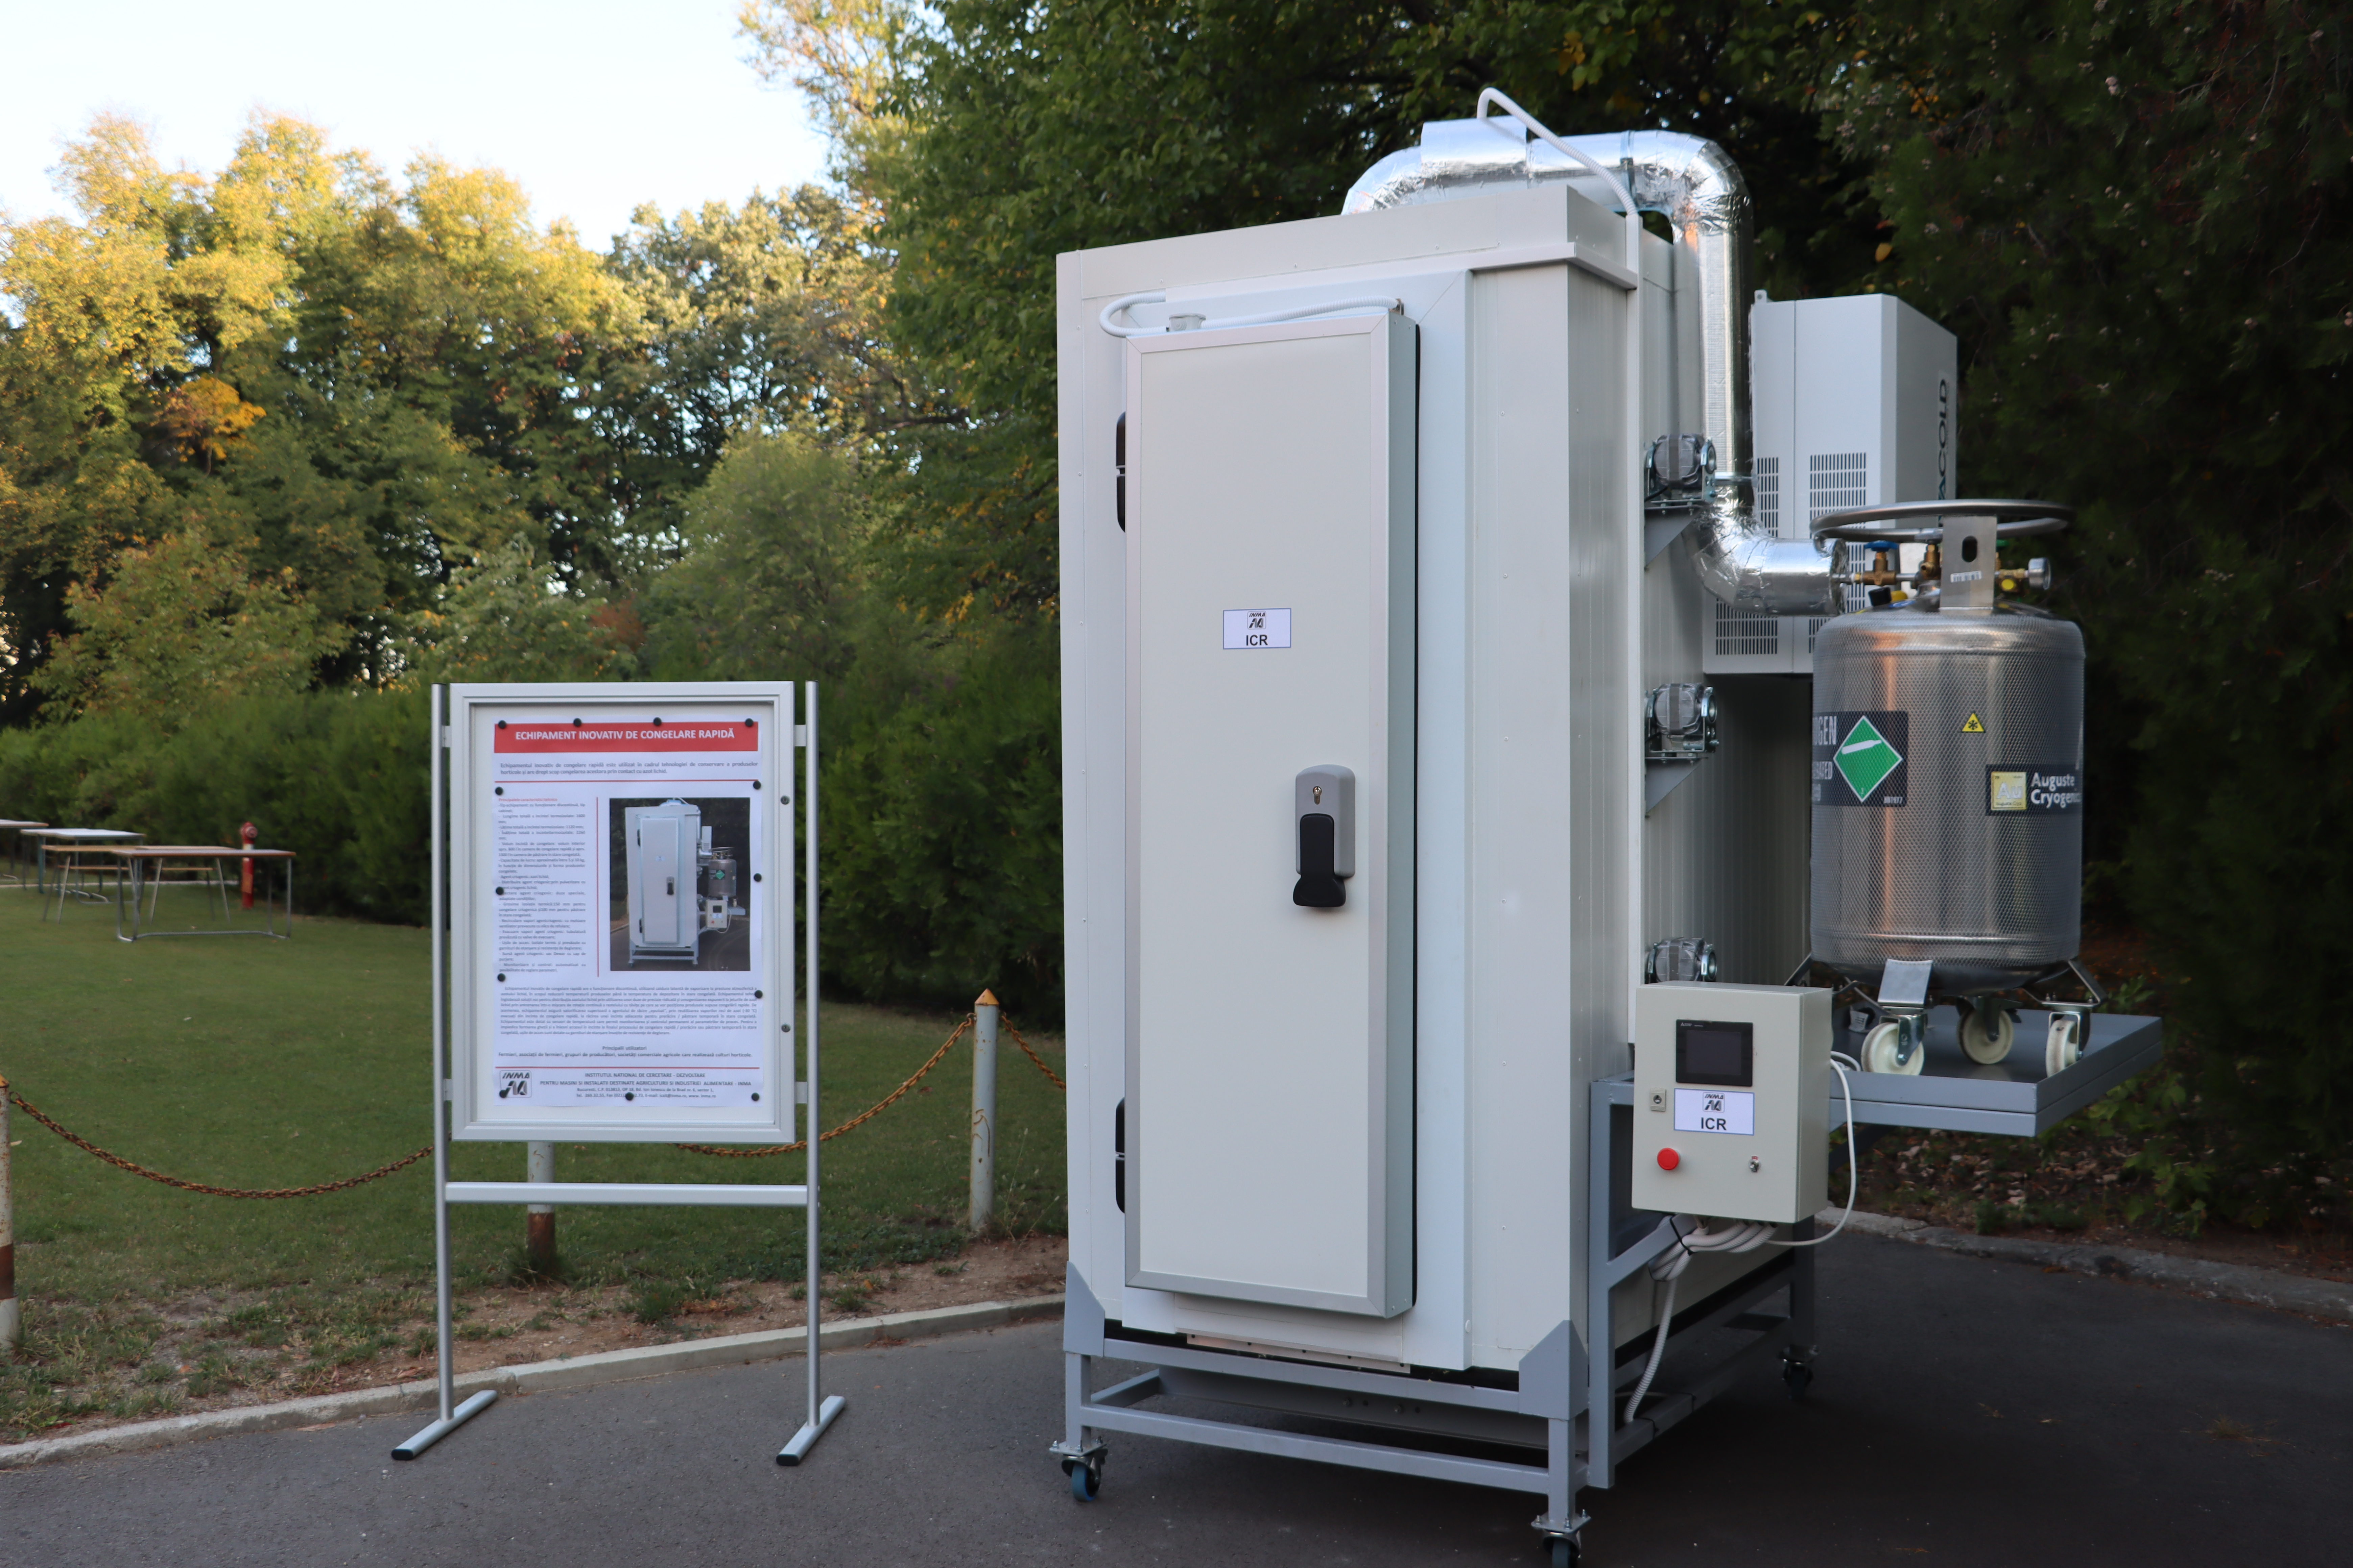
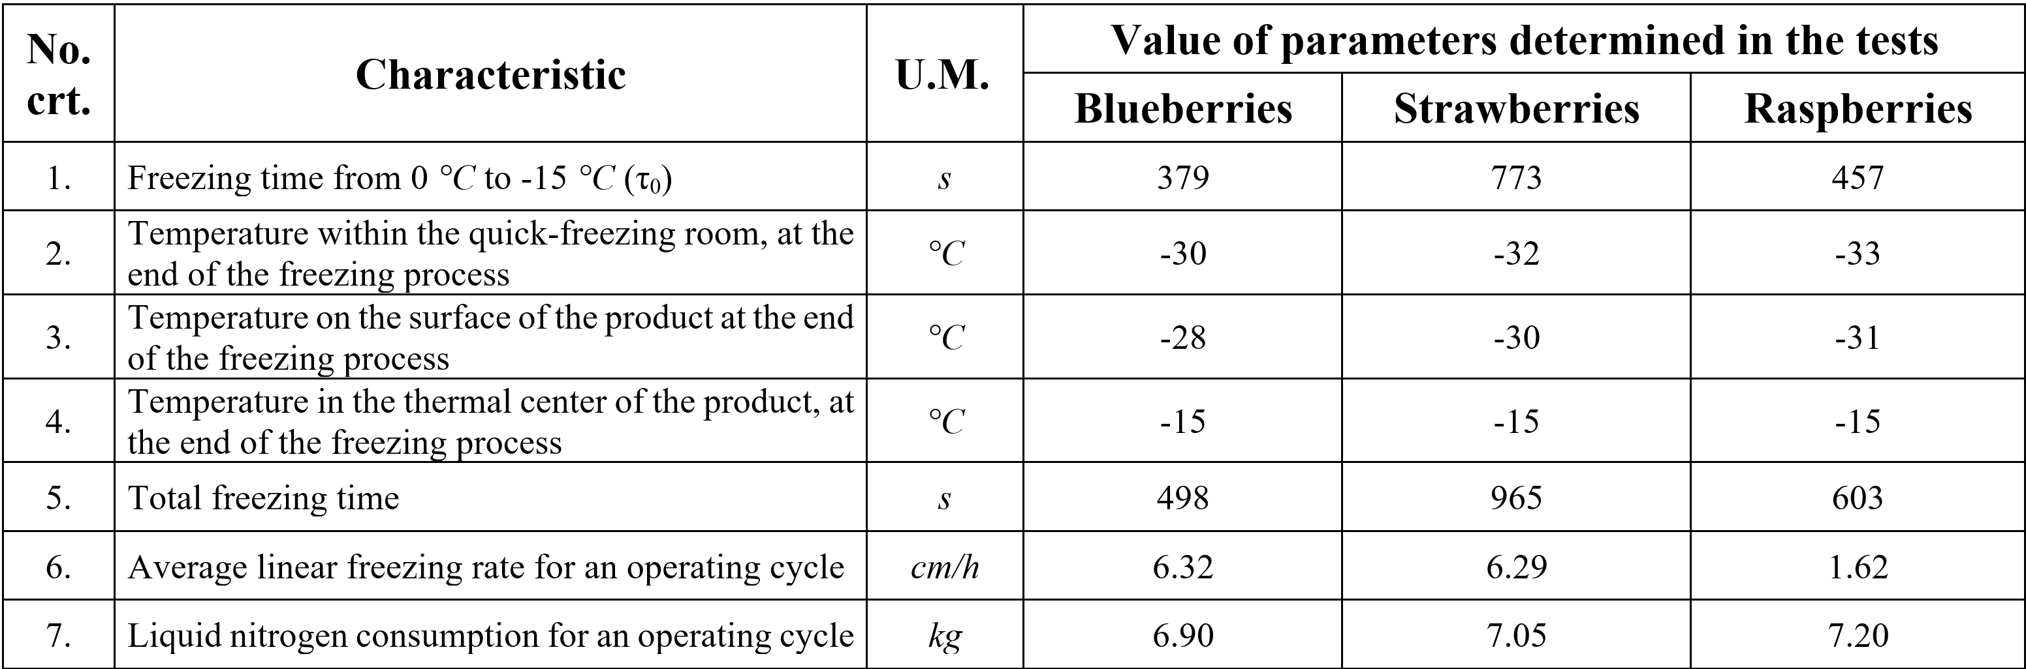
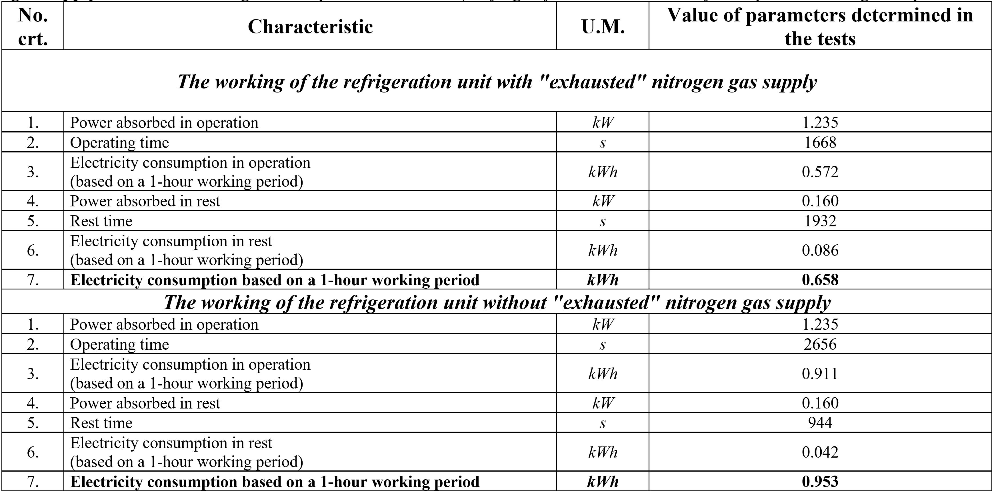
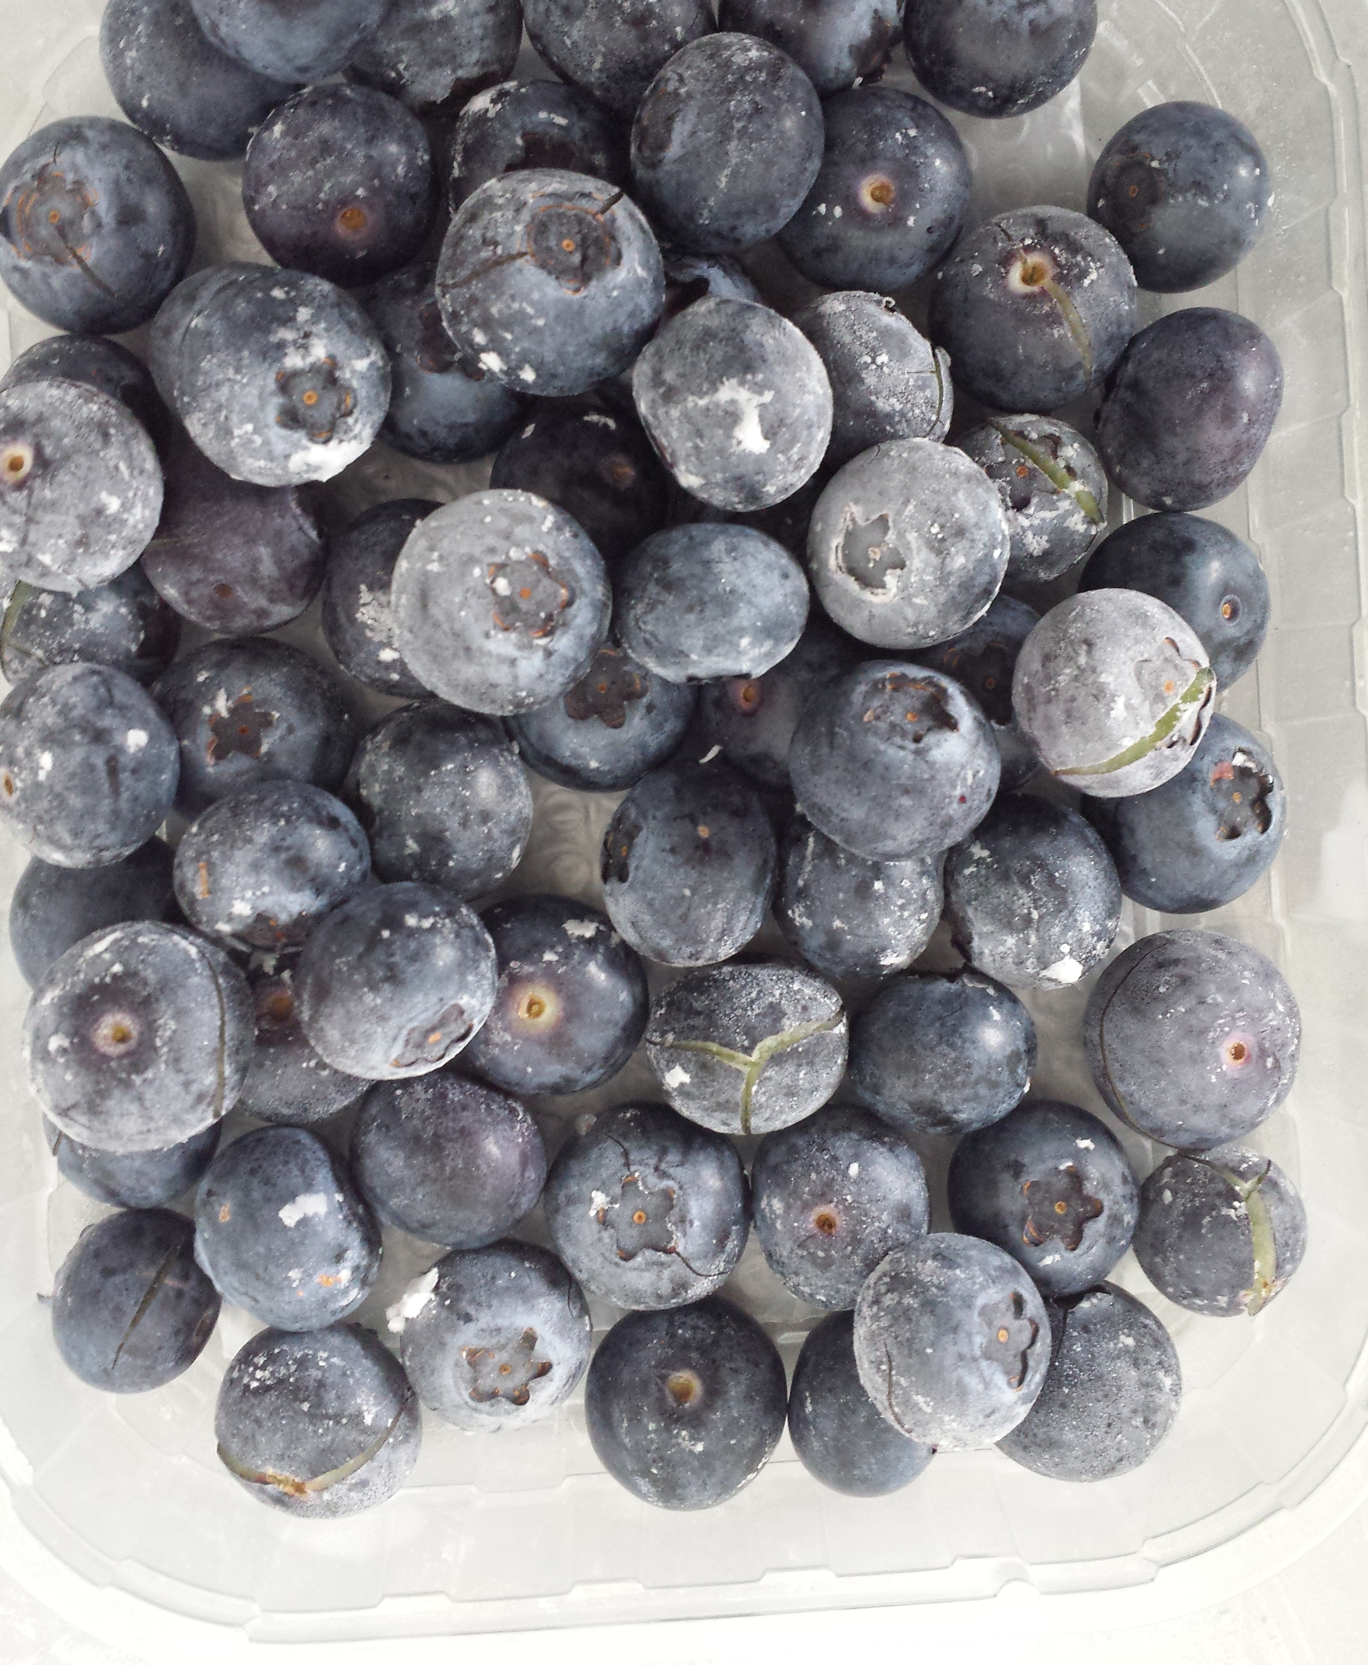
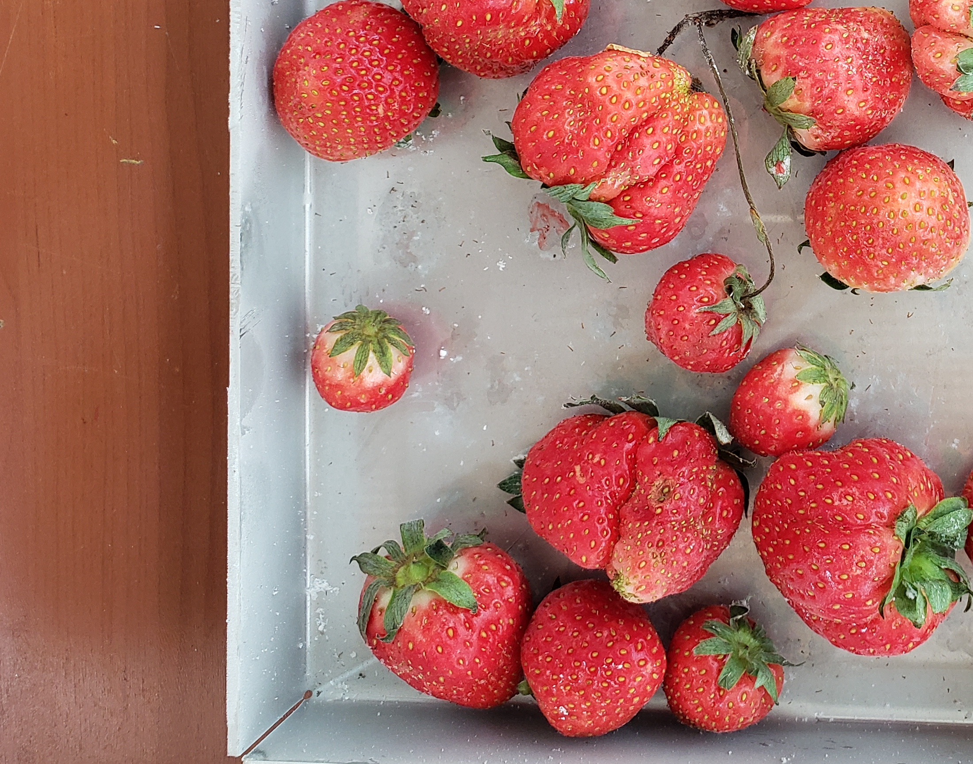
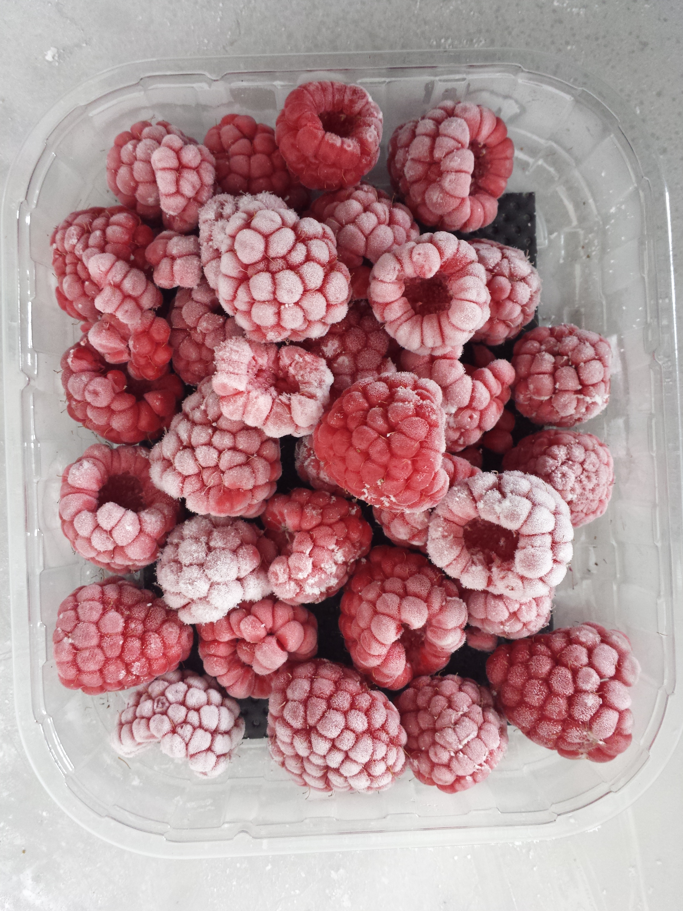
NATIONAL CONFERENCE
“ICAR ANNIVERSARY”
IVth Edition – 29 May 2025
EXPERIMENTAL RESEARCH OF A
MULTI-FUNCTIONAL QUICK-FREEZING EQUIPMENT
SORICĂ Cristian Marian, VLĂDUȚ Nicolae-Valentin, SORICĂ Elena, VLĂDUȚOIU Laurențiu Constantin, GRIGORE Andreea Iulia
INMA Bucharest, No. 6 Ion Ionescu de la Brad Blvd., 013813, Bucharest, Romania
INTRODUCTION
The use of liquid nitrogen for the quick-freezing of food is one of the most common applications of gases in the food industry, being carried out with the aim of maintaining the qualities of the product for as long as possible, both from an organoleptic and nutritional point of view, through the quick decreasing of the temperature to values lower than -18°C inside the product, so as to inhibit the activity of microorganisms.
MATERIAL AND METHODS
The present paper aims to determine the working qualitative indices and the energy indices of a multifunctional quick-freezing equipment with liquid nitrogen, cabinet type, having a discontinuous operation and an automatic working regime, developed by INMA within a national research program. At present, the equipment is subject to a national patent application (CBI A-00054/07.02.2023) and a European patent application (EPC EP23020352.3/25.07.2023).
The experimental research was carried out using three species of berries, respectively blueberries, strawberries and raspberries. Each sample had a mass of 5000 g, 500 g on each of the 10 trays. The average mass of a berry was determined, for each sample, as the mean of five aleatory weighings from the mass of the product. The average height and maximum equatorial diameter of the berries corresponding to each sample of the three species were also measured. This was achieved as a mean of five random measurements from the product mass.
The freezing process is considered complete only when the temperature in the product thermal centre reaches -15 °C. During the quick-freezing process there were followed the main parameters, such as: freezing time from 0 °C to -15 °C; temperature within the quick-freezing room at the end of the freezing process; temperature on the surface of the product at the end of the freezing process; temperature in the thermal center of the product at the end of the freezing process; total freezing time; mass of the liquid nitrogen container used for freezing. After processing the experimental data, the following indexes were determined: average linear freezing rate; liquid nitrogen consumption for a freezing cycle. Depending on the value of the average linear freezing rate, w_{m}, there is the following classification of freezing methods: slow-freezing (w_{m} = 0.5 cm/h); quick-freezing (w_{m} = 0.5...3 cm/h); very quick-freezing (w_{m} = 3...10 cm/h); ultra quick-freezing (w_{m} = 10...100 cm/h).
RESULTS AND DISCUSSIONS
The aspect of the three species of berries used for experimentation and its characteristics are presented below:
Aspect of the fruits used for experimentation:
blueberries – left, strawberries – center and raspberries - right
Dimensional characteristics according to the geometric shape of the analyzed fruits
The parameters of the freezing process, as well as the aspect of the samples after the freezing, are shown below:
Multifunctional quick-freezing equipment
Aspect of the samples after the freezing
Following the analysis of the experimental data, there were found the following: the minimum total freezing time was recorded for blueberries and the maximum total freezing time was recorded for strawberries; for blueberries and strawberries the average linear freezing rates (w_{m}) recorded values corresponding to a very fast freezing process and for raspberries the average linear freezing rate recorded a value corresponding to a fast-freezing process; liquid nitrogen consumption recorded a minimum value for blueberries and a maximum value for raspberries. Also, it was found that the solution of using the "exhausted" nitrogen gas supply obtained from the quick-freezing process, to reduce the thermal load of the refrigeration unit within the classic freezing room, led to a reduction in hourly electricity consumption.
CONCLUSIONS
- The best results in terms of keeping the attributes and quality of the horticultural products at a level as close as possible to that of the fresh product, are obtained when using artificial cold (refrigeration, freezing), despite all other methods.
- Among the existing freezing methods, freezing with cryogenic agents allows obtaining average linear freezing rates superior to the other methods.
- The fastest method for cooling food products is to use liquid nitrogen, which comes into direct contact with the food to be frozen.
- Although quick-freezing is regarded as the best technique to maintain the texture of frozen products, very high average linear freezing rates may lead to epidermis and pulp damage, as a consequence of thermal shock.
- Using the "exhausted" nitrogen gas supply obtained from the quick-freezing room, led to a reduction in hourly electricity consumption by 30.96 % of the classic refrigeration unit within the pre-cooling / temporary storage room in a frozen state.

