Slide 1
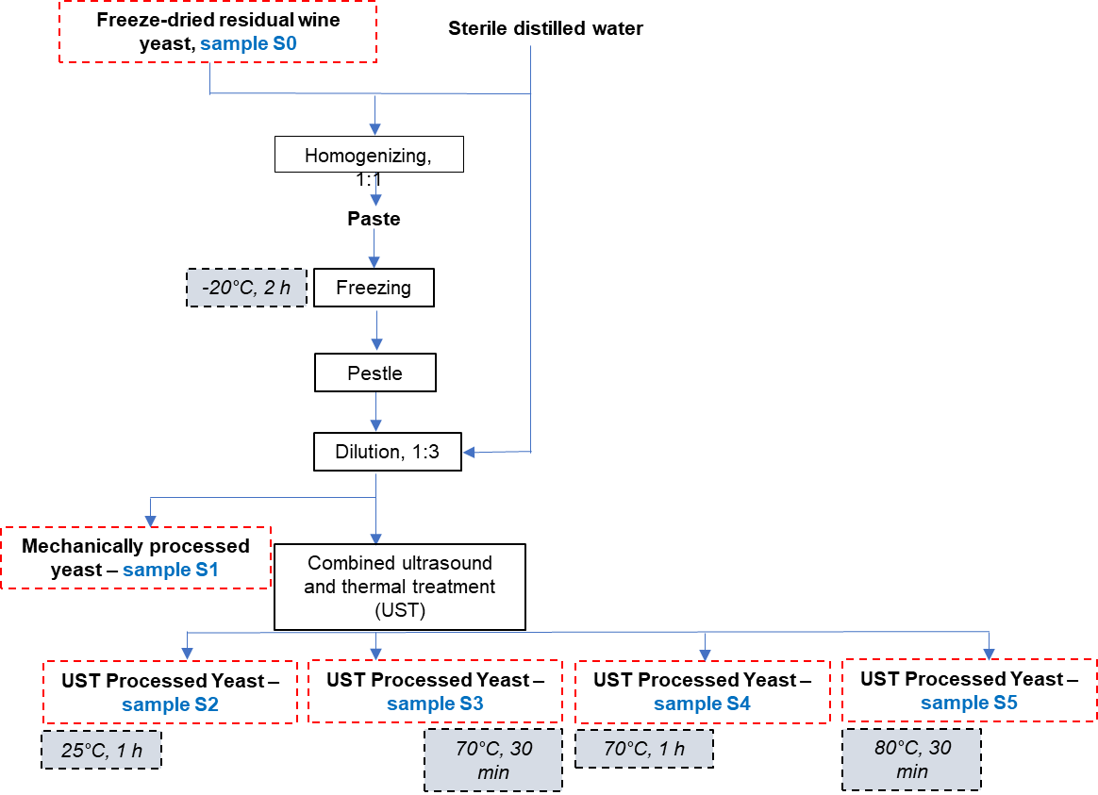
CONFERINȚA NAȚIONALĂ “ANIVERSAREA ICAR”
Ediția IV – 29 mai 2025
BIOCOMPOSITES FROM RED GRAPE BY-PRODUCTS: A SOIL FERTILIZATION APPROACH
Cotârleț Mihaela; Gisman Georgiana; Constantin Oana-Emilia; Vasile Aida-Mihaela; Gisman Viorica; Stănciuc Nicoleta; Râpeanu Gabriela; Buruiană Laura-Daniela; Bahrim Gabriela-Elena
INTRODUCTION
The organic (nutrients and bioactives) and mineral composition of the red pomace (Băbească neagră grape variety) were characterized in the perspective of formulation of a innovative biofertilizer. In addition, residual wine lees biomass, obtained from the vinication of the same grape variety, was processed through different physic-mechanical treatments, to release the valuable postbiotics (proteins, polyphenols) and to obtain the parabiotics (dead cells), that will be used the biofertilizer formulation, with a positive impact on the soil microbiome.
MATERIALS AND METHODS
Materials and reagents
The unfermented red grape pomace (Vitis vinifera) from the Băbească neagră variety and the residual wine lees were collected to Bratu winery, located in Odaia Manolache village, Vânători commune, Galați County (45º33′27.5182″N, 28º0′21.7552″E). The raw grape pomace was stored in refrigerated containers at -20°C until use, then dried at 35°C with hot air convection, until a moisture content of 8% was achieved and then was grounded and stored in vacuum-sealed bags under refrigeration (4°C). The residual wine lees produced during the fermentation of the same grape juice was collected, frozen, and lyophilized (-42°C, 0.11 mbar) to a constant mass. All chemicals used were of analytical grade were obtained from Sigma-Aldrich company (Steinhelm, Germany).
Methods
The organic and mineral composition of dried pomace were analysed by using Fourier-transform infrared spectroscopy (FTIR) with an ISRpirit-T FT-IR spectrometer equipped with a built-in QATR-S type ATR accessory, DLATGS detector, and KBr beam splitter in the range of 4000-400 cm⁻¹ at room temperature, with a resolution of 2 cm⁻¹, and X-ray fluorescence spectroscopy (XRF OLYMPUS Vanta V ModelVCR-CCC-A3-E) [1]. For bioactive compounds assay, a quantity of 0.5 g of dried red pomace was subjected to solid-liquid extraction, assisted by ultrasounds, using 4.5 mL of 70% ethanol and 0.5 mL of glacial acetic acid. Ultrasound-assisted extraction was performed in a water bath with sonication at 30°C for 30 minutes, followed by centrifugation at 6000 rpm for 10 minutes at 4°C. The extract was characterized by determining the total phenolic content, total flavonoid content and the total monomeric anthocyanin content [2].
The lyophilized lees was processed to extract the postbiotics and obtainement of the parabiotics. After treatments, the samples were processed by centrifugation at 6000×g for 10 minutes. The supernatants were collected, filtered through 0.22 µm pore size syringe filters, and stored under refrigerated conditions for subsequent analysis of bioactive compounds such as proteins and polyphenols [3].
RESULTS AND DISCUSSION
Dried red pomace (Băbească neagră) characterisation
The FTIR analysis of dried grape pomace revealed a significant organic composition that provides essential nutrients for soil microorganisms that are active implied in organic mineralization processes.
The XRF analysis of the pomace identified the higher concentration of potassium (9.64 %) and silicon (8.47%), both minerals having an important contribution for plants growth, vitality and health. Thus, K is essential for plant growth, being crucial in the process of photosynthesis and water regulation and Si is beneficial for the vigour of plants and improving their resistance to exogenous abiotic stresses (e.g., salt stress, drought, heavy metals contamination etc.). Biogenic silica is also protective against herbivores.
In the extracts of red grape pomace, a total polyphenol content of 42.35 ± 0.13 mg gallic acid/g dry weight, total flavonoids of 29.80 ± 0.25 mg catechin equivalents/g dry weight, and a total monomeric anthocyanin content of 1.49 ± 0.08 mg cyanidin-3-O-glucoside equivalents/g dry weight were evidenced.
All these compositional characteristics of red pomace recommend it as a valuable ingredient for a composite formula with both roles at biostimulant and biofertilizer, based on slag, dolomite, CKG, residual lees and grape pomace, to bring innovation thought reducing the reliance on chemical fertilizer, by using nutrients and bioactives with the positive impact on soil microbiome and plant metabolism, health and safety assurance.
Residual wine lees biomass biotication
To release of the postbiotics and obtain the parabiotics the lyophilised wine lees was proccesed according to steps presented below [2] :
The different treatments (mechanical and physical) caused the lysis of the cell walls from the perspective of obtaining formulas enriched in cellular bioactive compounds (proteins and polyphenols) and parabiotics (dead cells). The ultrasounds treatment combined with the thermal treatment at 80◦C for 30 minutes, assure the highest level of total polyphenolics and proteins content released and a totaly inactivation of cells.
CONCLUSIONS
This research targets a innovative formulation for a composite biofertilizer based on post- and parabiotics in combination with the organic and mineral compounds from red wine by-products and industrial wastes, according with the objectives of the project PNRR/2022/9/MCDI/I5, Financing contract 760005/30.12.2022, Project ID 2, " Establishment and operationalization of a Competence Center for Soil Health and Food Safety (CeSoH)", Component Project 4 " Innovative and emerging solutions for smart valorization of residual resources impacting health and safety of soil-food axis (InnES).
REFERENCES
Castro, L.E.N.; Barroso, T.L.C.T.; Ferreira, V.C.; Forster Carneiro, T., 2025. Waste, 3(4). https://doi.org/10.3390/waste3010004.
Serea, D.; Râpeanu, G.; Constantin, O.; Bahrim, G.; Stănciuc, N.; Croitoru, C., 2021. The Annals of the University Dunarea De Jos of Galati. Fascicle VI - Food Technology, 45 (1), 9-25. https://doi.org/https://doi.org/10.35219/foodtechnology.2021.1.01.
Cotarleț, M.; Vasile, A.M.; Turturică, M.; Rapeanu, G.; Cîrciumaru, A.; Stănciuc, N.; Bahrim, G.E., 2025. Applied Food Research 5(1), 100794. https://doi.org/10.1016/j.afres.2025.100794

