Slide 1
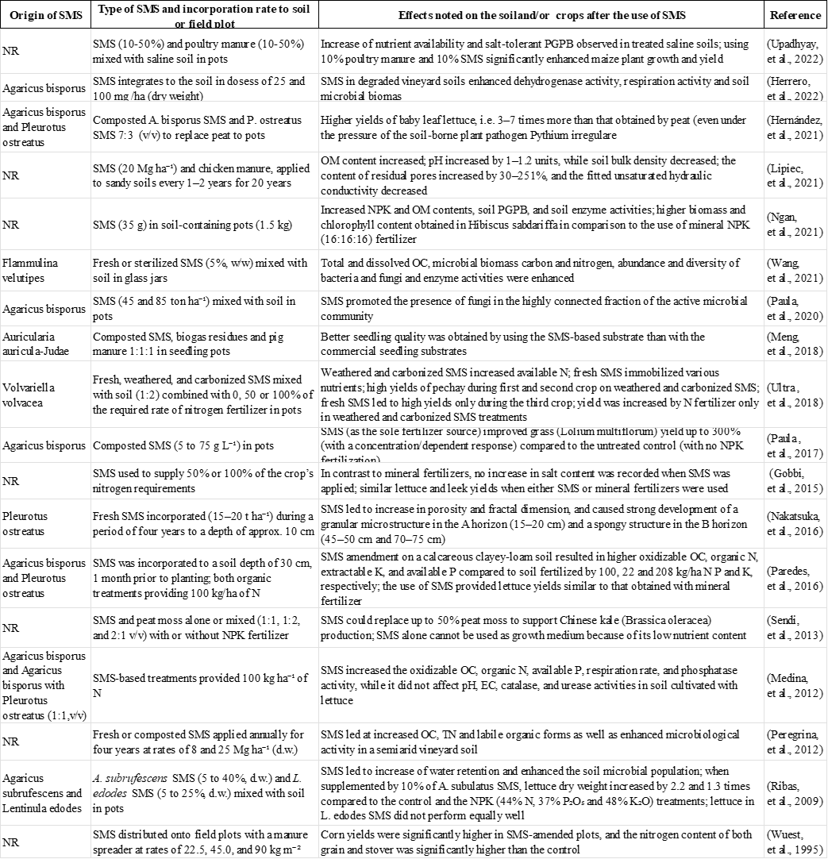
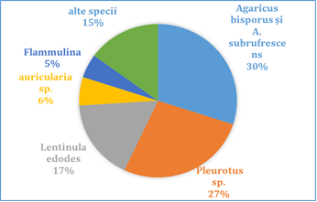
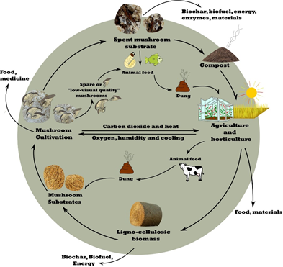
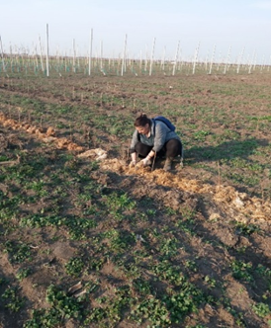
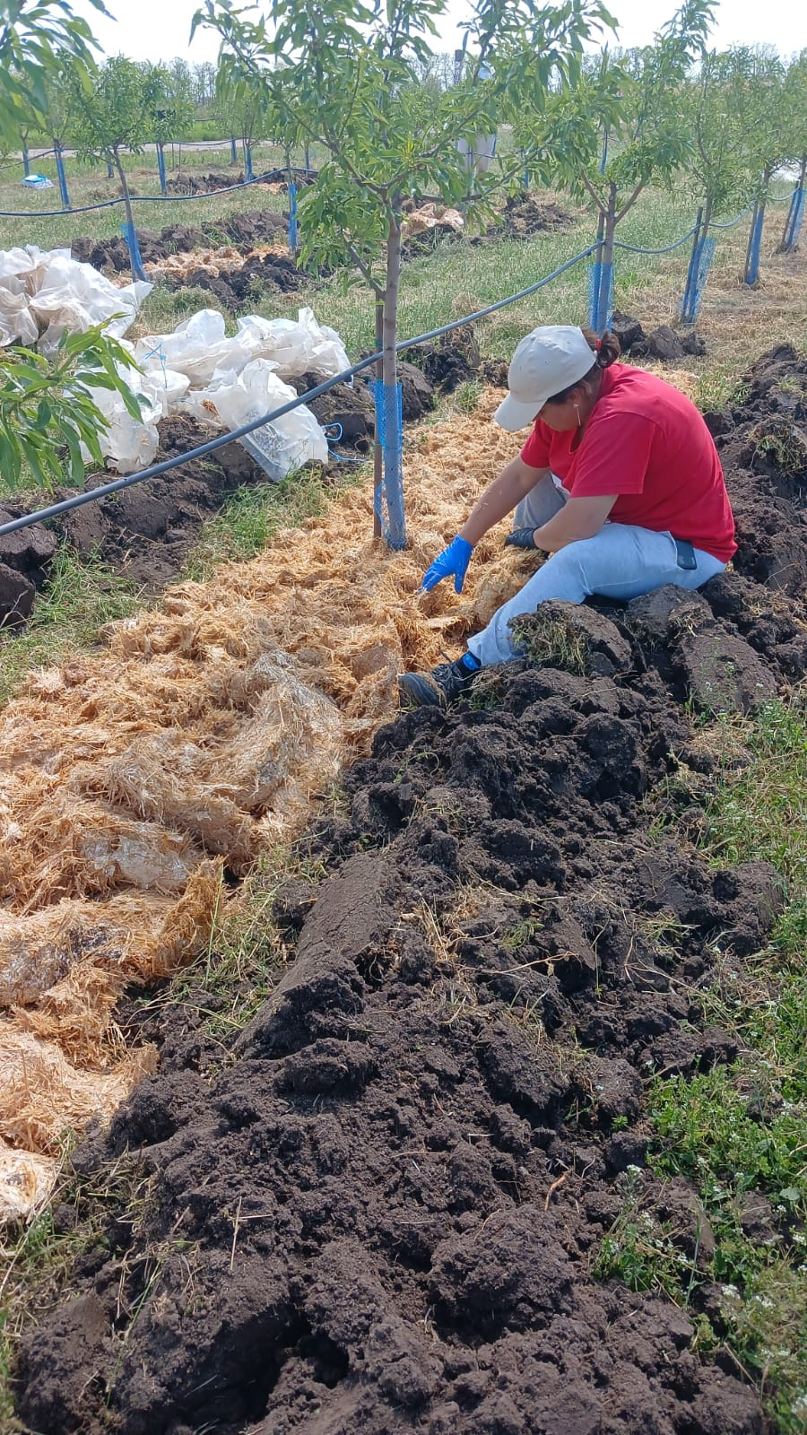
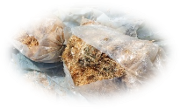
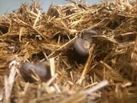
CONFERINȚA NAȚIONALĂ “ANIVERSAREA ICAR”
Ediția IV – 29 mai 2025
THE ROLE OF SPENT MUSHROOM SUBSTRATE IN SUSTENABLE ORCHARD MANAGEMENT
DOGARU Mihaela Cecilia*, MOLOȘAG Ailin, SANDU Nicoleta, OLTENACU Cătălin Viorel
Correspondence address*: dogaru.mihaela @ scdpbaneasa.ro
Research and Development Station for Fruit Tree Growing Băneasa, 4 Ion Ionescu de la Brad Boulevard, Sector 1, Bucharest, Romania, Phone +40 212 330 613, Fax +40 212 330 614; E-mail secretariat@scdpbaneasa.ro
INTRODUCTION
Organic matter plays an essential role in maintaining and improving soil fertility, which is fundamental to the productive capacity of plants. In the current context, with the challenges of climate change and the intensive use of agricultural resources, we believe that a correct management of organic matter can contribute to the protection and regeneration of soils.
This paper is a review article that synthesizes national and international research findings regarding the use of spent mushroom substrate, with a particular focus on its applications in the sustainable management of fruit tree plantations.
RESULTS AND DISCUSSION
Tabel 1.Reuse of spent mushroom substrate (SMS) as soil amendment based on outcome reported inpertinent publications
Fig.1. Mushroom species
(Sursa: Market. us Media)
Fig.2.Use of SMS in a circular economy
(Sursa/Source: Daniel Grimm & Han AB Wösten, 2018.)
MATERIAL AND METHODS
This review draws on experimental findings from various studies that assessed SMS application across different cropping systems. For example, application of unknown SMS at 20 mg/ha combined with poultry manure at 10 mg/ha in sandy soils over 20 years increased organic matter content by 102–201% and water holding capacity by up to 251% (Lipiec et al., 2021). Annual applications of SMS (8–25 mg/ha) in vineyard soils improved inorganic nitrogen, organic carbon, total nitrogen, and labile organic fractions (Peregrina et al., 2012).
Incorporation of A. bisporus SMS (100 kg/ha) increased oxidable carbon, organic nitrogen, and available phosphorus more than a 1:1 v/v mixture with P. ostreatus SMS (Medina et al., 2012). Microbial and enzymatic activity, such as phosphatase activity, also improved with no negative effects on soil salinity or pH.
SMS combined with Bacillus amyloliquefaciens improved soil performance in Hibiscus sabdariffa more effectively than NPK fertilizers (Ngan et al., 2021). Fresh or sterilized SMS from F. velutipes applied in cucumber crops enhanced microbial biomass and dissolved organic carbon compared to NPK (Wang et al., 2021).
In lettuce, A. subrufescens and L. edodes SMS produced higher dry matter yields than NPK fertilizers (Paredes et al., 2016). SMS use has also shown higher yields than mineral fertilizers across various crops (Gobbi et al., 2015; Wuest et al., 2012).
Was to investigate the potential of using mushroom compost in fruit growing, particularly in the culture of fruit shrubs. In this sense, observations and determinations were made in the experimental field and confirmed by the chemical analyzes carried out in the agrochemical laboratory of RSFG Baneasa Bucharest (Dogaru et al., 2024)
Abbreviations used:NPK-nitogen, phosphorus, potassium; NR - not reported; OC - organic carbon; OM - organic matter; PGPB - plant growth promoting bacteria; TN - total nitrogen
Fig.3.Location of the experiment in the Moara Domnească experimental field, 2024-2025 (Sursa/Source: original)
CONCLUSIONS
Spent mushroom substrate has considerable potential in sustainable orchard and horticultural systems:
SMS is a valuable by-product of an expanding agricultural sector.
Its application improves soil fertility, structure, and biological activity.
It aligns with circular economy principles and can be used in composting, biofertilizers, construction materials, energy, and as a growth medium.
In controlled orchard systems, SMS enables the use of CO₂ emissions and heat, supporting EU renewable energy goals.
SMS use reduces greenhouse gas emissions and promotes soil carbon sequestration.
Standardization, improved logistics, and environmental risk mitigation are essential for broader adoption.
SMS offers a sustainable alternative to conventional fertilizers, with added benefits for soil and crop quality.
ACKNOWLEDGEMENTS
The authors thank RSFG Băneasa and ASAS for their contributions to to the development and application of technological sequences for land preparation, orchard establishment, fruit tree cropping systems, and soil maintenance operations using mechanized methods.This work was supported by SCDP Băneasa, ICDP Pitești-Mărăcineni, and the ASAS Thematic Plan 2021–2027.

