Slide 1
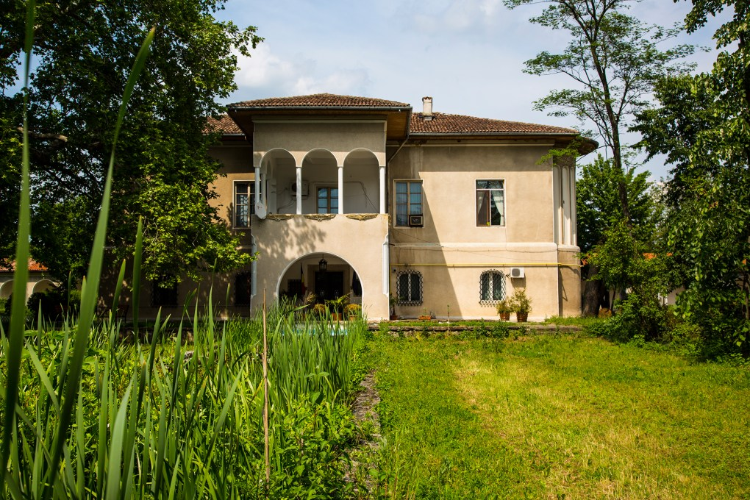
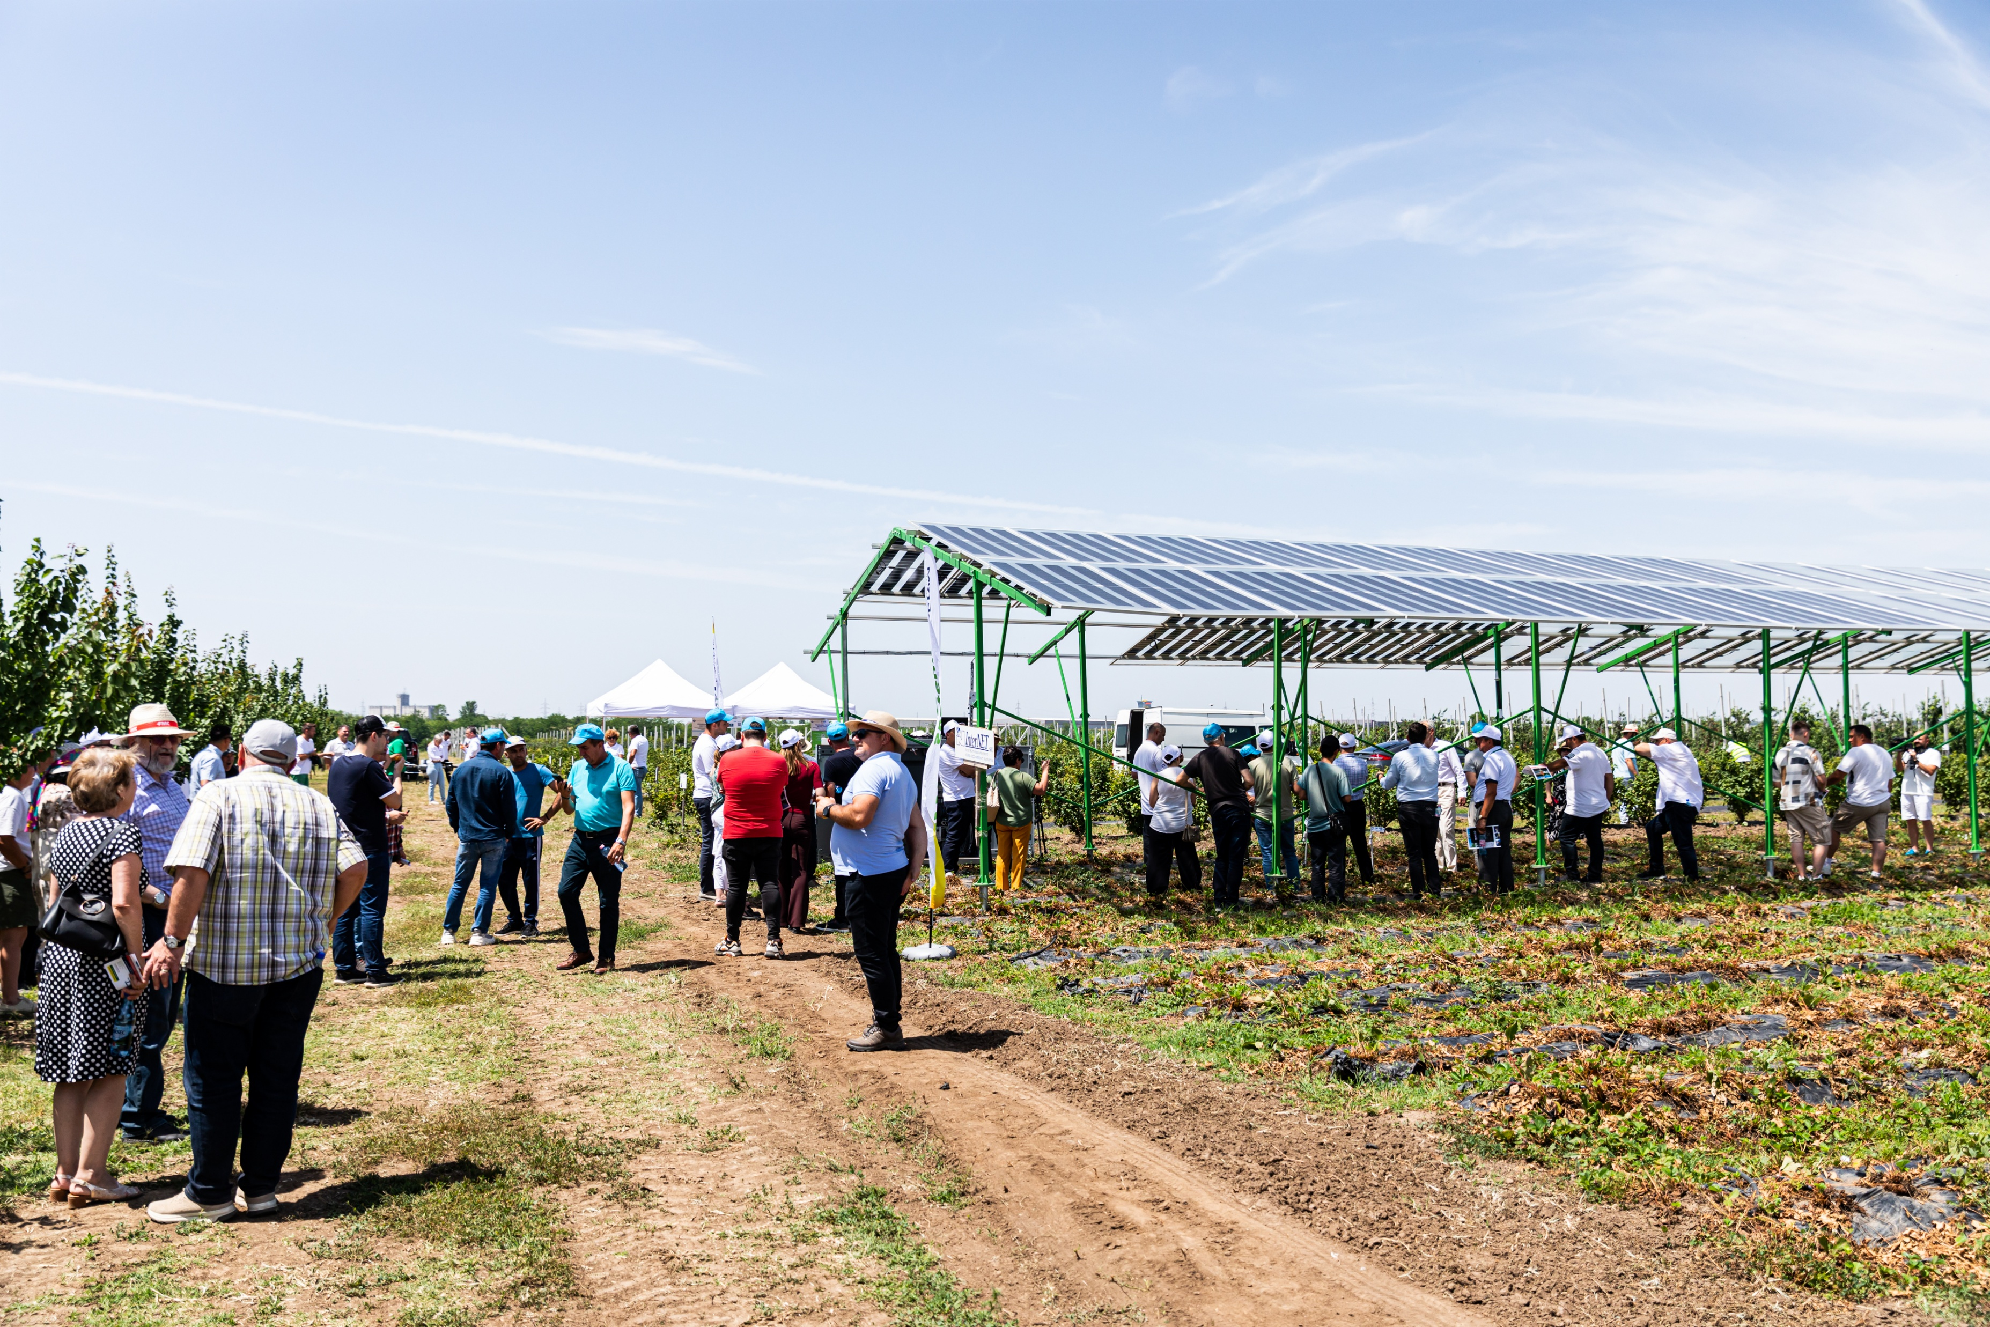
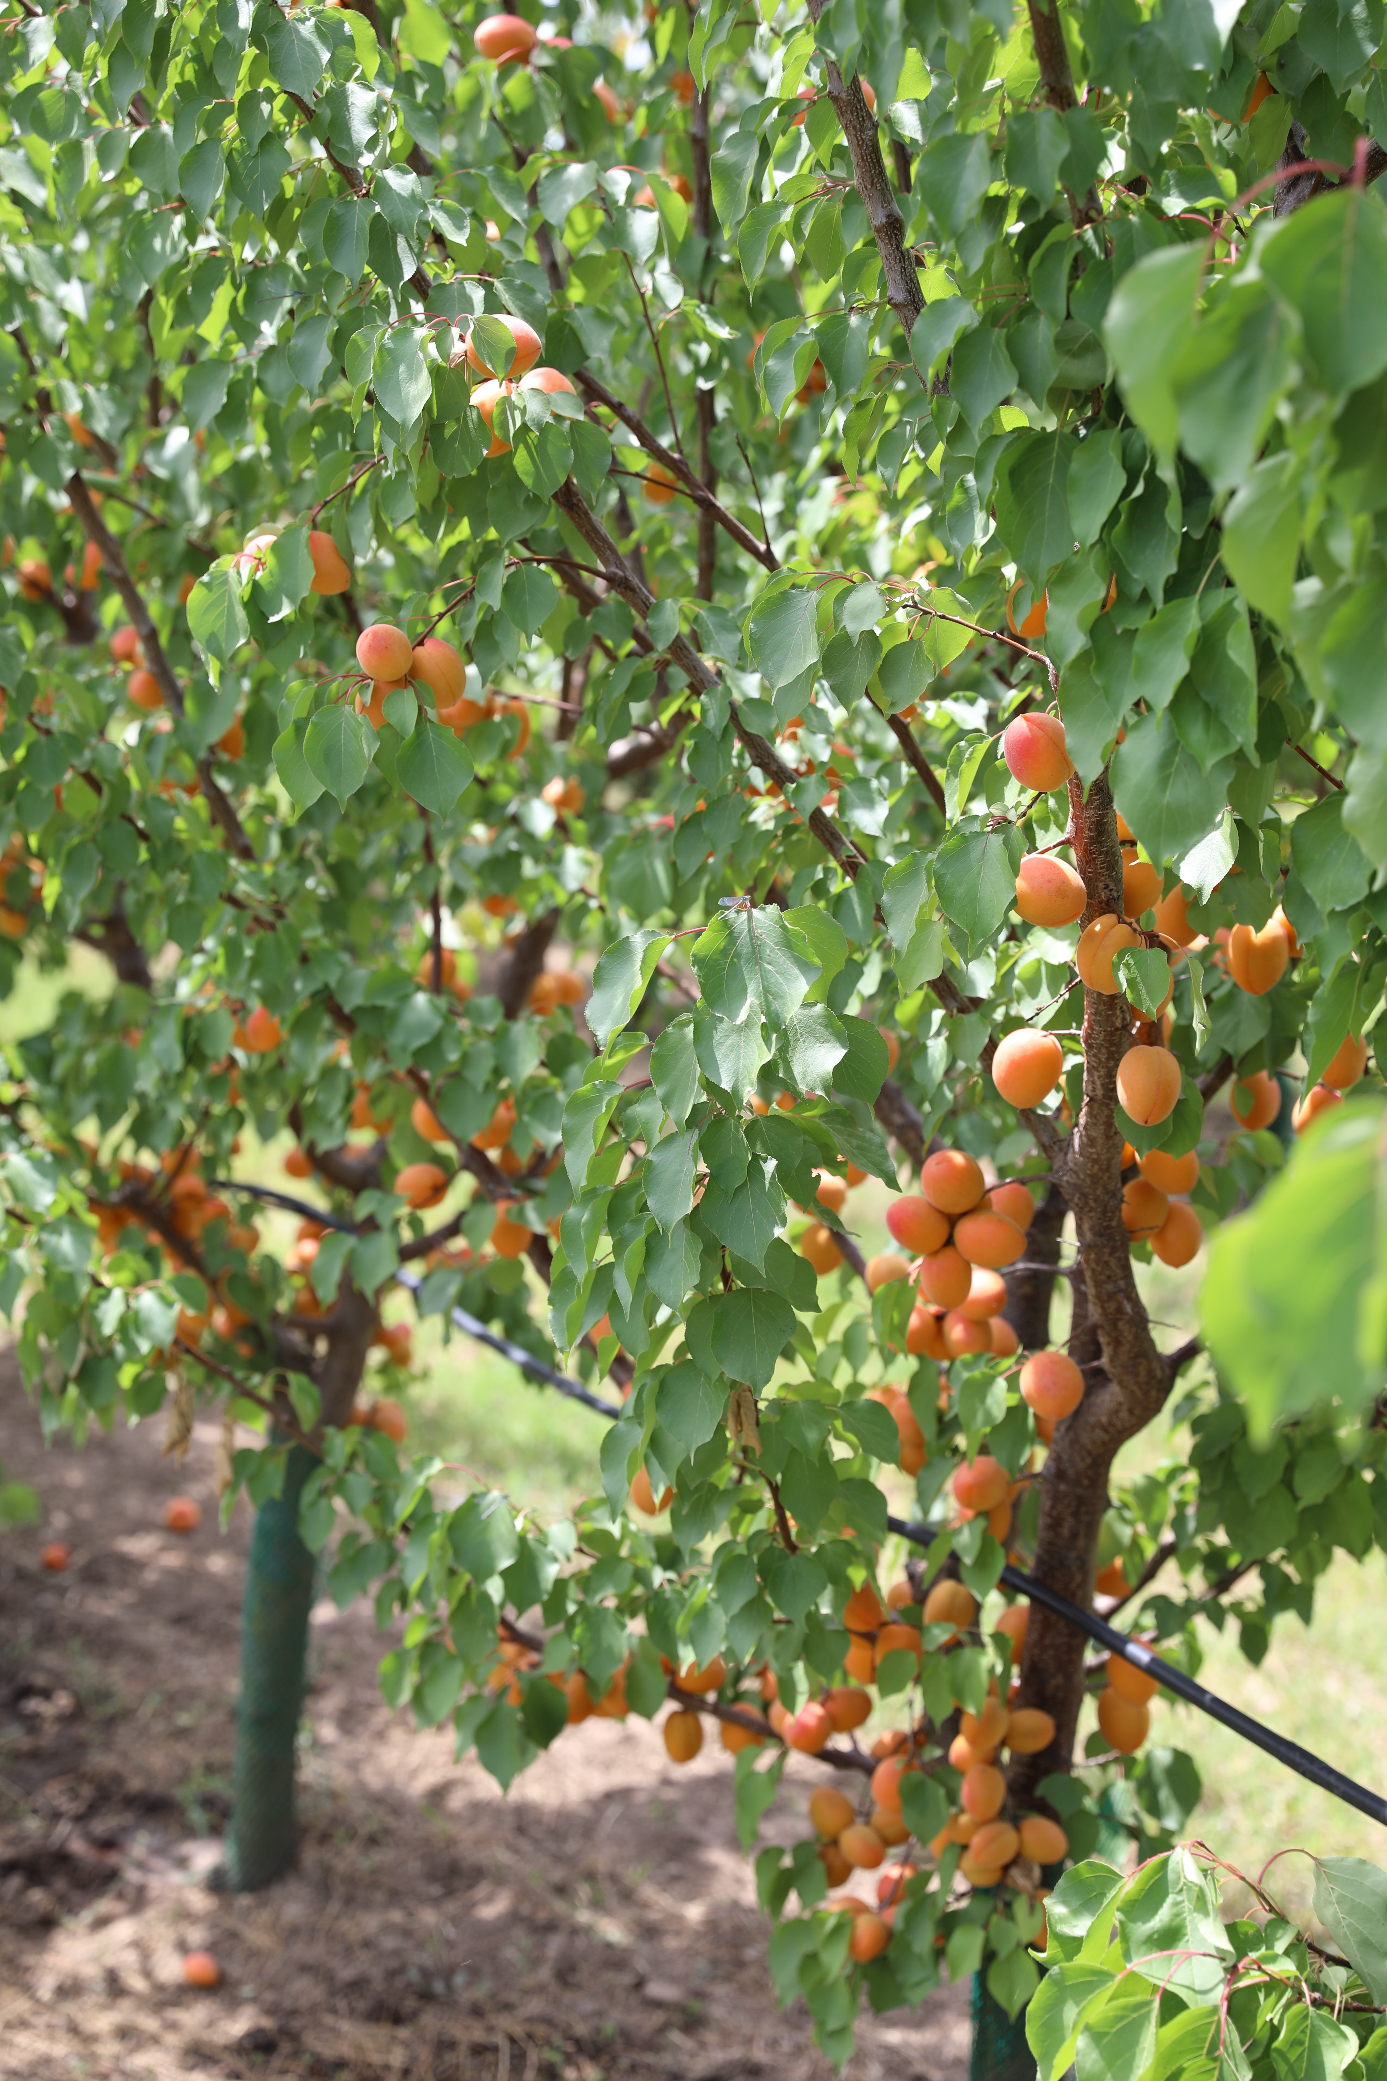
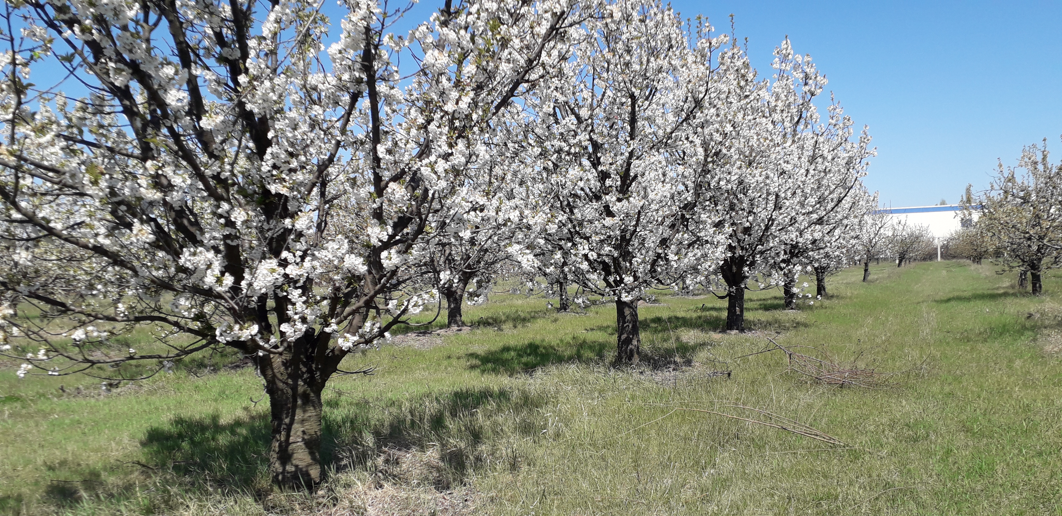
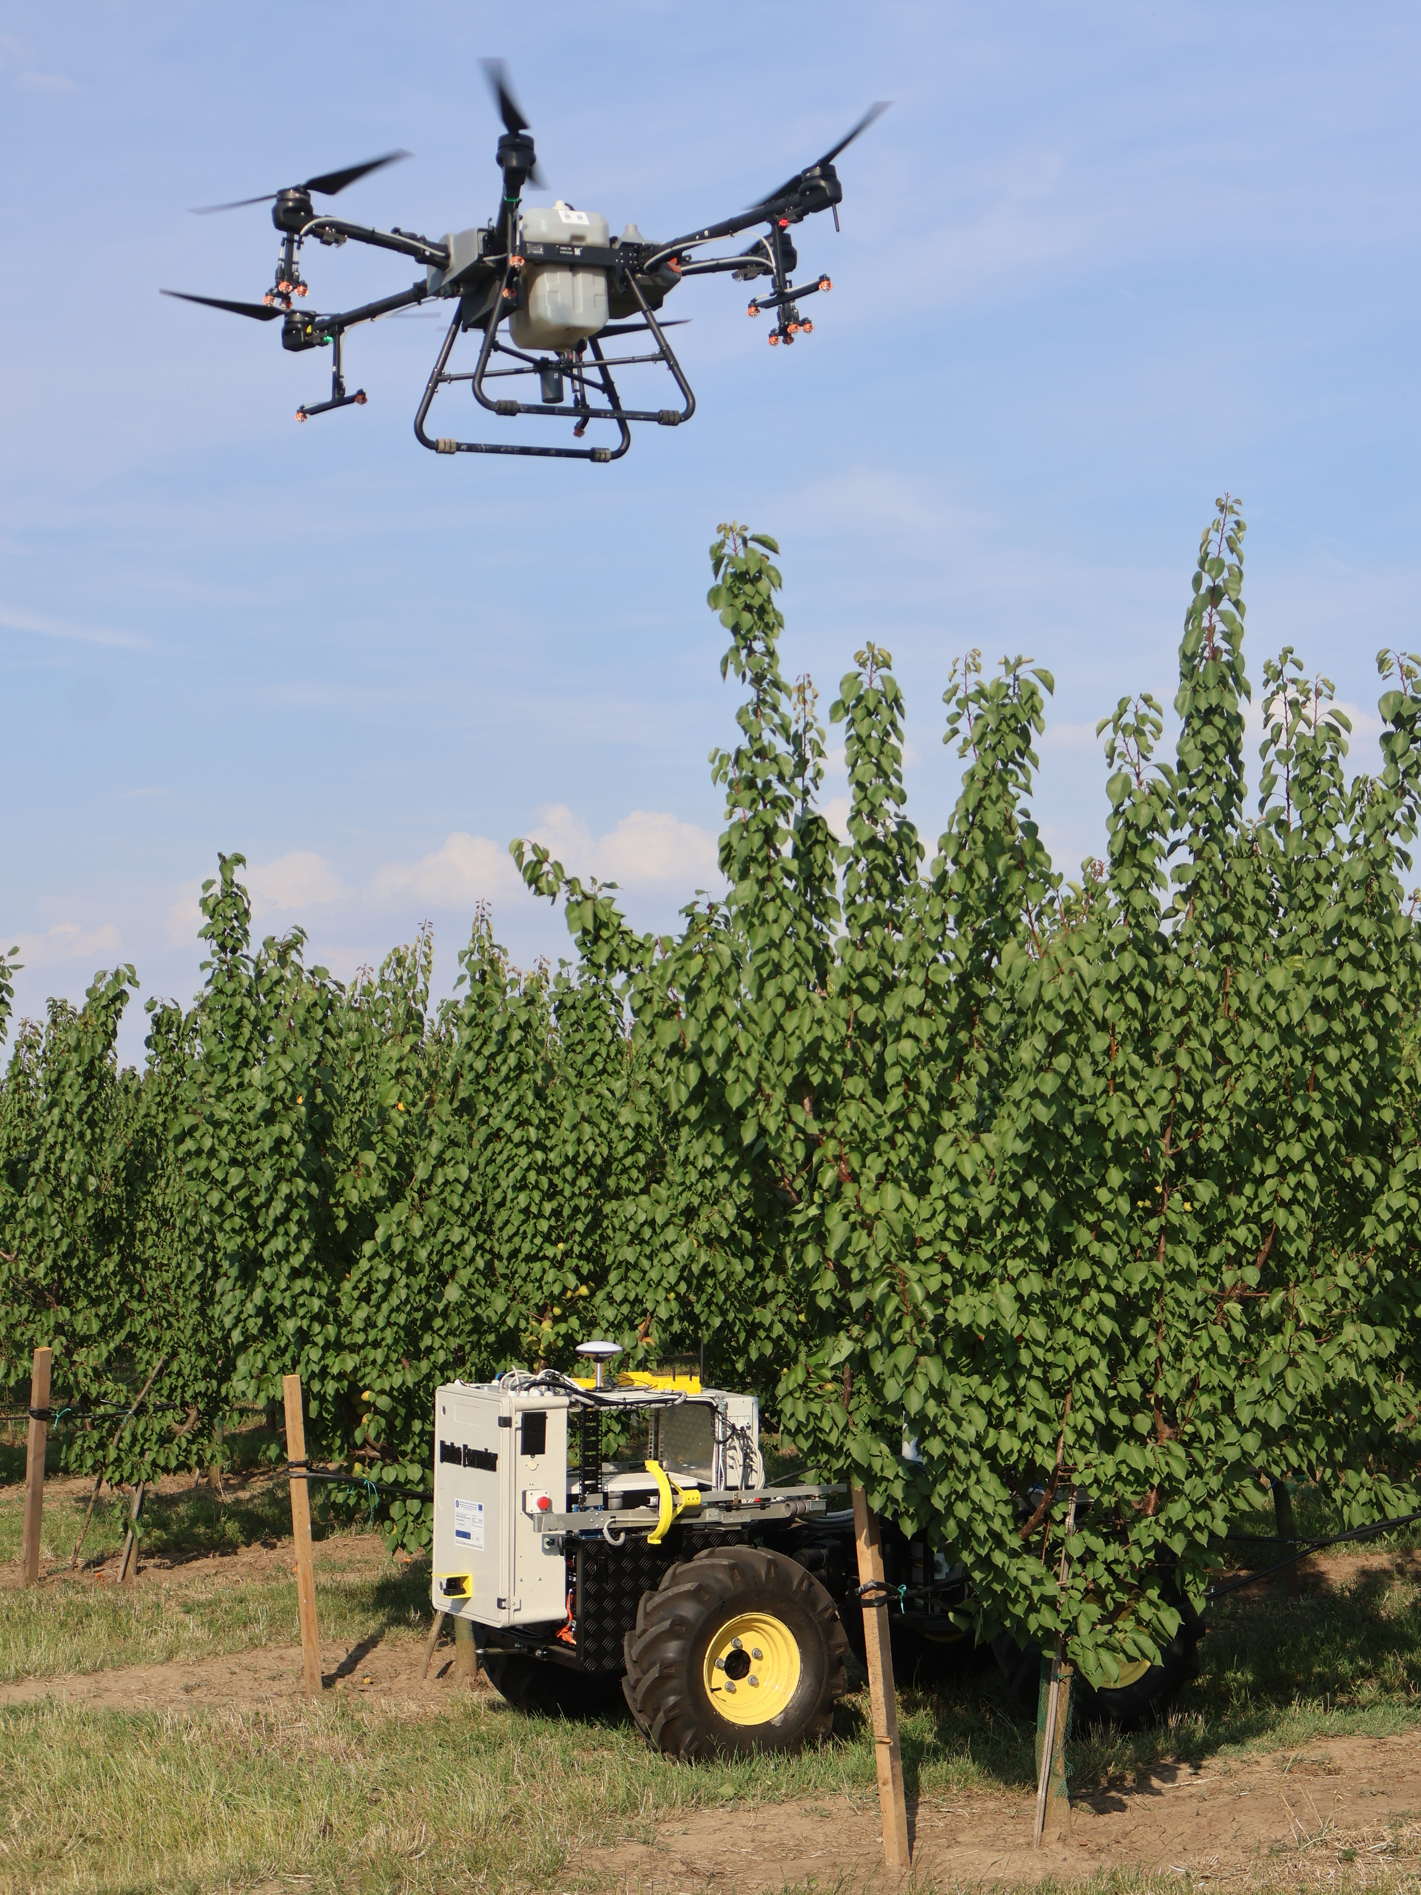
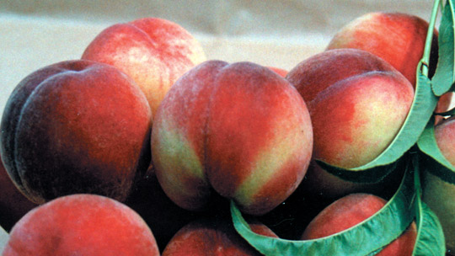
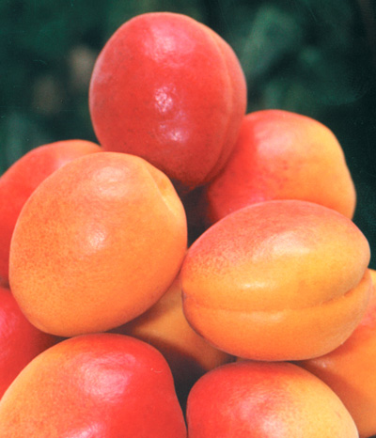
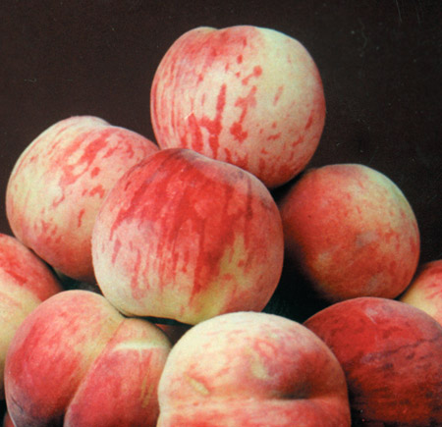
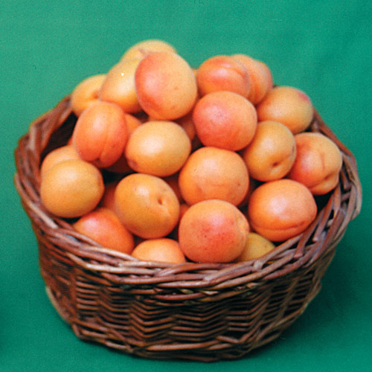
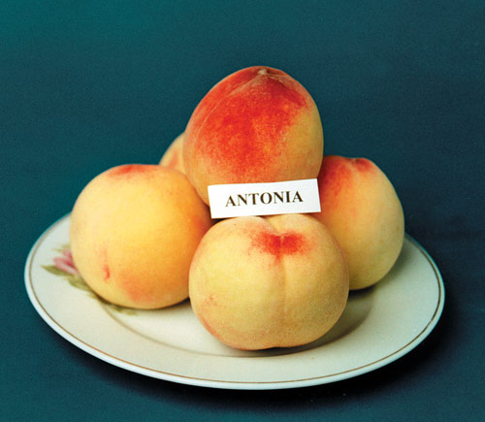
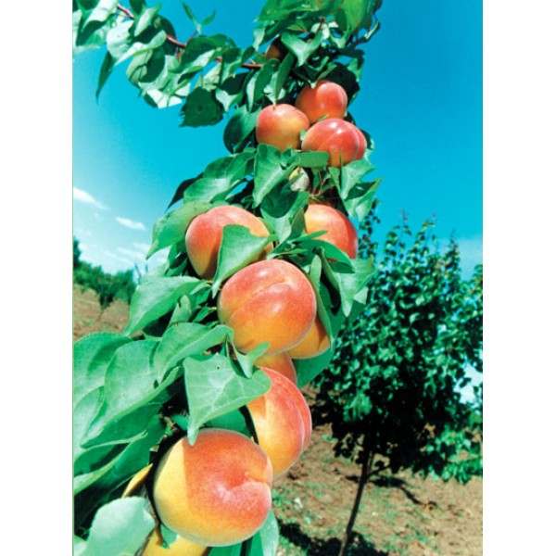
CONFERINȚA NAȚIONALĂ “ANIVERSAREA ICAR”
Ediția IV – 29 mai 2025
THE GENETIC HERITAGE OF RSFG BĂNEASA: PAST AND FUTURE PERSPECTIVES
MOLOȘAG Ailin, OLTENACU Cătălin Viorel*, OLTENACU Nicoleta, OLARU Mihaela, UDREA BRASLĂ Andreea, DRAGOMIR Damian, DOGARU Mihaela, HOLT Vlăduț
Correspondence address*: oltenacu_viorel@yahoo.com
Research and Development Station for Fruit Tree Growing Băneasa, 4 Ion Ionescu de la Brad Boulevard, Sector 1, Bucharest, Romania, Phone +40 212 330 613, Fax +40 212 330 614; E-mail secretariat@scdpbaneasa.ro
INTRODUCTION
Fruit breeding at RSFG Băneasa began with Romania’s first structured peach improvement program. Through the work of breeders like Viorica Bălan (apricot) and Antonia Ivașcu (peach), the station became a national leader. Key achievements include improved fruit quality, disease resistance, and climate adaptability, reflected in numerous cultivars now grown across Romania.
MATERIAL AND METHODS
The breeding programs at RSFG Băneasa used a comprehensive germplasm base: over 650 apricot genotypes and 670 peach and nectarine accessions, including Romanian landraces and introductions from China, the U.S., and Western Europe.
Conventional methods were applied, including controlled hybridization, backcrossing, and self-pollination, generating diverse F₁, F₂, and backcross populations. In apricot, a diallel crossing scheme was used among selected parents to improve fruit quality and disease resistance.
Open pollination in germplasm orchards served as an additional source of genetic variability. Physical mutagenesis was also employed: apricot buds were irradiated with cobalt-60 (⁶⁰Co) at 0.3 KR to induce compact growth and biochemical changes.
Selection criteria included fruit quality (soluble solids, firmness, aroma), resistance to diseases (e.g., Monilinia, Stigmina, PPV), phenological traits (bloom time, ripening period), and tree architecture (vigor, spur formation).
Field evaluation was conducted under temperate-continental conditions at Băneasa and other trial sites. Promising hybrids were monitored across seasons for yield, adaptability, and stability.
RESULTS AND DISCUSSION
PEACH Prunus persica (L.) Batsch | APRICOT Prunus armeniaca (L.)
Alexia | Carmela
Key traits Growth habit: medium vigor, semi-erect growth, globular crown; forms mixed branches. Fruit: large (150–170 g), round, slightly flattened, asymmetric; white skin with 60–70% intense red blush. Flesh: white-cream, firm, juicy, sweet-acid, aromatic; semi-clingstone. Traits: ripens in late June (3rd decade), enters bearing in year II, long productive life (>15 years), high yield (35–40 kg/tree). Resistance: good tolerance to Taphrina deformans and Cytospora cincta; resistant to frost and drought. | Key traits Growth habit: medium vigor, pyramidal crown with strong main branches. Fruit: very large (95–100 g), elongated-spherical, bright yellow-orange with ~45% red blush. Flesh: orange, firm, juicy, balanced sweet-acid flavor, strong aroma, stone non-adherent (4.5%). Traits: early ripening (2nd decade of June), begins bearing in year III, highly productive (38–40 kg/tree). Resistance: Monilinia laxa, Stigmina carpophila, Cytospora cincta; good tolerance to frost and drought.
Amalia | Rareș
Key traits Growth habit: medium vigor, semi-vigorous tree, dense globular crown, suitable for intensive systems (700–1200 trees/ha). Fruit: medium-large (115–121 g), round-oval, creamy-white with red blush over 2/3 of surface. Flesh: white-cream, fine texture, juicy, sweet-acid, very pleasant taste; non-adherent to stone. Traits: mid-late ripening (3rd decade of July), early bearing (year III), good yield (38 kg/tree), fresh and processing use. Resistance: genetically resistant to Taphrina deformans, Sphaerotheca pannosa; resistant to drought and frost. | Key traits Growth habit: low vigor, globular-flattened crown, early flowering. Fruit: medium size (60–65 g), spherical-elongated, light orange with red spots. Flesh: firm, very juicy, sweet, good aroma, balanced acidity, non-adherent medium stone (4 g). Traits: extra-early ripening (early June), productive (30–35 kg/tree), begins bearing in year III. Resistance: Monilinia laxa, Stigmina carpophila, Cytospora cincta; strong resistance to frost.
Antonia | Viorica
Key traits Growth habit: medium vigor, semi-erect crown, produces on mixed branches. Fruit: large (160–180 g), round, symmetrical; white skin with 50–60% red blush. Flesh: white-cream, juicy, firm, sweet, pleasant aroma; contains 12.5–13.5% soluble solids; semi-clingstone. Traits: mid-season ripening (2nd–3rd decade of July), enters bearing in year II, high productivity (~30 t/ha). Resistance: strong tolerance to peach-specific pathogens (Taphrina deformans, Sphaerotheca pannosa); frost-hardy even in adverse years. | Key traits Growth habit: medium vigor, globular crown, strong branching. Fruit: very large (118–127 g), spherical, slightly flattened, intense orange with no green spots. Flesh: juicy, firm, sweet with pronounced almond aroma; stone non-adherent. Traits: early ripening (late June), productive (35–40 kg/tree in year IV), good processing qualities. Resistance: Monilinia laxa, Stigmina carpophila, Cytospora cincta; good frost tolerance.
CONCLUSIONS
The genetic improvement programs at RSFG Băneasa have produced resilient and productive apricot and peach cultivars, supported by extensive germplasm resources. These breeding outcomes result from decades of targeted hybridization, selection, and mutation breeding. Cultivars developed at the station combine extended harvest seasons, superior flavor, and resistance to cold, drought, and multiple pathogens, ensuring reduced chemical dependence. Adapted to Romania’s agroclimatic conditions, these varieties meet both grower needs and consumer expectations. The integration of molecular tools ensures future-ready strategies to tackle climate change and evolving biotic pressures.
ACKNOWLEDGEMENTS
The authors thank RSFG Băneasa and ASAS for their contributions to fruit tree breeding and genetic resource conservation. This work was supported by SCDP Băneasa, ICDP Pitești-Mărăcineni, and the ASAS Thematic Plan 2021–2027.

