Slide 1


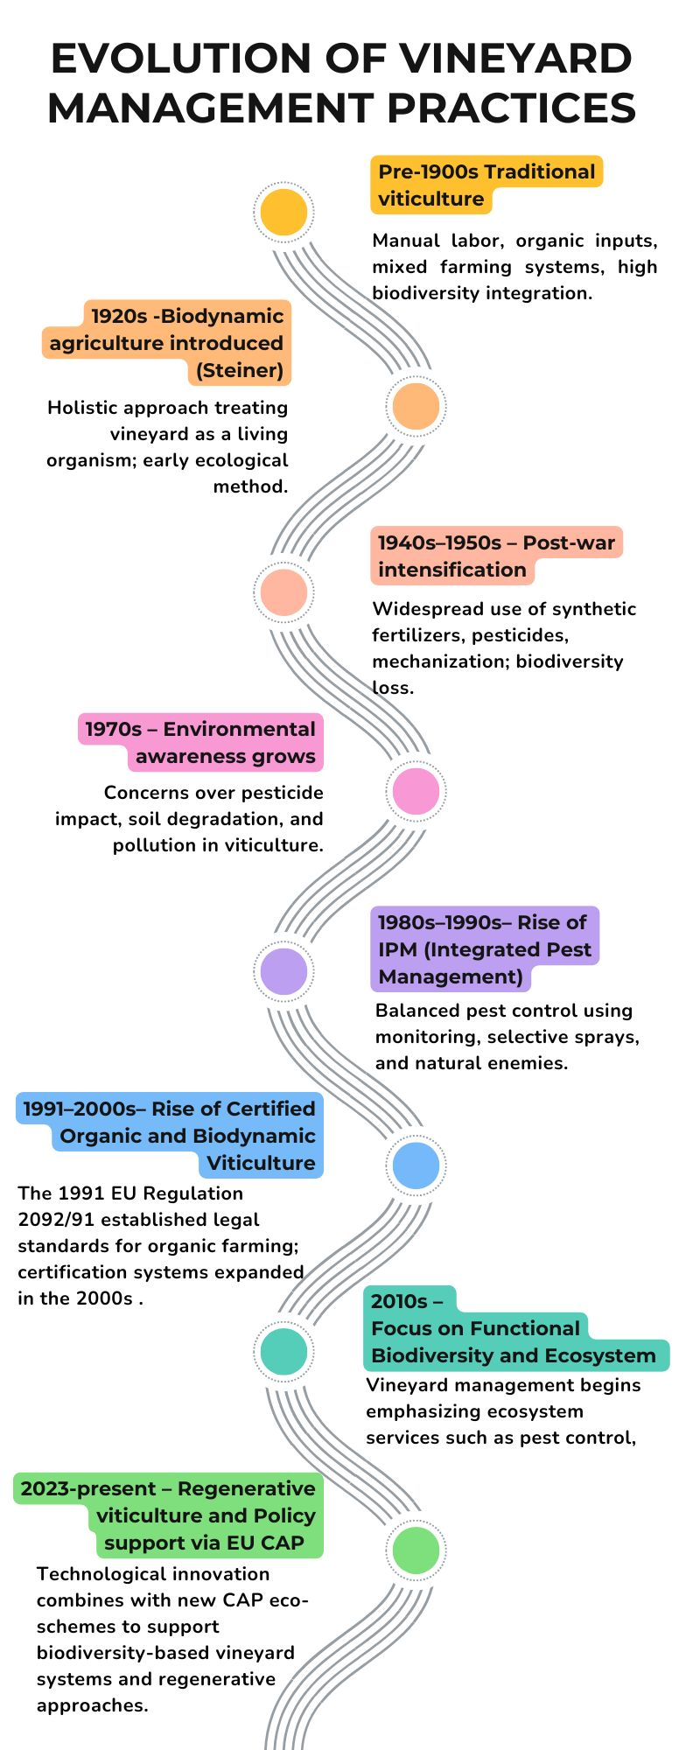
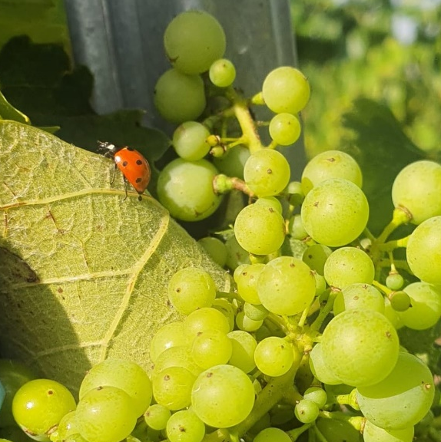
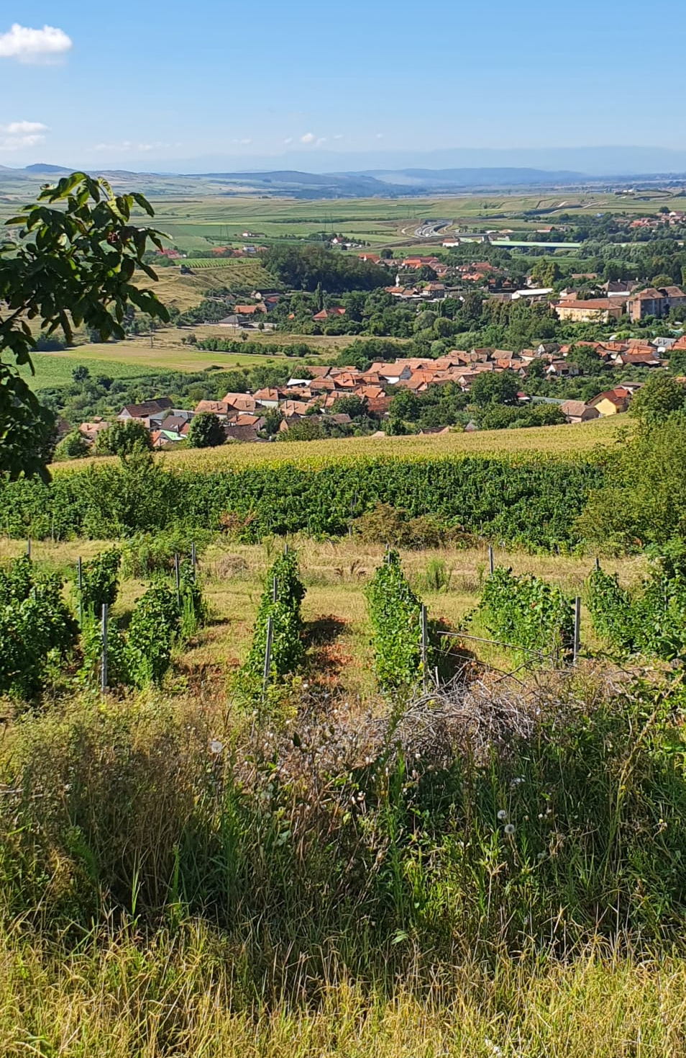
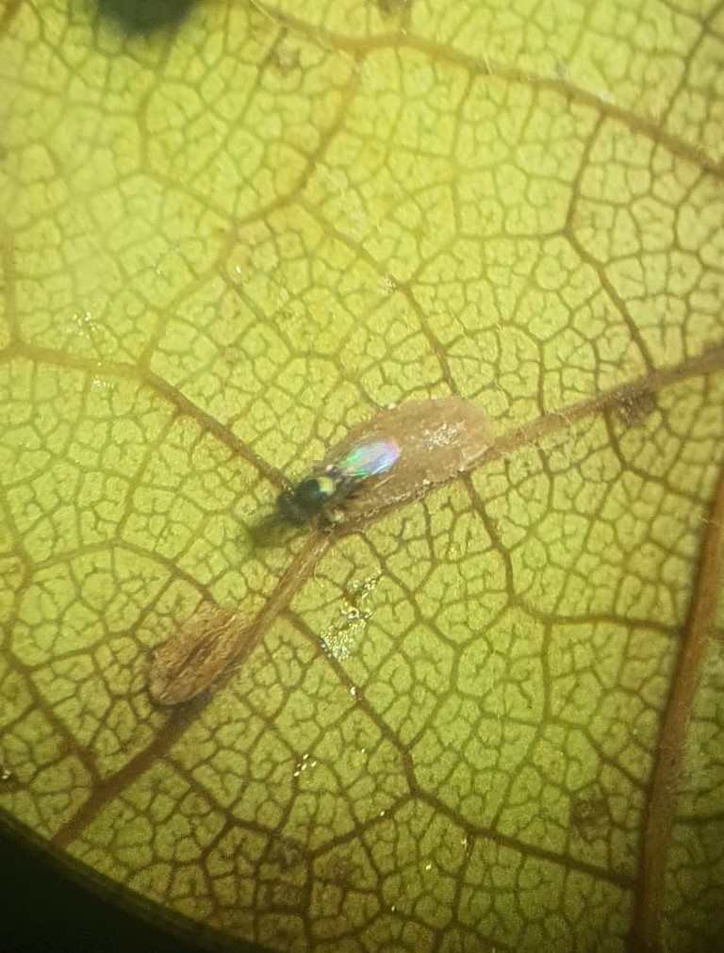
CONFERINȚA NAȚIONALĂ “ANIVERSAREA ICAR”
Ediția IV – 29 mai 2025
THE IMPACT OF AGROTECHNICAL PRACTICES ON BIODIVERSITY AND BENEFICIAL ENTOMOFAUNA IN VINEYARDS
GIURCĂ Ioana Sorina¹, TOMOIAGĂ Liliana Lucia¹, MUNTEAN Maria-Doinița¹, SÎRBU Alexandra Doina¹,
RĂCOARE Horia Silviu¹, CHEDEA Veronica Sanda¹, COMȘA Maria¹
INTRODUCTION
Vineyards represent cultural, economic, and ecological systems of great importance in many regions with a temperate climate. As perennial agricultural systems, they shape the entire landscape, creating unique ecosystems and contributing to the formation of distinct cultural traditions (Daniel et al., 2012). However, over 70% of global vineyards are still managed conventionally, relying heavily on synthetic inputs, intensive tillage, and frequent mowing. These practices have contributed to soil degradation, biodiversity loss, and reduced ecosystem resilience (Nicholson et al., 2020; Eurostat, 2020).
To address these challenges, sustainable approaches such as Integrated Pest Management (IPM), organic farming, and biodiversity-based viticulture have emerged. These practices emphasize natural pest control, habitat conservation, reduced tillage, and the use of cover crops and ecological infrastructures like hedgerows and flower strips. Developing region-specific, resilient viticulture systems able to sustain high productivity while protecting environmental health in the face of continuous climate and land-use changes depends on addressing these gaps.
HISTORICAL OVERVIEW OF VINEYARD MANAGEMENT PRACTICES
Traditionally, vineyards were managed with organic inputs and manual labor, that supported biodiversity. In the 20th century, industrial agriculture introduced synthetic fertilizers, pesticides, and mechanization, boosting yields but degrading soils and disrupting ecological balance (Stefanucci et al., 2018). In response, Integrated Pest Management emerged, combining biological controls with reduced chemical use (Winter et al., 2018; O’Brien et al., 2025).
Today, the focus has shifted to functional biodiversity and agroecological resilience. EU policies like the CAP 2023–2027, encourage vineyards to integrate nature-based solutions for climate adaptation and long-term sustainability (EU CAP, 2023; O'Brien et al., 2025).
AGROTECHNICAL PRACTICE | CONVENTIONAL APPROACH | BIODIVERSITY-BASED APPROACH | BIODIVERSITY IMPACT | ADVANTAGES OF BIODIVERSITY-BASED PRACTICE
Soil Tillage | Frequent, deep tillage for weed control and aeration | Reduced or no-till systems, with mulching and cover crops | conventional → soil biota loss; low disturbance → enhanced soil life | Improved soil structure, microbial diversity, and erosion control
Inter-row Management | Bare soil or frequent mowing of spontaneous vegetation | Diverse cover crops or spontaneous vegetation | Low structural complexity vs. high | Natural pest control, pollination support, and weed suppression
Pesticide Use | Broad-spectrum chemical pesticides used prophylactically | Targeted application, selective biopesticides, or pheromone traps | High non-target impact vs. selective impact → preservation of natural enemies | Reduced pest resistance, natural pest suppression, lower residue risk
Fertilization | Synthetic fertilizers focused on rapid nutrient delivery | Organic compost, green manures, and microbial inoculants | Reduced microbial diversity vs. enhanced belowground biodiversity | Soil fertility, organic matter retention, balanced nutrient cycling
Ecological Infrastructures | Often absent or minimal | Hedges, flower strips, stone piles, uncultivated borders | Low habitat heterogeneity vs. high → more beneficial and ecological niches | Greater functional diversity and landscape-level resilience
Canopy and Pruning Management | Standardized pruning for productivity | Site-specific pruning optimizing beneficial insect habitat | Can affect arthropod shelter and predator habitat quality | Reduces fungal pressure, supports natural enemies
Irrigation | Uniform or excessive watering | Precision irrigation or dry farming depending on climate | Overwatering reduces microbial diversity; precision protects habitat quality | Maintains microbial activity and avoids water stress or excess
Cover Crops | Rarely used or replaced by herbicides | Flowering forbs, legumes, or species mixes | No floral resources vs. extended blooming and prey habitat for beneficials | Attracts pollinators, improves soil health, suppresses pests
Pest Monitoring | Reactive: spraying after symptoms appear | Preventive: pest thresholds, monitoring traps, biological indicators used | Conventional: fewer feedback loops; sustainable: promotes ecological balance | Reduces unnecessary sprays, supports early interventions
Livestock Integration (optional) | Not practiced | Sheep grazing under vines in dormancy periods | Adds nutrient cycling and reduces mowing; minimal in conventional | Enhances soil biology, reduces compaction and herbicide needs
BIODIVERSITY AND ECOLOGICAL INFRASTRUCTURES IN THE VINEYARD
Vineyards support a wide range of organisms—including plants, fungi, insects, and soil fauna—whose presence is shaped by both environmental conditions and vineyard management practices (Oprea, 2001; Bernard et al., 2006). Ecological infrastructures like hedgerows, flower strips, and stone piles enhance functional biodiversity by providing food, shelter, and overwintering habitats for beneficial insects (Böller et al., 2004). At least 5% of the farm area should be dedicated to these features, though 15% is ideal. However, if poorly managed, such areas can also shelter pests (Tirello et al., 2013). Maintaining vegetation diversity improves ecosystem resilience and supports key groups like spiders, pollinators, parasitoids, and birds (Winter et al., 2018).
INFLUENCE OF AGROTECHNICAL METHODS AND THE PEST–NATURAL ENEMY EQUILIBRIUM
Conventional systems often prioritize yield and simplicity but can lead to reduced biodiversity, soil degradation, and pest resistance. In contrast, biodiversity-focused practices, such as reduced tillage, ecological infrastructures, and targeted pest control foster a resilient agroecosystem by supporting beneficial organisms, improving soil health, and reducing reliance on chemical inputs.
CASE STUDY: BENEFICIAL ENTOMOFAUNA AND BIODIVERSITY BALANCE IN TÂRNAVE VINEYARD
The Târnave Vineyard stands out as a strong model for biodiversity preservation in viticulture, with 28.46% of its area dedicated to agroecological infrastructure and supporting a rich community of beneficial insects such as predatory mites, Coleoptera, and Heteroptera; (Tomoiagă et al., 2016). These results highlight the effectiveness of regionally adapted, biodiversity-friendly practices in enhancing ecological balance and reducing the need for chemical inputs.
CONCLUSION
Conventional vineyard management, still practiced on over 70% of global vineyards, poses a substantial threat to biodiversity and long-term ecosystem health, with studies linking it to 30–40% declines in beneficial arthropod populations compared to organic or integrated systems.
Inter-row vegetation and ecological infrastructures (e.g., hedgerows, flower strips) increase species richness and functional diversity. Also, using cover crops, compost, and no-till management boost soil microbial activity, sequester carbon, and help reduce erosion. Organic vineyard systems show higher biodiversity than conventional ones, though the benefits vary depending on local climate, vineyard age, and landscape context. These findings highlight the importance of long-term, region-specific biodiversity monitoring.
Technological advancements, including drones, soil sensors, remote imaging, and AI-based pest recognition systems, enable precision ecological monitoring, reducing unnecessary interventions and improving biodiversity outcomes.
Fig.1. Key beneficial entomofauna from Târnave vineyard contributing to natural pest control.
Fig.2. Vineyard landscape Transylvania, an example of biodiversity-friendly viticulture, with diverse inter-row vegetation supporting ecosystem stability.
BIBLIOGRAFIE SELECTIVĂ (opțional)
A 32

