Slide 1
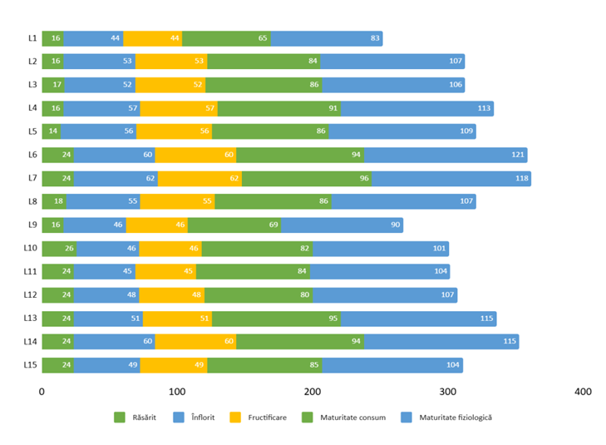
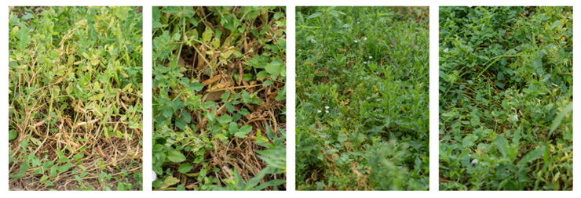
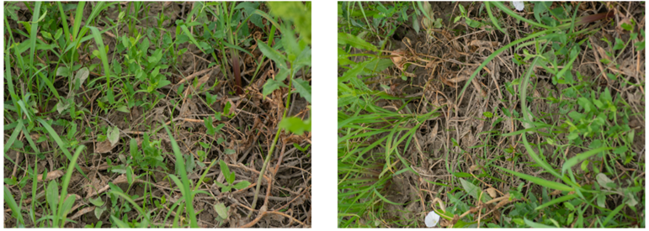
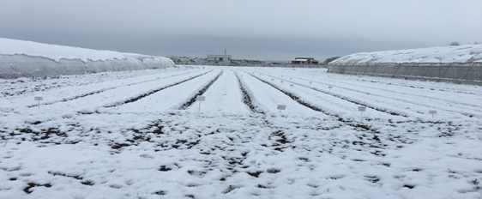
CONFERINȚA NAȚIONALĂ “ANIVERSAREA ICAR”
Ediția IV – 29 mai 2025
STAȚIUNEA DE CERCETARE-DEZVOLTARE PENTRU LEGUMICULTURĂ BUZĂU
PHENOLOGICAL RESPONSES OF PEA (PISUM SATIVUM L.) ACCESSIONS
TO CLIMATIC VARIABILITY BETWEEN 2020 AND 2023
GHERASE Ion, AGAPIE Ovidia Loredana, BARCANU-TUDOR Elena, KIVU Bianca Elena,
COJOCARU Georgiana, TEODORESCU Eliza, DRĂGHICI Maria Elena
INTRODUCERE:.
Pea (Pisum sativum L.), an important legume in temperate agriculture, is highly sensitive to climatic changes. This study explores the phenological behavior of 15 accessions from the VRDS Buzău germplasm collection over four years (2020–2023), under varying weather conditions. The aim is to understand how temperature and precipitation fluctuations influence emergence, flowering, pod formation, and maturation in order to support climate-resilient cultivation.
MATERIAL ŞI METODA DE LUCRU
The study was conducted from 2020 to 2023 at the Vegetable Research and Development Station Buzău, Romania. Fifteen pea accessions (14 accessions + cv. Getica) were sown annually on March 3. Plants were grown on raised beds with 114.28 plants/m². Irrigation was implemented via gravitational flow through furrows, while the soil was maintained free of weeds and aerated through mechanical tillage. Phenological stages (emergence, flowering, pod formation, consumption and physiological maturity) were monitored. Climatic data (temperature, precipitation) were recorded daily from March to July. Statistical analysis was performed using ExcelStat.
REZULTATE OBŢINUTE
2020 – Rain-delayed harvest (Figure 1)
This year had moderate temperatures but increasing rainfall during later phenophases. Emergence occurred in 14–26 days. Flowering began on May 2, and pod formation started mid-May. Excess precipitation (231 l/m²) during maturity stages delayed harvest and reduced yields. Accession L1 had the shortest cycle (83 days), while L6 reached physiological maturity in 121 days.
2021 – Cool spring, high disease pressure (Figure 2)
Low spring temperatures (avg. 6.7°C) delayed emergence to 18–34 days. Flowering extended over 38 days due to fluctuating weather. Heavy rainfall during pod filling and maturation stages (235 l/m² in June) hindered weed control and favored disease, figure 3. Physiological maturity stretched from 71 to 116 days, with late-maturing accessions heavily impacted.
2022 – Drought and strong winds (Figure 4)
This atypical year saw a long emergence period (up to 35 days) due to soil moisture deficit and dry winds. Flowering and pod formation occurred quickly, but low rainfall (only 19 l/m² during late stages) led to early physiological maturity and reduced yield. Some accessions completed their cycle in under 75 days. Drought-tolerant traits became clearly visible.
2023 – Favorable weather, uniform growth
Optimal conditions led to the fastest emergence (12–18 days). Flowering and pod development were well-synchronized across accessions. Rainfall was evenly distributed, and average temperatures supported stable growth. Physiological maturity occurred between 100–119 days. Yield potential was highest in this year, demonstrating the benefit of stable climate.
Fig. 1. The reproductive phenogram of pea accessions for the year 2020
Fig. 2. The effects of heavy precipitation on pea plants
Figure 3. The effects of heavy precipitation on pea accessions during the harvesting period
CONCLUZII
Figure 4. Overview of the experimental field on February 26, 2022
Climatic variability significantly influenced the phenological development of pea accessions between 2020 and 2023. Temperature and precipitation fluctuations altered the timing of emergence, flowering, and maturity, directly impacting yield. Early accessions were more sensitive to excess rainfall, while late ones were more affected by drought. The study highlights the importance of selecting climate-resilient genotypes and monitoring environmental conditions to ensure stable and efficient pea production under changing climate scenarios.

