Slide 1
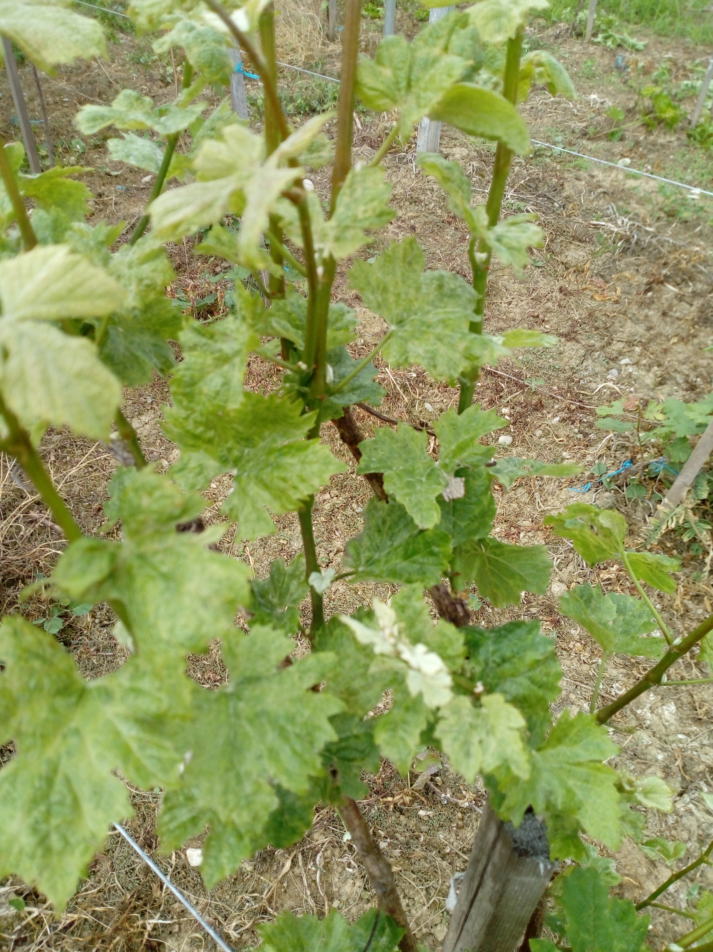
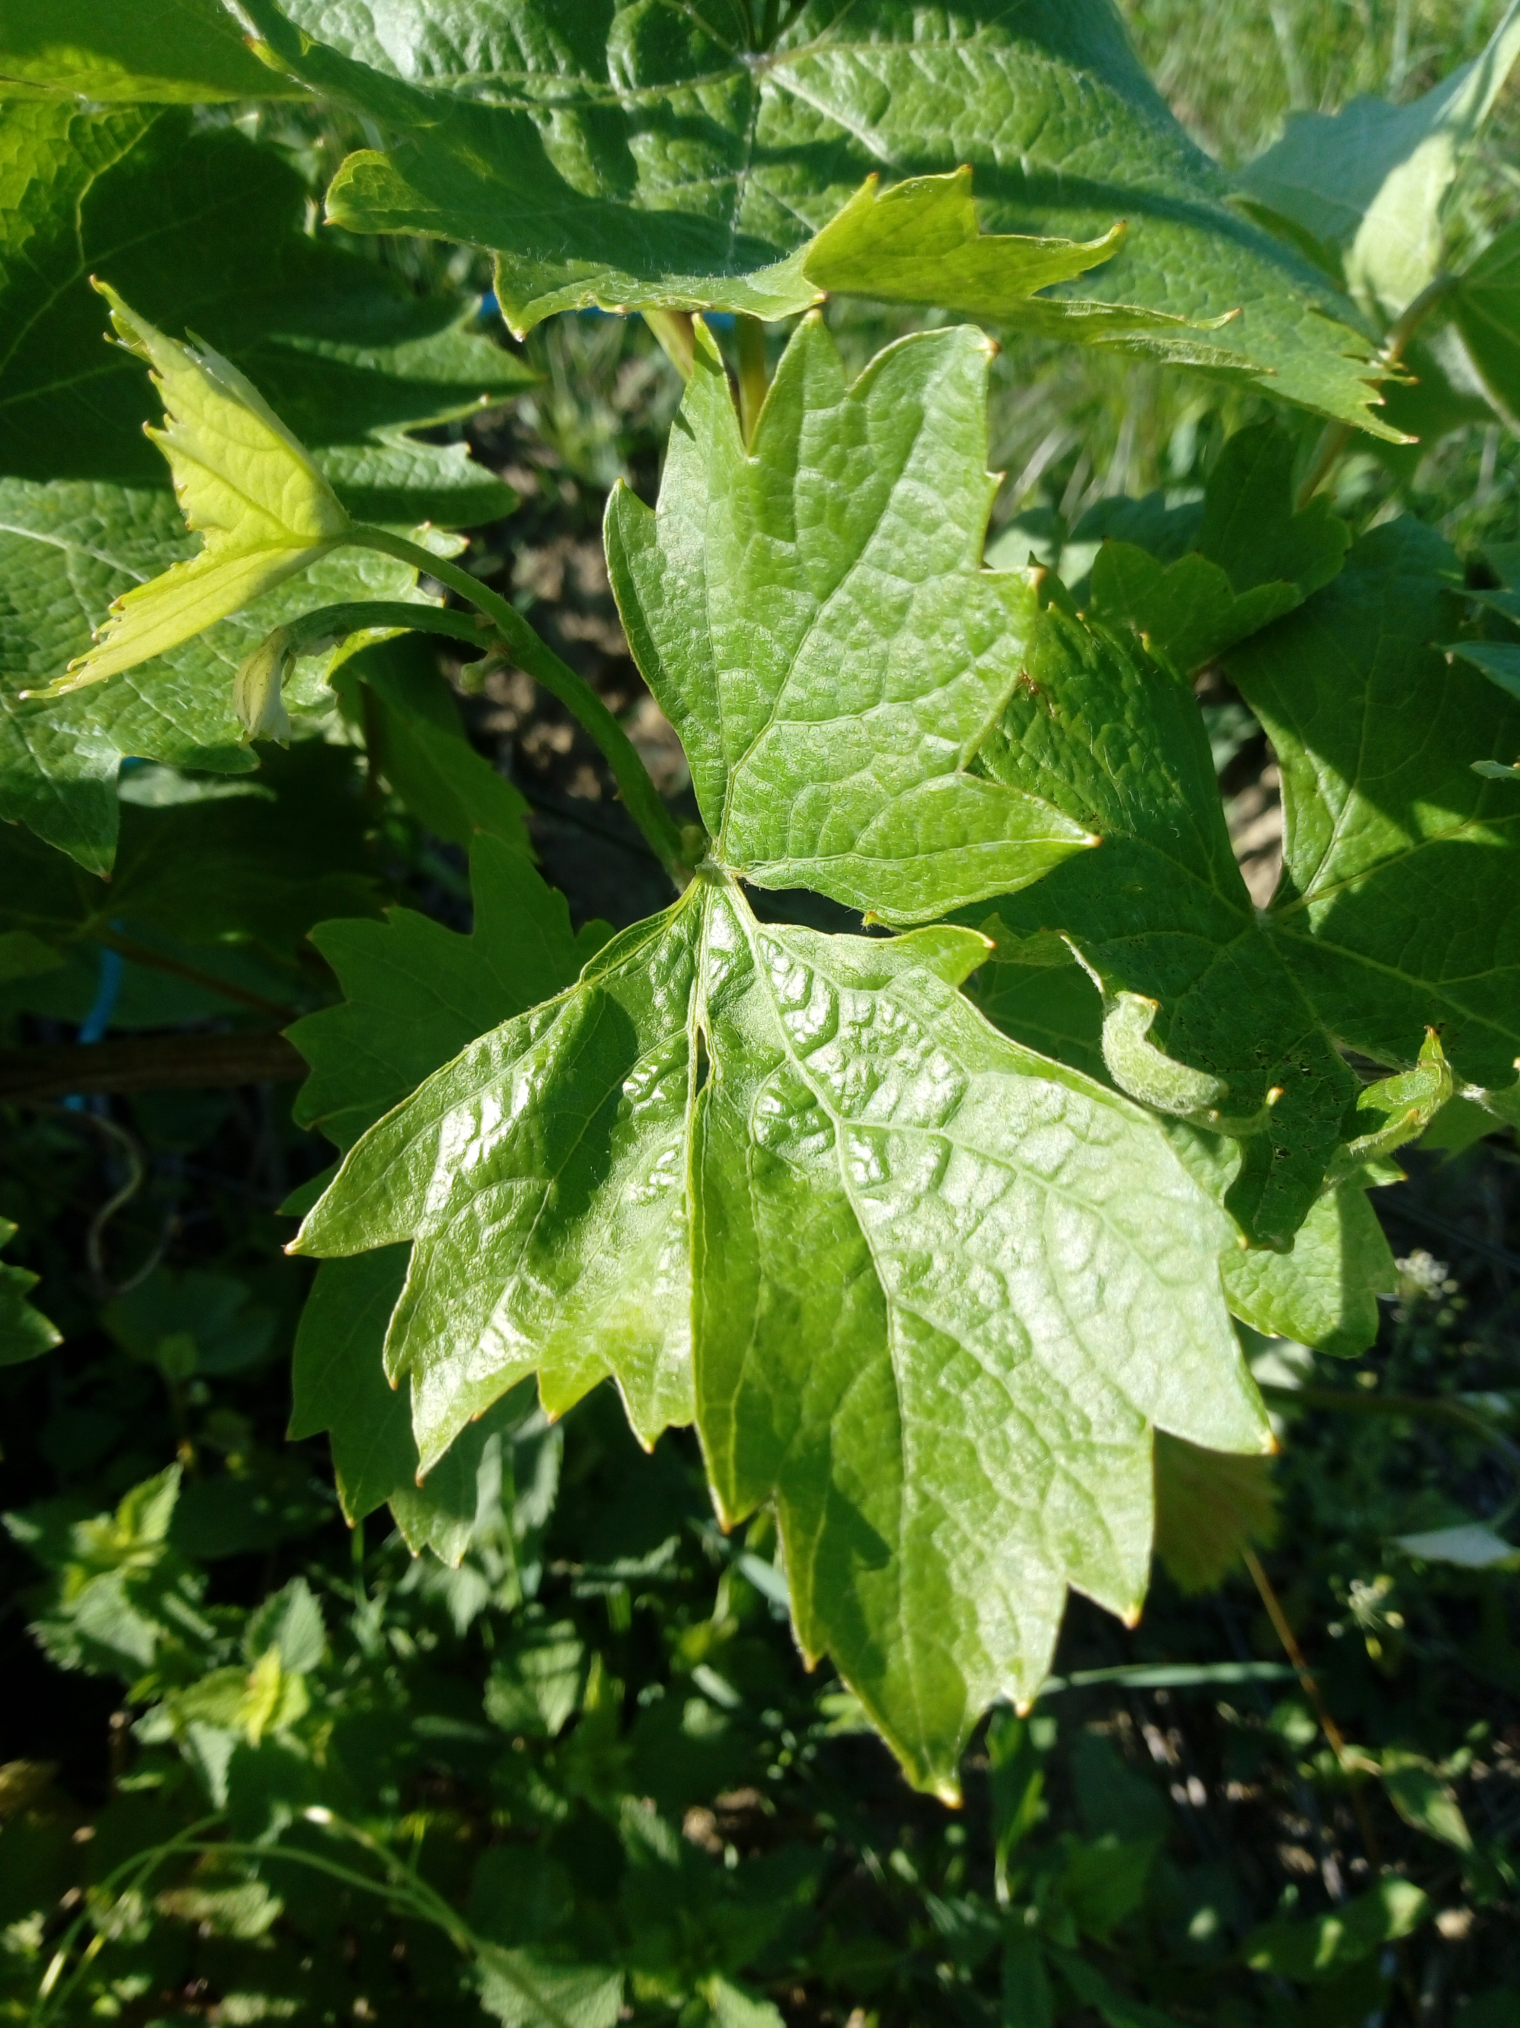
CONFERINȚA NAȚIONALĂ “ANIVERSAREA ICAR”
Ediția IV – 29 mai 2025
Sigla Instituției
autorului principal
Distribution of the viral complex Grapevine Pinot gris virus
and Grapevine fleck virus in grapevine
on phenophases of vegetation
Guță Ionela-Cătălina, Buciumeanu Elena-Cocuța, SUMEDREA dORIN IOAN
INTRODUCTION: Grapevine Pinot gris virus and Grapevine fleck virus are widely distributed in vine growing countries of the world. The study deals with the distribution of GPGV and GFkV in grapevine plants having mixed infection with these viruses, in different phenophases, with the aim to identify the tissues with high virus concentration (most suitable tissue for virus detection), and, also, to identify the tissues with the minimum viral concentration, to be used in virus elimination procedures.
Material and mehods
Different organs and tissues of Vitis vinifera L., Negru mare cv. double infected with GPGV + GFkV were analysed by ELISA (Clark and Adams, 1977) with commercial reagents (Bioreba, Switzerland), following the manufacturer’s instructions, during the phenophases of grapevine growth and development. The grafted plants showing GPGV infection symptoms were grown in ex situ grapevine collection belonging to INCDBH Ștefănești-Argeș. Two grapevine plants were analysed before flowering (05/16/2023), after flowering (06/24/2023), fall (09/12/2023), and dormancy phenophases. From each plant, 2 shoots were analysed, from which were collected: leaf (leaf blade and petiole) located at the base, middle and tip of the shoot; lateral shoot; apex; rachis; berry skin; seed; cane after leave fall. The plant material was grinded and homogenised with extraction buffer at 1/10 ratio (m/v). At completion of reactions, optical densities (OD) were measured with double filter at 405/492 nm, using a Chromate microplate reader (Awareness Technology, Inc., Florida, USA). The sample was considered positive when its OD 405/492 nm value was at least three times the negative control value.
Results and discussion
The most important strategy to prevent the viruses spread is the use of healthy propagation material, selected through periodic monitoring followed by the elimination of diseased plants, or obtained by virus elimination methods. It is known that the virus titre is variable during the vegetation period in different organs and tissues of the plant.
Below are presented the ELISA results on 2 plants belonging to Negru mare genotype natural infected with GFkV + GPGV viral complex, cultivated ex situ, from different organs located in different zones of the trunk, in the vegetation phenophases. OD = optical density at 405/492 nm. The test result was expressed as positive (+) = presence of virus, negative (-) = not identified by ELISA, and nt. = not tested.
Before flowering phenophase
After flowering phenophase
Ripening phenophase
Sampling location and biological material type |  | Shoot 1 |  |  |  | Shoot 2
 |  | GFKV |  | GPGV |  | GFKV |  | GPGV
 |  | OD | Result | OD | Result | OD | Result | OD | Result
Plant 1
Lower leaf | Leaf blade | 2.777 | + | 0.298 | + | 3.303 | + | 0.352 | +
 | Petiole | 1.948 | + | 3.285 | + | 2.276 | + | 2.965 | +
Leaf, node 5 below inflorescence | Leaf blade | 3.238 | + | 3.062 | + | 2.995 | + | 3.573 | +
 | Petiole | 1.017 | + | 3.549 | + | 1.676 | + | 3.555 | +
Apex |  | 0.454 | + | 2.022 | + | nt. | nt. | nt. | nt.
Plant 2
Lower leaf | Leaf blade | 1.936 | + | 0.123 | - | 3.549 | + | 0.236 | -
 | Petiole | 1.318 | + | 3.572 | + | 2.185 | + | 3.495 | +
Leaf, node 5 above inflorescence | Leaf blade | 3.403 | + | 3.528 | + | 3.011 | + | 3.260 | +
 | Petiole | 0.439 | + | 3.381 | + | 0.621 | + | 3.5723 | +
Apex |  | 1.614 | + | 3.393 | + | nt. | nt. | nt. | nt.
Tendril |  | nt. | nt. | nt. | nt. | 0.821 | + | 3.570 | +
Sampling location and biological material type |  | Shoot 1 |  |  |  | Shoot 2
 |  | GFKV |  | GPGV |  | GFKV |  | GPGV
 |  | OD | Result | OD | Result | OD | Result | OD | Result
Plant 1
Lower leaf | Leaf blade | 3.031 | + | 0.148 | - | 2.636 | + | 0.166 | -
 | Petiole | 2.569 | + | 0.225 | - | 1.798 | + | 0.290 | -
Leaf, node 11 | Leaf blade | 2.980 | + | 0.128 | - | 2.360 | + | 0.129 | -
 | Petiole | 2.439 | + | 2.787 | + | 2.111 | + | 2.283 | +
Lateral shoot, node 15 (whole) |  | 0.660 | + | 0.625 | + | nt. | nt. | nt. | nt.
Tendril, node 10 |  | 2.337 | + | 0.817 | + | nt. | nt. | nt. | nt.
Apex |  | nt. | nt. | nt. | nt. | 1.516 | + | 0.212 | -
Rachis |  | nt. | nt. | nt. | nt. | 0.782 | + | 2.396 | +
Berry |  | nt. | nt. | nt. | nt. | 2.297 | + | 1.717 | +
Plant 2
Lower leaf | Leaf blade | 2.286 | + | 0.152 | - | 2.494 | + | 0.136 | -
 | Petiole | 3.536 | + | 0.298 | - | 3.327 | + | 0.273 | -
Leaf, node 9 | Leaf blade | 1.567 | + | 0.133 | - | nt. | nt. | nt. | nt.
 | Petiole | 1.774 | + | 1.225 | + | nt. | nt. | nt. | nt.
Apex |  | 1.816 | + | 0.875 | + | nt. | nt. | nt. | nt.
Tendril, node 8 |  | 3.493 | + | 1.214 | + | nt. | nt. | nt. | nt.
Rachis |  | nt. | nt. | nt. | nt. | 0.854 | + | 2.604 | +
Berry |  | nt. | nt. | nt. | nt. | 3.048 | + | 1.030 | +
Sampling location and biological material type |  | Shoot 1 |  |  |  | Shoot 2
 |  | GFKV |  | GPGV |  | GFKV |  | GPGV
 |  | OD | Result | OD | Result | OD | Result | OD | Result
Plant 1
Lower leaf | Leaf blade | 1.298 | + | 0.098 | - | 1.455 | + | 0.101 | -
 | Petiole | 0.770 | + | 0.114 | - | 0.616 | + | 0.105 | -
Leaf, node 7 | Leaf blade | 1.885 | + | 0.104 | - | 3.196 | + | 0.100 | -
 | Petiole | 1.088 | + | 0.102 | - | 0.545 | + | 0.163 | -
Apex |  | 2.398 | + | 1.082 | + | 2.761 | + | 3.480 | +
Rachis |  | nt. | nt. | nt. | nt. | 3.490 | + | 1.020 | +
Skin |  | nt. | nt. | nt. | nt. | 3.559 | + | 3.562 | +
Seed |  | nt. | nt. | nt. | nt. | 0.275 | + | 3.569 | +
Plant 2
Lower leaf | Leaf blade | 2.769 | + | 0.125 | - | 2.394 | + | 0.100 | -
 | Petiole | 0.703 | + | 0.094 | - | 2.106 | + | 0.097 | -
Leaf, node 7 | Leaf blade | 1.396 | + | 0.103 | - | 2.657 | + | 0.099 | -
 | Petiole | 0.519 | + | 0.099 | - | 0.935 | + | 0.097 | -
Apex |  | 2.068 | + | 0.139 | - | 3.082 | + | 0.189 | -
Dormancy
Sampling location and biological material type | Cane 1 |  |  |  | Cane 2
 | GFKV |  | GPGV |  | GFKV |  | GPGV
 | OD | Result | OD | Result | OD | Result | OD | Result
Plant 1
Base | 2.470 | + | 0.469 | + | 3.547 | + | 1.779 | +
Middle | 3.567 | + | 1.369 | + | 3.560 | + | 1.986 | +
Top | 3.540 | + | 1.778 | + | 3.572 | + | 2.727 | +
Plant 2
Base | 3.540 | + | 0.453 | + | 3.567 | + | 0.113 | -
Middle | 3.554 | + | 0.648 | + | 3.537 | + | 0.393 | +
Top | 3.539 | + | 0.796 | + | 3.538 | + | 0.257 | -
Conclusions
■ The detection of GPGV+GFkV viral complex
can be realized by ELISA both in the vegetation
and dormancy. The highest ELISA values have been
registered before flowering phenophase for both viruses
in leaf blade and petiole.
■ Since GPGV and GFkV concentrations are fluctuating in apex, the initiation of tissue cultures to eliminate the viral complex can be done in different grapevine during the active growth period of the plant.
GPGV symptoms on Negru mare cv.: chloroses, leaf mottling and deformation
Selective bibliography
Krebelj A.J., Čepin U., Ravnikar M., Novak M.P., 2015. Spatio-temporal distribution of Grapevine fanleaf virus (GFLV) in grapevine. Eur. J. Plant Pathol., 142, 159–171
Osman F., Golino D., Hodzic E., Rowhani A., 2018. Virus Distribution and Seasonal Changes of Grapevine Leafroll-Associated Viruses. Am. J. Enol. Vitic., 69(1), 70-76..
Fuchs, M., 2025. Grapevine viruses: Did you say more than a hundred? J. Plant Pathol., 107, 217–227. https://doi.org/10.1007/s42161-024-01819-5.

