Slide 1
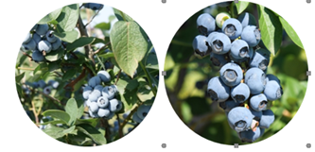
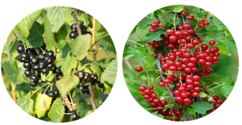
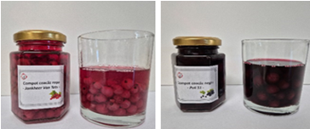
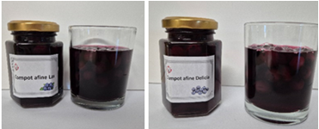
CONFERINȚA NAȚIONALĂ “ANIVERSAREA ICAR”
Ediția IV – 29 mai 2025
RESEARCH ON THE SUITABILITY OF CERTAIN VARIETIES OF BLUEBERRY AND CURRANT FOR PROCESSED PRODUCTS
Veringă Daniela, Niţu Adriana, Popescu Simona, Vapor Cristina, Oana Hera, Mariana Toma
INTRODUCTION: Fruits are important sources of essential vitamins, minerals and antioxidants, having beneficial effects on the human body. Although the fruits can be consumed fresh, due to the perishability of many of them, they are processed, thus extending their shelf life and reducing food waste. The total processing of fruits represents an important aspect in Romanian economy, and source of income and development for communities, by adding value to food productions from already established fruit-growing areas
MATERIAL AND METHODS
The research was conducted on two blueberry varieties (Delicia and Lax- fig.1) and two currant varieties (Jonkheer Van Tets and Poli 51- fig.2), provided by I.C.D.P. Piteşti-Mărăcineni. These were analyzed organoleptically and characterized biometrically. The fruits were processed in the laboratory of I.C.D.I.M.P.H.- Horting into preserve, jam, and compote varieties, following technological parameters and without the addition of preservatives or other food additives. After the minimum 21-day stabilization period, the products were analyzed according to STAS 12656-88, Method A, to evaluate their organoleptic properties: appearance, consistency, taste, and aroma. Based on the grades given by the tasters, each product received a rating and was classified into one of the five corresponding quality classes: very good (18,1-20,0 points); good (15,1-18,0 points); satisfactory (11,1-15,0 points); unsatisfactory (7,1-11,0 points) ; inadquate (0-7,0 points).
Fig. 1 Delicia si Lax varieties
RESULTS AND DISCUSSIONS
Fig.2 Poli 51 si Jonkheer van Tets varieties
Table 1 Sensory analysis of JAM
The process used to obtain the fruit preserve (fig. 1) was the preservation of fruits in sugar syrup, according to STAS 3750-90, it containe 45-55% fruit, 72% soluble dry matter and 0.7% acidity (expressed as malic acid). The results of the sensory analysis are presented in table 1.
Specification | Variety
 | Currants |  | Blueberry
 | Jonkheer Van Tets | Soi Poli 51 | Delicia | Lax
Appearance | 4,8 | 4,8 | 4,8 | 4,8
Color | 4,8 | 5,0 | 5,0 | 5,0
Consistency | 4,4 | 4,4 | 4,0 | 4,6
Taste | 4,8 | 4,6 | 4,4 | 4,8
Average score | 18,8 | 18,8 | 18,2 | 19,2
Score | very good | very good | very good | very good
Figura 1 Blueberry fruit preserve: Lax end Delicia
Table 2 Sensory analysis of PRESERVE
Specification | Variety
 | Currants |  | Blueberry
 | Jonkheer Van Tets | Soi Poli 51 | Delicia | Lax
Appearance | 4,4 | 5,0 | 4,8 | 4,4
Color | 4,8 | 5,0 | 5,0 | 5,0
Consistency | 3,6 | 4,0 | 4,8 | 4,6
Taste | 4,4 | 4,4 | 4,8 | 4,6
Average score | 17,2 | 18,4 | 19,4 | 18,6
Score | good | very good | very good | very good
Jam (fig. 2 and 3) is a concentrated gelled product made from fresh fruit with the addition of sugar and lemon juice (if needed), packed in hermetically sealed and pasteurized containers. From an organoleptic point of view, the jam must comply with STAS 3183/90: appearance of the product: fruit, pieces of fruit, in a gelled mass, without syrup separation, without signs of fermentation or mold. The color must be characteristic of the fruit variety, with a pleasant taste and aroma, typical of the fruit variety, and without any foreign taste or smell.
Fig 2 Currant jam: Jonkheer van Tets si Poli 51
Figura 3 Blueberry jam: Delicia si Lax
The compote (fig. 4 and 5) is a product made from fruits in sugar syrup, with the addition of lemon juice (if needed), packed in hermetically sealed and pasteurized containers. From an organoleptic point of view, it complies with STAS 3164/90 : fruits covered with syrup, not broken, up with a degree of ripeness and similar dimensions; appearance of the syrup: clear, with slight ffine particles of fruit in suspension; consistency of the fruits:moderately firm, cooked fruits, but not broken up; color of the fruits: characteristic of the variety and degree of ripeness; taste and smell: pleasant, characteristic of cooked fruits, without foreign taste and smell (mold, fermentation, sour).
Table 3 Sensory analysis of COMPOTE
Specification | Variety
 | Currants |  | Blueberry
 | Jonkheer Van Tets | Soi Poli 51 | Jonkheer Van Tets | Lax
Appearance | 4,8 | 4,8 | 4,8 | 4,8
Color | 5,0 | 4,8 | 5,0 | 4,8
Consistency | 4,4 | 4,4 | 4,6 | 4,8
Taste | 4,6 | 4,5 | 5,0 | 4,8
Average score | 18,8 | 18,5 | 19,4 | 19,2
Score | very good | very good | very good | very good
Fig 4 Currant compote: Jonkheer van Tets and Poli 51
Figura 5. Blueberry compote: soiul Lax si Delicia
CONCLUSIONS
Most of the products met the quality standards, receiving the rating 'very good'. An exception was red currant jam, which received the rating 'good'. This indicates that all fruit varieties are suitable for processing in the form of preserve, jam and compote.
In red currant preserve, the seeds are present in the syrupy mass, which may pose some inconveniences.
The compote made from the Delicia variety received the highest score , among all the products fallowed by the compote from the Lax variety .
The Poli 51 currant jam, compared to the red currant jam, had a more gelled consistency due to the natural pectic substances present in the fruit..

