Slide 1
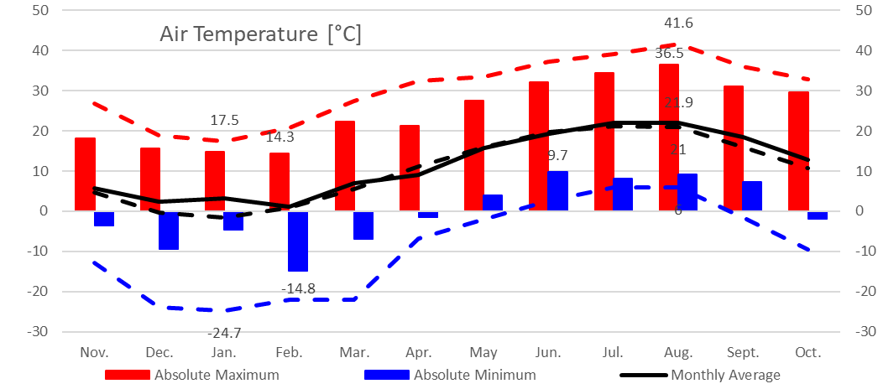
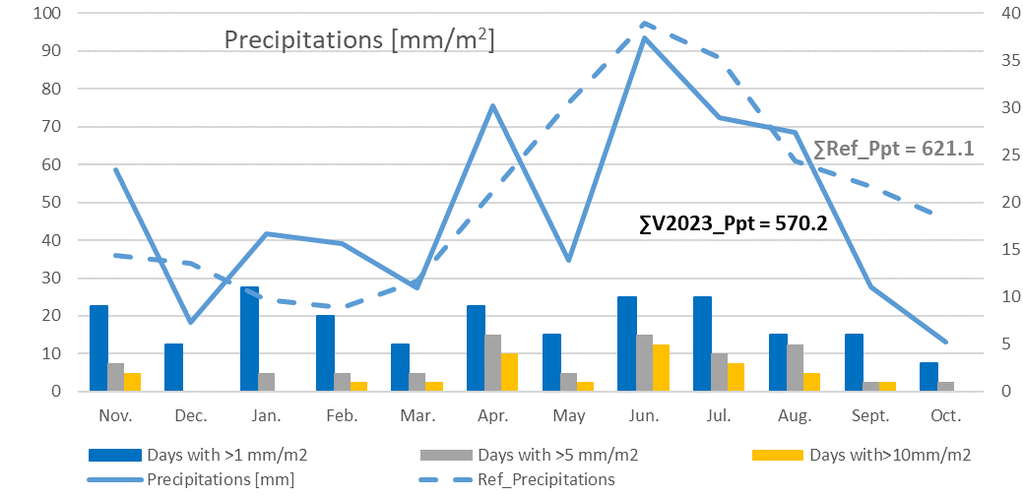
CLIMATIC CHARACTERIZATION OF THE VITICULTURAL YEAR 2023 AT SCDVV BLAJ
ACADEMIA DE ȘTIINȚE AGRICOLE ȘI SILVICE
“GHEORGHE IONESCU ȘIȘEȘTI”
STAŢIUNEA DE CERCETARE-DEZVOLTARE PENTRU
VITICULTURĂ ŞI VINIFICAŢIE BLAJ
MUNTEAN Maria-Doinița, TOMOIAGĂ Liliana Lucia, SÎRBU Alexandra Doina,
GIURCĂ Ioana Sorina, RĂCOARE Horia Silviu, COMȘA Maria*
ABSTRACT
This paper documents the agrometeorological peculiarities of the vintage 2023 in Blaj viticultural center. Based on data recorded by the SCDVV Blaj weather station, several thermal, hydric and heliothermic indicators registered between November 1, 2022 and October 31, 2023 were assessed. The period of active vegetation period, summed up, 187 days, in which 3517 ˚C of active temperature, 1577.5 ˚C of useful temperature, 2137 hours of effective insolation and 385.2 mm of precipitation were achieved. Uder this climatic conditions a higher production than normal was achieved, meanwhile the grapes kept an optimal sugar acidity balance and high quality white wines were obtained.
RESULTS AND DISCUTIONS
The average temperature of the whole 2023 viticultural year was 0.9 ˚C higher than the reference period, the maximum temperature of 36.5 ˚C was recorded in August and the minimum of -14.8 ˚C was recorded in February. The thermal resources available during the viticultural year 2023 excided the ones available in the reference period. The global thermal balance reached 3649.2 ˚C, the active thermal balance reached 3517.5 ˚C and the useful thermal balance reached 1577.5 ˚C, all being quite high, characteristic for warm years in this area.
Figure 1. Air temperatures recorded at SCDVV Blaj during 2023 vintage
The whole viticultural year 2023 summed up 570.2 mm of precipitations, of which 385.2 were registered during the vegetation period. A deficit of 50.9 mm precipitations was noted during 2023 vintage compared to the reference period. Most days recorded light rain. Most of the heavy rains occurred in June during the flowering phenophase and in the month of high demands (July, August).
Figure 2. The pluviometric regime recorded at SCDVV Blaj
CONCLUSIONS
The values of the main climatic elements recorded in the viticultural year 2023 at SCDVV Blaj indicate the existence of favorable conditions for most of the grapevine cultivars, especially for the white and rose ones.
The period of active vegetation in 2023, at SCDVV Blaj, summed up, 187 days, in which 3517 ˚C of active temperature, 1577.5 ˚C of useful temperature, 2137 hours of effective insolation and 385.2 mm of precipitation were achieved.
Climatic changes are obvious at SCDVV Blaj. There is a increase of the thermal resources of almost 300˚C, an increase of the heliothermic resources during the vegetation period and a decrease in the hydric resources
SELECTIVE BIBLIOGRAPHY
Chedea, V. S., Drăgulinescu, A. M., Tomoiagă, L. L., Bălăceanu, C., & Iliescu, M. L. (2021). Climate change and internet of things technologies—Sustainable premises of extending the culture of the amurg cultivar in Transylvania—A use case for Târnave Vineyard. Sustainability, 13(15), 8170.
Zaldea, G., Doina, D., Liliana, P., Maria, I., Viorica, E., Anamaria, T., Ionica, B., & Andreea, G. (2022). The evolution of climatic conditions between 1989 and 2021 in representative vine areas of Romania. Lucrări Ştiinţifice Seria Horticultură, 65 (2), 69-74.
CONFERINȚA ANIVERSARĂ ICAR ed. III
București, 30 mai 2024

