Slide 1


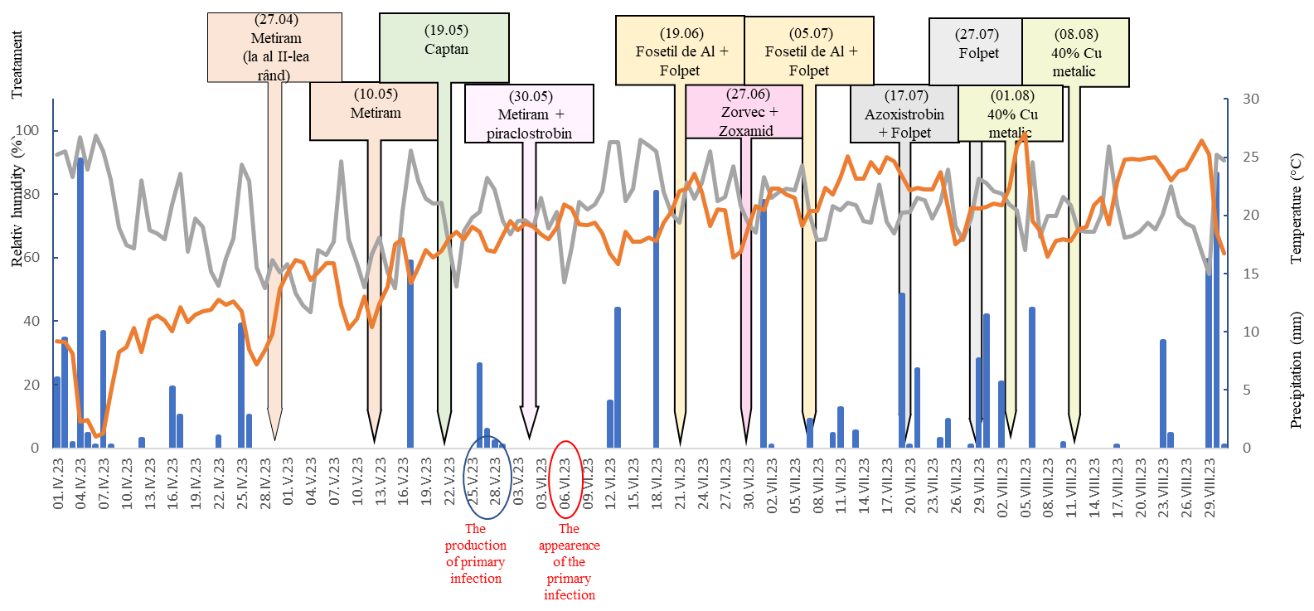
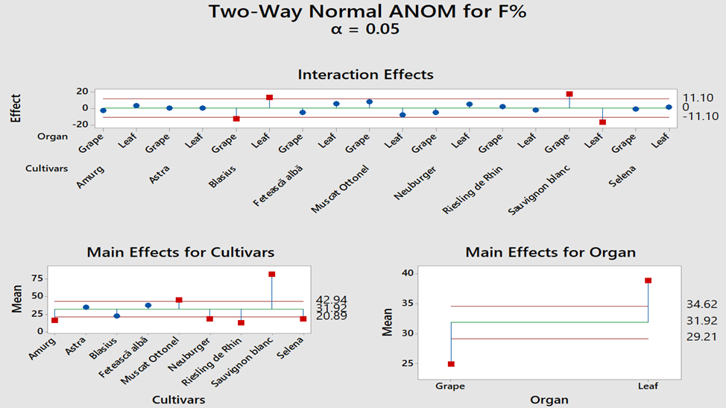
DOWNY MILDEW (PLASMOPARA VITICOLA) ATTACK IN THE GRAPEVINE PLANTATIONS OF SCDVV BLAJ IN 2023
ACADEMIA DE ȘTIINȚE AGRICOLE ȘI SILVICE
“GHEORGHE IONESCU ȘIȘEȘTI”
STAȚIuNEA DE CERCETARE DEZVOLTARE PENTRU
VITICULTURĂ ȘI VINIFICAȚIE BLAJ
COMȘA MARIA, TOMOIAGĂ LILIANA LUCIA, CHEDEA VERONICA SANDA, RĂCOARE HORIA SILVIU, SÎRBU ALEXANDRA DOINA, GIURCA IOANA SORINA, MUNTEAN DOINIȚA MARIA*
REZUMAT: The present study was conducted on the vegetation period of 2023, on the varietes Astra Amurg, Blasius, Selena, Fetească albă, Muscat Ottonel, Neuburger and Riesling de Rhin in SCDVV Blaj vineyards. The assessment of the infestation was determined on leaf and grapes. The most affected was Sauvignon blanc and the least affected was the Riesling de Rhin and Blasius.
RESULTS AND DISCUSSIONS
The climatic conditions during the vegetation period of 2023 at SCDVV Blaj were favorable for the development of the pathogen Plasmopara viticola, including critical periods for managing this disease (Figure 1).
In 2023, a total of 10 phytosanitary treatments with fungicides against downy mildew were applied in the experimental plots located at Crăciunelu de Jos accordinigly to the scheme in Figure 1.
Figure 1. The scheme of phytosanitary treatments applied in the experimental plots, the manifestation of downy mildew and climatic conditions - Crăciunelu de Jos 2023
The highest attack degree (AD%) on grapes was recorded in Sauvignon blanc (36.43 %), with a significantly difference compared to all other varieties. The lowest AD% on grapes was recorded for the Blasius variety
(0.1%), followed by Amurg (0.11%).
It can be observed that across organs, regardless of variety, the highest F% (frequency) was on leaves. The highest frequency among the grapevine varieties, regardless of the organ, was in Sauvignon blanc and the lowest in Rhine Riesling (Figure 2).
Figure 2. Graphical representation of the interactions effect of the cultivar and plant part on the downy mildew attack
CONCLUSIONS.
The climatic conditions during the vegetation period of 2023 in the Târnave vineyard were favorable to the development of grapevine downy mildew.
From the analysis of these data, it can be stated that the downy mildew attack in the Târnave vineyard largely depends on the interaction between environmental factors, grapevine variety, and the climatic conditions.
SELECTIV REFERENCES
1. Călugăr A, Babeş AC, Bunea CI, Pop TI, Tomoiagă L, Iliescu M. Oenological Characterization Of Wines From Grape Clones Created At Research Station For Viticulture And Enology Blaj, Romania, 2018; CZU. 2018;663(2):50–6.
CONFERINȚA ANIVERSARĂ ICAR ed. III
București, 30 mai 2024

