Slide 1
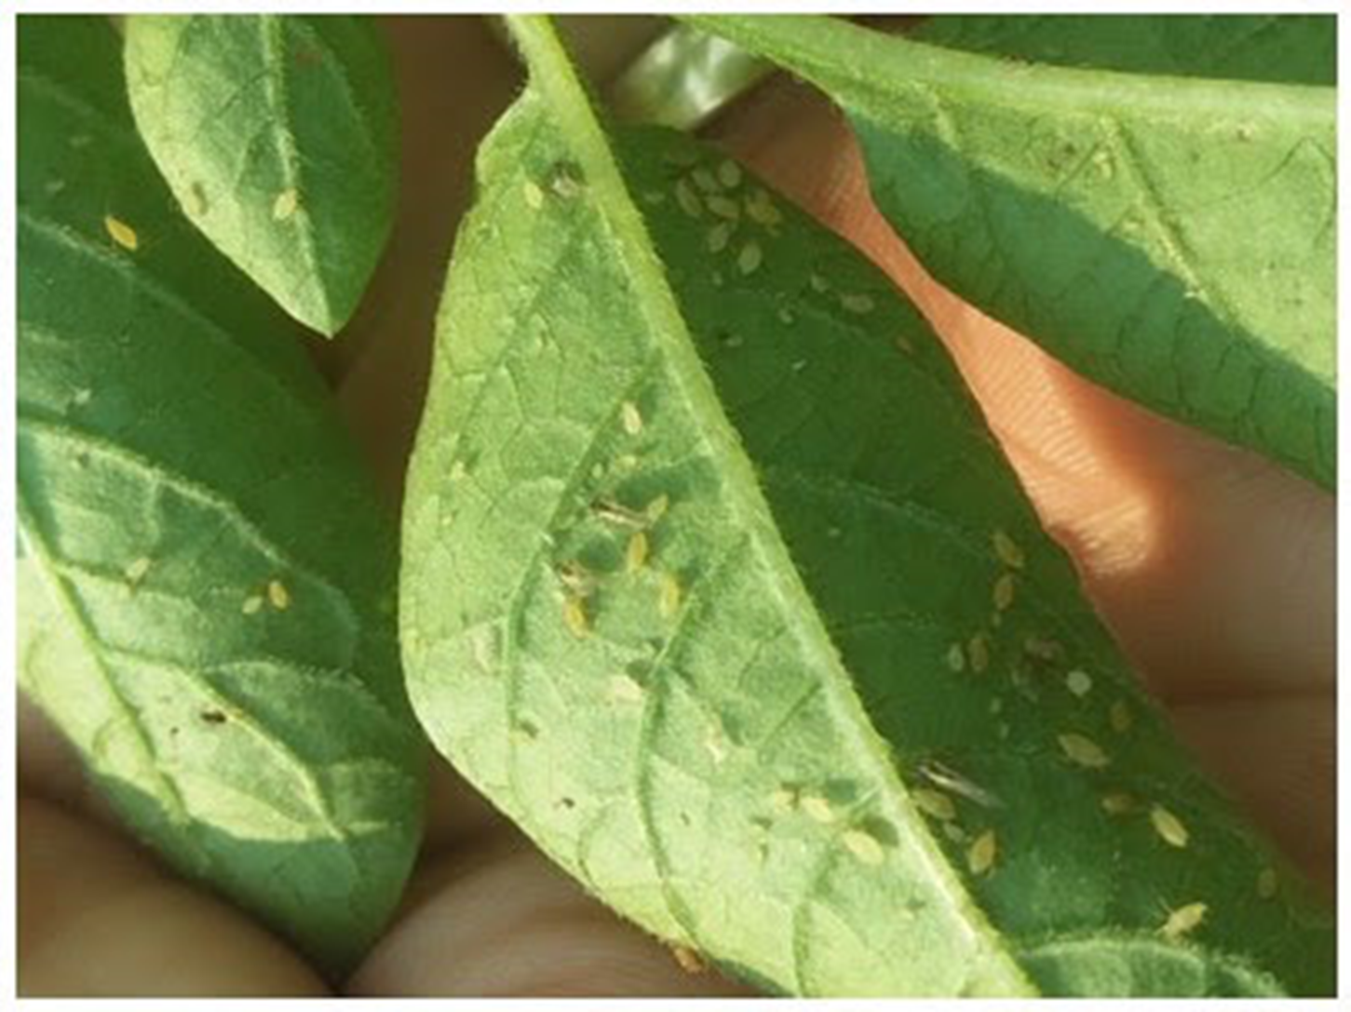
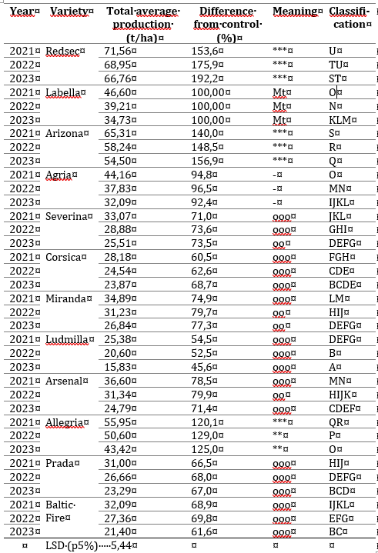
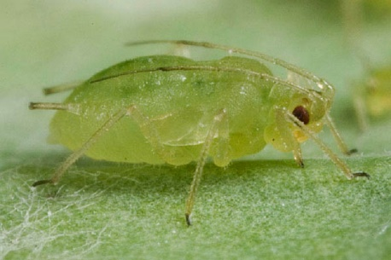
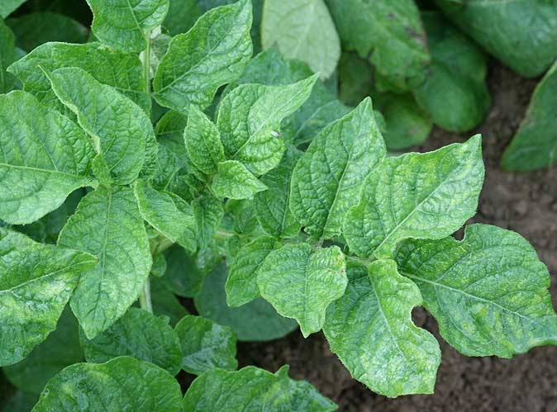
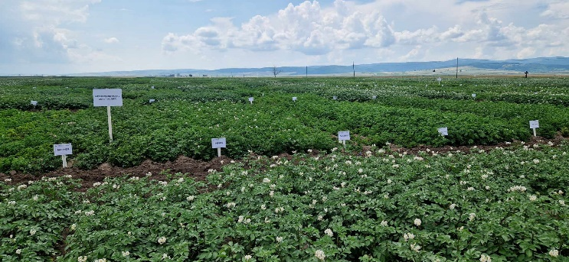
Influence of climate change on potato virotic degeneration
ACADEMIA DE ȘTIINȚE AGRICOLE ȘI SILVICE
“GHEORGHE IONESCU ȘIȘEȘTI”
Stațiunea de Cercetare – Dezvoltare pentru Cartof Târgu Secuiesc
Abstract
Mike Luiza, Baciu Anca
In the experimental field of the R.D.S.P. Targu Secuiesc, a comparative culture with 12 new potato varieties has been developed to test their tolerance to virotic degeneration in the period 2021 - 2023. In the first year (2021) no viroids were visually identified, in 2023 most viroids were identified in Labella (12.95%), Baltic Fire (10.08%) and Ludmilla (6.17%) varieties. During 2022 and 2023, Labella (12.95% / 19.58/%), Baltic Fire (10.08% / 17.76%) and Ludmilla(6.17% / 13.86%) varieties remain in first place with the highest % of virological infection. In terms of average yields over the three years of study, the highest yields were recorded for Redsec with 69.09 t/ha, Arizona with 59.35 t/ha and Allegria with 49.99 t/ha.
RESULTS
The evaluation of the 12 varieties grown in the comparative competition crops tested for virotic degeneration revealed 3 varieties with total average yields ranging from 43.42 t/ha (Allegria) to 71.56 t/ha (Redsec), the positive differences from the control variety being highly significant and statistically assured. The lowest average total yields were recorded for Ludmilla (15.83 t/ha in 2023 and 20.60 t/ha in 2022) and Baltic Fire (21.40 t/ha in 2023), the negative differences compared to the control variety being highly significant and statistically assured.
Table 1. Influence of climatic conditions and variety on the average total yield obtained in the comparative competition crops with varieties tested for virotic degeneration from 2021 to 2023
Table 2. Results on the influence of climatic conditions on the average total yield obtained in comparative competition crops with varieties tested for virotic degeneration in the period 2021 - 2023
CONCLUSIONS
1. If in the first year (2021) no viroids were visually identified, in 2022 most viroids were identified in Corsica (20.25%), Labella (15.55%), Arizona (15.00%), Severina (14.58) and Prada (13.81%).
2. In 2022, Redsec remains the variety with the lowest % of virus infection with 1.67% followed by Baltic Fire (2.56%).
3. The highest average yields were recorded in 2023 for Redsec with 71.56 t/ha, Arizona with 65.31 t/ha and Allegria with 55.95 t/ha, with high yields also in 2022 - 2023.
4. The most resistant variety to virotic degeneration was Redsec with a 3-year average yield of 52.04 t/ha and an average % of viroids of 1.67%.
REFERENCES
Brien P.J., Allen E.J. - 1981. The concept and measurment of physiological age. Abstracts of Conference papers 8-th Triennial Conference EAPR, Wageningen, p. 64-66.
Grison C. - 1990, The physiological quality of seedlings. The French potato.
Kawakami K., - 1962, The Physiological Degeneration of Potato Seed Tubers and its Control European Potato Jurnal.
CONFERINTA ANIVERSARA ICAR ed. III
Bucuresti, 30 mai 2024

