Slide 1
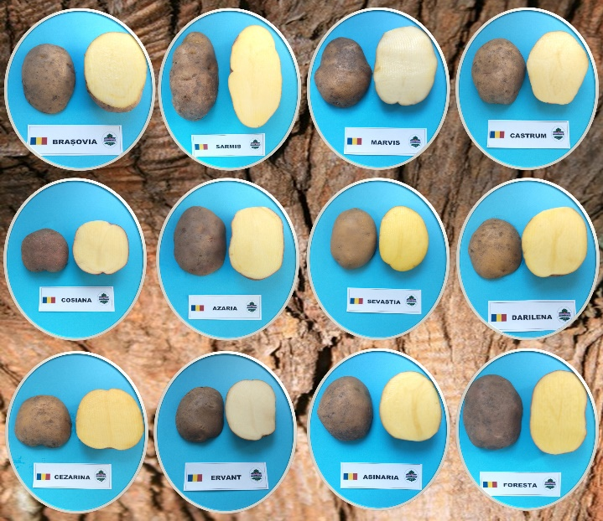
ACHIEVEMENTS IN THE POTATO BREEDING AT NIRDPSB BRASOV Ștefan Maria, Hermeziu Manuela, Bărăscu Nina, Hermeziu Radu
ACADEMIA DE ȘTIINȚE AGRICOLE ȘI SILVICE
“GHEORGHE IONESCU ȘIȘEȘTI”
NATIONAL INSTITUTE OF RESEARCH AND DEVELOPMENT FOR POTATO AND SUGAR BEET (NIRDPSB BRASOV)
ABSTRACT
Potato represents the most important non-cereal crop in the world. Currently, is cultivated in more than 130 countries, both for human consumption and for animal feed, for industrialization and processing in various forms (chips, French fries, flakes, etc.). The classic breeding program within the NIRDPSB Brasov aimed over the years, the obtaining of new potato varieties with resistance to biotic and abiotic factors and with high production capacity, in order to meet the quantitative and qualitative needs of consumers and farmers alike. Among the achievements of NIRDPSB Brasov are also the obtaining between 2014-2021 of 12 new potato varieties.
RESULTS AND DISCUSSIONS
Table 1. Evaluation of varieties resistance to PVY, PLRV and potato late blight
Table 3. The average productions of NIRDPSB Brasov
varieties in the SITRV network
Variety | Y virus | PLRV virus | Potato late blight
 |  |  | Foliage | Tubers
Brasovia | Medium resistant | Medium resistant | Medium resistant | Medium resistant
Sarmis | Medium resistant | Medium resistant | Medium resistant | Medium resistant
Marvis | Medium resistant | Medium resistant | Medium resistant | Medium resistant
Castrum | Very resistant | Very resistant | Medium sensitive | Medium sensitive
Cosiana | Medium resistant | Medium resistant | Medium resistant | Medium resistant
Sevastia | Resistant | Resistant | Medium resistant | Medium resistant
Azaria | Medium resistant | Medium resistant | Relatively resistant | Relatively resistant
Asinaria | Medium resistant | Medium resistant | Medium resistant | Medium resistant
Darilena | Medium resistant | Medium resistant | Medium resistant | Medium resistant
Cezarina | Resistant | Resistant | Medium resistant | Medium resistant
Ervant | Resistant | Resistant | Medium sensitive | Relatively resistant
Foresta | Medium resistant | Medium resistant | Relatively resistant | Relatively resistant
Variety | Production (t/ha) | Difference from the witness (%)
Brasovia | 33,88 | 114,86
Castrum | 33,54 | 113,71
Marvis | 30,81 | 104,43
Sarmis | 31,41 | 106,48
Magic (witness) | 29,50 | 100
Cosiana | 33,91 | 101,49
Sante (witness) | 33,41 | 100
Azaria | 38,83 | 107,35
Darilena | 38,52 | 106,50
Asinaria | 36,72 | 101,54
Roclas (witness) | 36,17 | 100
Sevastia | 36,17 | 101,38
Roclas (witness) | 35,55 | 100
Cezarina | 45,58 | 116,16
Ervant | 45,98 | 117,18
Roclas (witness) | 39,24 | 100
Foresta | 38,14 | 110,10
Roclas (witness) | 34,33 | 100
Table 2. The culinary quality of the varieties (Brasov, 2020)
Variety | Aspect | Taste | Color | Crushing when boiling | Consis-tency | Flouri-ness | Moi-sture | Starch struc-ture | Class
Brașovia | 1,50 | 1,91 | 3,56 | 1,28 | 2,38 | 2,38 | 1,84 | 1,81 | A/B
Castrum | 2,34 | 1,72 | 4,81 | 2,44 | 2,78 | 2,88 | 2,22 | 2,28 | B
Marvis | 1,56 | 1,97 | 3,75 | 1,66 | 2,16 | 2,84 | 2,25 | 2,16 | B
Sarmis | 1,28 | 1,22 | 4,94 | 1,41 | 2,16 | 2,09 | 2,03 | 1,50 | A/B
Cosiana | 2,50 | 2,5 | 2,5 | 3,5 | 2,50 | 3,00 | 2,00 | 3,00 | B/C
Azaria | 2,34 | 1,97 | 4,31 | 2,41 | 2,47 | 3,09 | 2,59 | 2,38 | B
Sevastia | 1,00 | 1,41 | 5,94 | 1,06 | 1,81 | 1,50 | 1,53 | 1,22 | A
Darilena | 1,63 | 1,78 | 4,69 | 1,84 | 2,31 | 2,53 | 2,06 | 2,13 | B
Asinaria | 1,19 | 1,78 | 5,63 | 1,31 | 1,81 | 2,44 | 2,31 | 1,88 | A/B
Cezarina | 1,06 | 1,94 | 4,88 | 1,06 | 2,06 | 1,81 | 1,63 | 1,34 | A/B
Ervant | 1,28 | 1,31 | 3,88 | 1,31 | 2,22 | 2,31 | 2,09 | 1,34 | A/B
Foresta | 1,13 | 2,03 | 5,63 | 1,31 | 1,81 | 1,50 | 1,53 | 1,22 | A
BRAȘOVIA
COSIANA
SEVASTIA
AZARIA
DARILENA
FORESTA
CONCLUSIONS
NIRDPSB Brasov is continuously concerned in creating new potato varieties competitive in terms of production capacity and resistance to diseases and pests, resilient varieties with superior characteristics. The introduction into cultivation of a large number of Romanian potato varieties represents an increased genetic diversity and offers farmers the possibility to choose varieties well adapted to local climatic conditions, to avoid thermos-hydric stress and to achieve a good productive potential every year.
CONFERINȚA ANIVERSARĂ ICAR ed. III
București, 30 mai 2024

