Slide 1
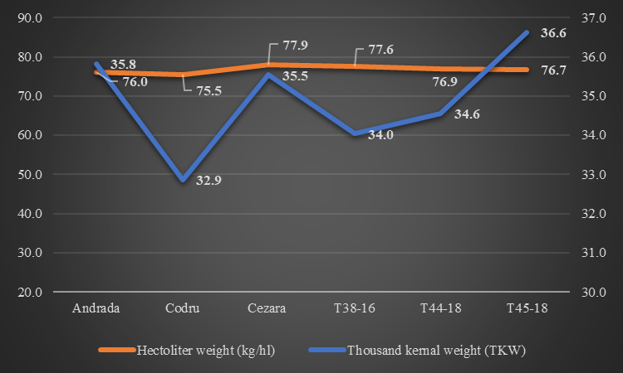
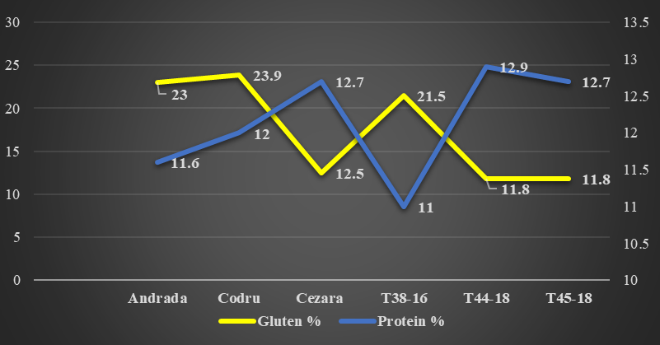
CONFERINȚA NAȚIONALĂ “ANIVERSAREA ICAR”
Ediția IV – 29 mai 2025
Sigla Instituției
autorului principal
RESEARCH ON THE IMPACT OF CLIMATE CHANGE ON YIELD FACTORS IN WINTER WHEAT CULTIVATED IN THE CENTRAL REGION OF MOLDOVA
Alexandra LEONTE, Cosmin MURARU, Andreea – Sabina PINTILIE, Rozalia KADAR
INTRODUCTION
Winter wheat (Triticum aestivum L.) is one of the main cereal crops cultivated on Earth. It provides basic food for half of Earth's population, so the preoccupation for increasing grain yield and grain quality is a primary concern. There has always been a concern for the renewal of cereal varieties, they are becoming more and more productive, being more adapted to the climatic conditions. According to data from the specialized literature, their yields have increased linearly since the 1960s, especially in areas with favorable conditions where the availability of water in soil was not limited and where the cultivation technology was adapted according to the demands of the variety (Zhou and et al., 2007; Fischer and Edmeades, 2010; Matus et al., 2012). Also, the cereal yield has increased a lot in the last decades and in areas where precipitation has been limited (Mediterranean areas), a fact that is due to the increased performance under water stress of the newly created varieties (Nouri et al., 2011; Hawkesford et al., 2013; Sánch - García et al., 2013).
MATERIAL AND METHODS
The experiment was carried out during the period 2021–2024 at the Agricultural Research and Development Station Secuieni (S.C.D.A. Secuieni), on a typical cambic chernozem soil with medium texture and acidic reaction: pHₕ₂O – 5.98. The soil was characterized by a good content of phosphorus (77.6 ppm PAL), calcium (13.6 mEq/100 g soil Ca), and magnesium (1.8 mEq/100 g soil Mg), a medium supply of active humus (1.88%) and nitrogen (16.2 ppm N-NO₃), and a low supply of potassium (124.6 ppm K₂O) (Pochișcanu et al., 2017).
The cultivation technology applied was specific to the conditions of central Moldova, and the data obtained were statistically interpreted according to the analysis of variance method (Leonte and Simioniuc, 2018).
Analyzing temperatures and precipitation throughout the entire winter wheat growing season in the Secuieni area reveals a shift toward increasingly warmer and drier conditions, which could lead to significant losses in agriculture.
MATERIAL AND METHODS
Among the winter wheat varieties and lines studied, the number of grains per ear varied significantly, ranging from 35.3 to 41.8 grains/ear, reflecting a diversity in the yield potential of each variant. The line T38-16 stood out with the highest number of grains per ear, reaching 41.8, while the variety Cezara recorded the lowest, with only 35.3 grains/ear. However, the Cezara variety achieved the highest grain weight per ear, at 1.421 grams/ear, whereas the lowest weight was recorded for the Codru variety, at 1.174 grams/ear. The difference between the maximum and minimum was 0.247 grams/ear, indicating a relatively moderate variation among the wheat varieties and lines studied. Analyzing the thousand kernal weight (TKW) for the winter wheat varieties and studied lines, the T45-18 line stood out with the highest value, reaching 36.6 grams, while the varieties Andrada (35.8 grams) and Cezara (35.5 grams) also recorded high values, which confirms their superior quality. In contrast, the Codru variety exhibited the lowest TKW value in the experiment, at 32.9 grams. Overall, the obtained values reflect significant genetic variability, which can be utilized in breeding programs to improve the physical qualities of the grains. The hectoliter weight (kg/hl) values indicate good winter wheat quality for all the studied genotypes, ranging between 75.5 kg/hl and 77.9 kg/hl. The highest hectoliter weight value was recorded by the Cezara wheat variety (77.9 kg/hl), followed by the T38-16 line (77.6 kg/hl), indicating high grain density and good potential for baking, while the Andrada variety recorded the lowest value at 76.0 kg/hl (Figure 1).
In the first year of testing, the yields obtained showed significant variability, ranging from 6325 kg • ha⁻¹, achieved by the Andrada variety, to 7151 kg • ha⁻¹, achieved by the T44-18 winter wheat line. A comparative analysis of all winter wheat lines and varieties with the control variant (T45-18 line) revealed that two varieties, Codru and Cezara, produced higher yields, along with two experimental lines, T38-18 and T44-18. In the second year, the winter wheat yields were lower compared to the first year, which can be attributed to less favorable climatic conditions or other environmental factors. The minimum yield was 5465 kg • ha⁻¹, achieved by the Andrada variety, while the maximum yield was 6391 kg • ha⁻¹, obtained by the control variant, T45-18.
In the final year of testing, unfavorable climatic conditions, particularly the significant precipitation deficit during the grain filling period, had a major impact on the winter wheat yields, resulting in the lowest values throughout the entire study period. The minimum yield was recorded by the T44-18 line, with only 4216 kg • ha⁻¹, while the maximum yield, 5270 kg • ha⁻¹, was obtained by the control variant, T45-18. Among all the variants analyzed, the T44-18 line had a significantly lower yield than the control, and the difference was statistically significant and interpreted as highly negative (Table 1).
Table 1. Winter wheat yields obtained at ARDS Secuieni during
the period 2021-2024
Varieties/ lines | Yield (kg • ha⁻¹ ) |  |  | Average 2021-2024 | Diff. | Sem. | CV (%)
 | 2021-2022 | 2022-2023 | 2023-2024
Andrada | 6325 | 5465^{oo} | 5104 | 5631 | -515 | o | 9,01
Codru | 6845 | 5648^{oo} | 4858 | 5784 | -362 |  | 14,13
Cezara | 6873 | 5864º | 5231 | 5989 | -157 |  | 11,29
T38-16 | 7036 | 6049 | 5185 | 6090 | -56 |  | 12,42
T44-18 | 7151 | 5767º | 4216^{ooo} | 5712 | -434 |  | 20,99
T45-18 | 6777^{Mt.} | 6391^{Mt.} | 5270^{Mt.} | 6146 | - | - | 10,40
DL 5% | 480 | 492 | 535 | 502
1% | 682 | 699 | 761 | 714
0,1% | 988 | 1012 | 1102 | 1034
Figura 1. The thousand kernal weight (TKW) and hectoliter weight (kg/hl) for winter wheat varieties and lines, average 2021-2024
Figura 2. Protein (%) and gluten (%) content values in the studied genotypes
CONCLUSION
In the research conducted at ARDS Secuieni, the winter wheat genotypes that surpassed the average yield threshold of 6000 kg • ha⁻¹ were the T45-18 line, with 6146 kg • ha⁻¹, and the T38-16 line, with 6090 kg • ha⁻¹. These genotypes stood out not only for their high yields but also for their reduced performance variability, as indicated by the coefficient of variation of 10.40% and 12.42%, respectively. This stability in the face of various environmental conditions makes them excellent options for cultivation.
The yield variations recorded by the genotypes depending on the annual cultivation conditions highlight the need for multiannual year of testing to accurately assess the stability and adaptability of the studied varieties and lines.

