Slide 1
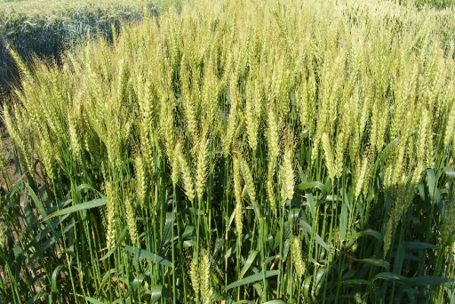
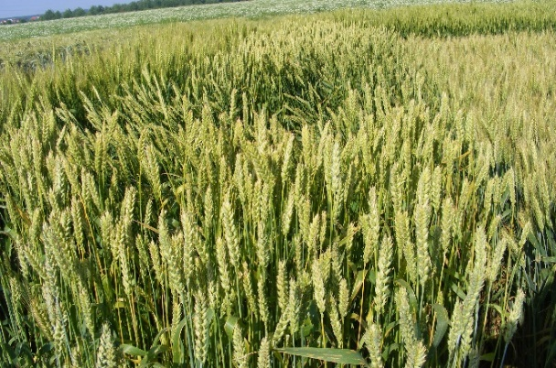
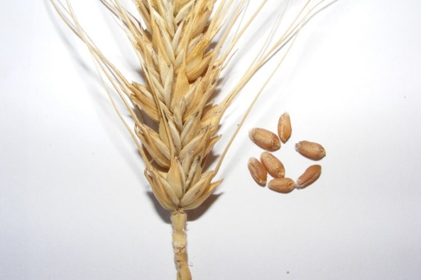
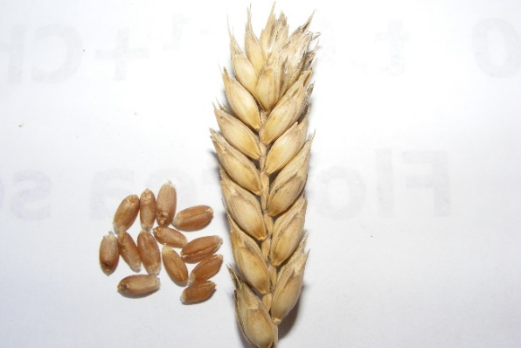
CONFERINȚA NAȚIONALĂ “ANIVERSAREA ICAR”
Ediția IV – 29 mai 2025
l
COMPARATIVE MORPHOLOGICAL ANALYSIS OF TRIVALE AND BEZOSTAIA WHEAT VARIETIES WITHIN CONV. AND ECO. CROP SYSTEMS
IONESCU Nicolaie, GHIORGHE Cristina, GHEORGHE Robert Marian, POPESCU Diana Maria,
NICOLAE Mariana Cristina, PODEA Maria Magdalena, DINUȚĂ Ilie Cătălin
INTRODUCTIONAt the current stage in wheat, the aim is to improve the genetic endowment with as many supports as possible expressed through quantitative and qualitative valences. On the one hand, the aim is to increase the level of grain biomass, and on the other hand, it is also required to obtain sustainability performances for the cultivation environment. Recently, however, this sustainability is also oriented towards promoting the conventional system with the ecological (green) one. From such an analysis, even morphological aspects, some useful sustainability characters could be identified, with the promotion in fact for both cultivation systems. For the analysis of this material, two wheat varieties with a somewhat longer history in cultivation were used. These are: the Trivale variety, which has been cultivated for over 20 years, and the Bezostaia variety with a much longer history (the 1960s). Both here and elsewhere, it is considered that cereals of the type presented here could increasingly gain ground, given their variable genetic heritage, with greater resilience, high tolerance to biotic and abiotic stress and growth.
.
MATERIALS AND METHODS. The variants were cultivated in the more special climatic conditions of the 2024 harvest with the Trivale and Bezostaia varieties (Marrige, 1985), in two already known cropping systems: the conventional system - Conv. and the ecological system - Eco (Murphy et al., 2007; Przystalski et al., 2008). The experiments were set up at the same time in the two systems, according to the block method, with the variants in an area of ​​25 m² each, in 4 repetitions/ replications. In the statistical calculation of all obtained values, the analysis of variance (Anova test) was used on the variation series. Statistical parameters were calculated using the formulas: ā =Σx/n, where ā = the average of the determinations, and x = the determined values, S² (variance) =1/(n-1) [Σx²-(Σx)²/n], S (standard error) = √S²), S % (variation coefficient) = S/ā.100.
RESULTS OBTAINED.
CONCLUZIFrom the study of the correlations between the most important characters, very significant positive situations were found in both varieties in the Eco cultivation system. It is possible that through this cultivation system in the two varieties there was a greater harmonization between the growth and development factors of the plants.I
Indices | Ear length, cm | Ear weight, g | No.grains/ ear | Grains weight, g | TGW*, g | Straw length, cm
 | Trivale Conv.
Ear weight, g | .709 | 1
No. grains | .773 | .933 | 1
Grains weight, g | .703 | .976 | .934 | 1
TGW, g | .394 | .754 | .555 | .803 | 1
Straw length, cm | -.065 | -.048 | .014 | -.062 | -.153 | 1
Straw diameter, mm | .322 | .369 | .387 | -.079 | .254 | -.079
 | Trivale Eco.
Ear weight, g | .827 | 1
No. grains | .843 | .954 | 1
Grains weight, g | .813 | .995 | .955 | 1
TGW, g | .306 | .525 | .287 | .541 | 1
Straw length, cm | .551 | .526 | .547 | .523 | .203 | 1
Straw diameter, mm | .437 | .490 | .438 | .483 | .365 | .256
LSD | (5%)- (0.195) (1%)- (0.254) ( 0.1%)- (0,32)
References. Hannell, U., L-Baeckstrom, G., Svensson, G., 2004. Quality studies on wheat grown in different cropping systems: a holistic perspective. Acta Agriculurae Scandinavica, Section B, Soil and Plant Science, Scandinavian U niversity Press, Norway.
Murphy, K.M., Campbell, K.G., Lyon, S.R., Jones, S.S., 2007. Evidence of varietal adaptation to organic farming systems. Field Crops Research, Elsevier, Amsterdam, HollandTilman, D., Cassman, K.G., Matson, P.A., Naylor, R., Polasky, S., 2002. Agricultural sustainability and intensive production practices. Nature, New York, USA.

