Slide 1


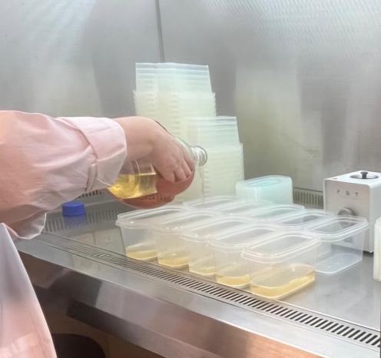
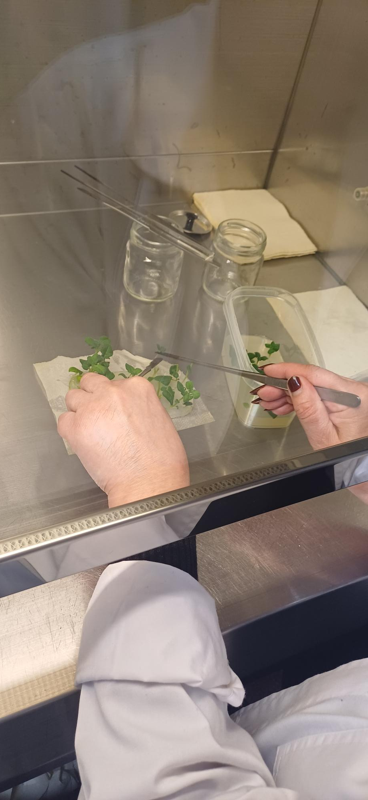
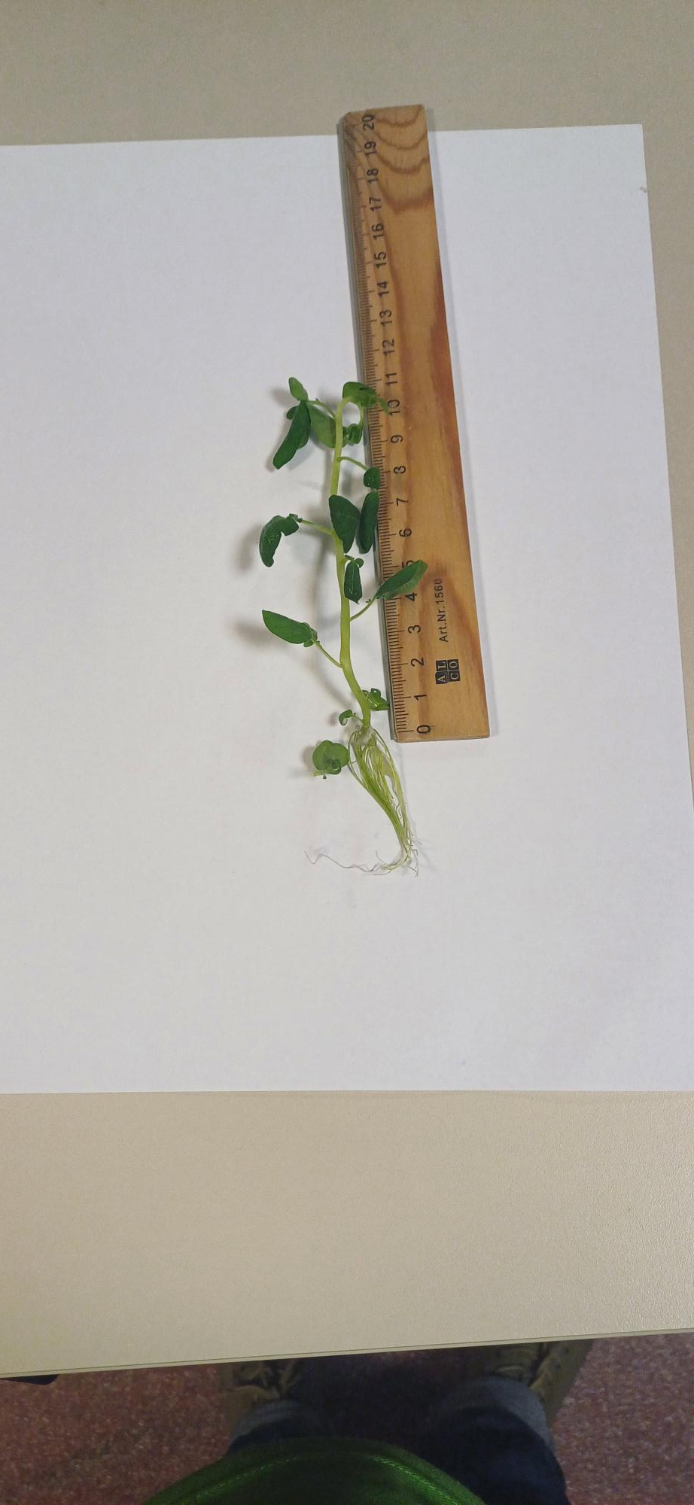
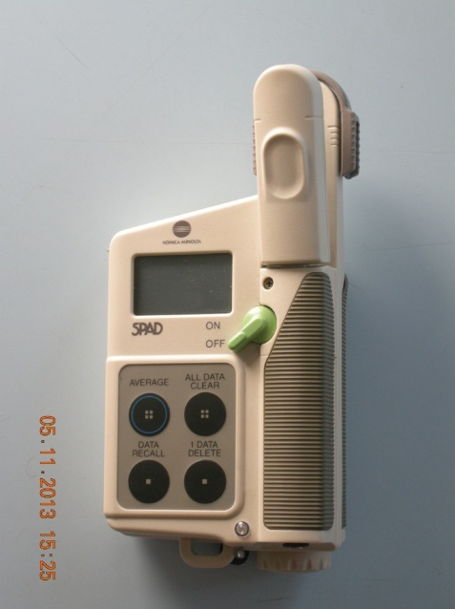
ESTIMATION OF CHLOROPHYLL CONCENTRATION IN POTATO
LEAVES BASED ON SPAD MEASUREMENTS
UNDER CONTROLLED CONDITIONS
CONFERINȚA NAȚIONALĂ “ANIVERSAREA ICAR”
Ediția IV – 29 mai 2025
Authors: POPA Monica, CIOLOCA Mihaela, TICAN Andreea
INTRODUCTION
Micropropagation techniques are the safest, most elaborate and fastest way to provide planting material for a seed potato crop and, implicitly, for production intended for consumption. Laboratory monitoring, control in a protected space (insect-proof space), regarding the growth and development status of plantlets determines the assurance of phytosanitary quality according to the established standard.
MATERIAL AND METHOD
The microplants obtained from meristems were transplanted, after acclimatization, into an "insect-proof" protected space to obtain planting material of superior phytosanitary quality.
Biometric observations were made on the biological material taken into study, for three Romanian potato varieties - Asinaria, Darilena and Foresta, regarding the average height of the plant, the average number of shoots and leaves, and by using the SPAD device, measurements were made on the chlorophyll content of potato leaves at the time of transplanting the vitroplants and after the acclimatization
period.
RESULTS AND DISCUSSION
Table 1. The influence of variety on the average plantlets height (cm) and the number of leaves (prepared for ex vitro environment)
Variety | The plantlets height in vitro | Diff. | Sign. | Number of leaves in vitro | Sign | Diff.
Asinaria | 8.90 | 0.8 | ns | 8.60 | 0.77 | ns
Darilena | 12.03 | 3.88 | * | 9.09 | 1.26 | *
Foresta (Ct.) | 8.15 | - | - | 7.83 | - | -
DL 5%=2.38, DL 1%=5.50, DL 0.1%=17.49
DL 5%=1.17 , DL 1%=2.70 , DL 0.1%=8.58
Table 2. The influence of variety the average plantlets height (cm) and the number of leaves (acclimatized in vivo)
Variety | The plantlets height in vivo | Diff. | Sign. | Number of leaves in vivo | Sign | Diff.
Asinaria | 36.90 | 4.10 | ns | 42.00 | -13.00 | ns
Darilena | 41.00 | 8.20 | ns | 100.20 | 45.20 | ***
Foresta (Ct) | 32.80 | - | - | 55.00 | - | -
DL 5%=9.93 , DL 1%=13.67, DL 0.1%=18.82
DL 5%=23.48, DL 1%=32.34 , DL 0.1%=44.52
Fig. 1. SPAD values recorded in vitro plants (ready for transplanting)
Fig . 2. Comparison of SPAD values of potato plants grown in greenhouse (after the acclimatization period)
Fig. 3. Comparison of SPAD values of potato plants grown in greenhouse (after flowering)
CONCLUSIONS
The statistical analysis performed for each varieties shows that plantlets height is bigger for Darilena variety, with a positive difference comparative (3.88 cm) with control variety (Foresta).
Analysis of the varieties used in the experiment shows that the best results were achieved for Darilena variety with a number of leaves by 9.09 and with a positive difference of 1.26 leaves, comparative with control variety.
The study of variety influence on the number of leaves is highlighted with a very significant positive difference for the Darilena variety (45.20).
These experiments were performed to model the relationship between chlorophyll concentration measured both in vitro and in vivo.

