Slide 1
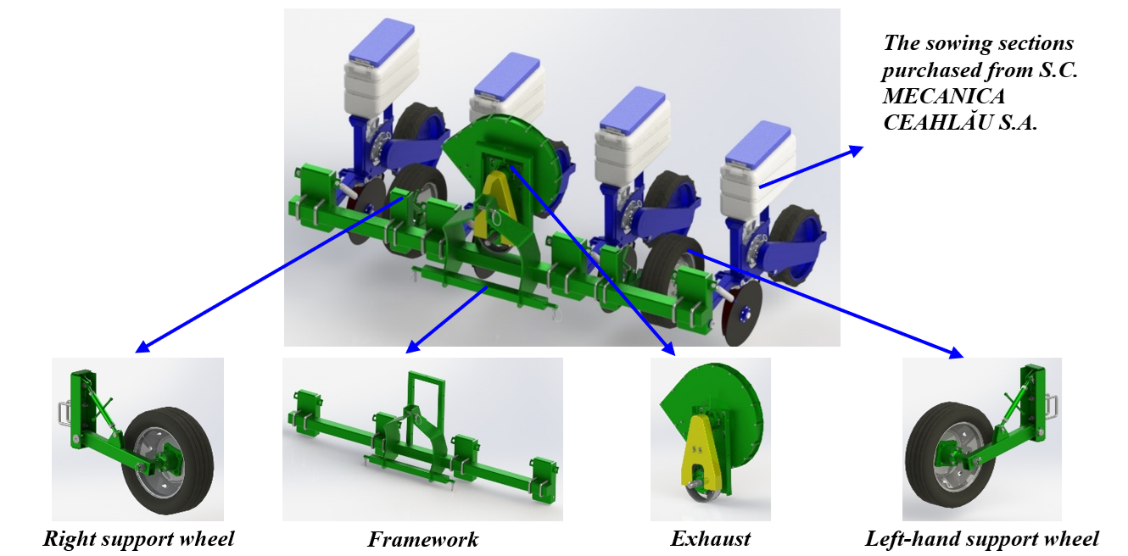
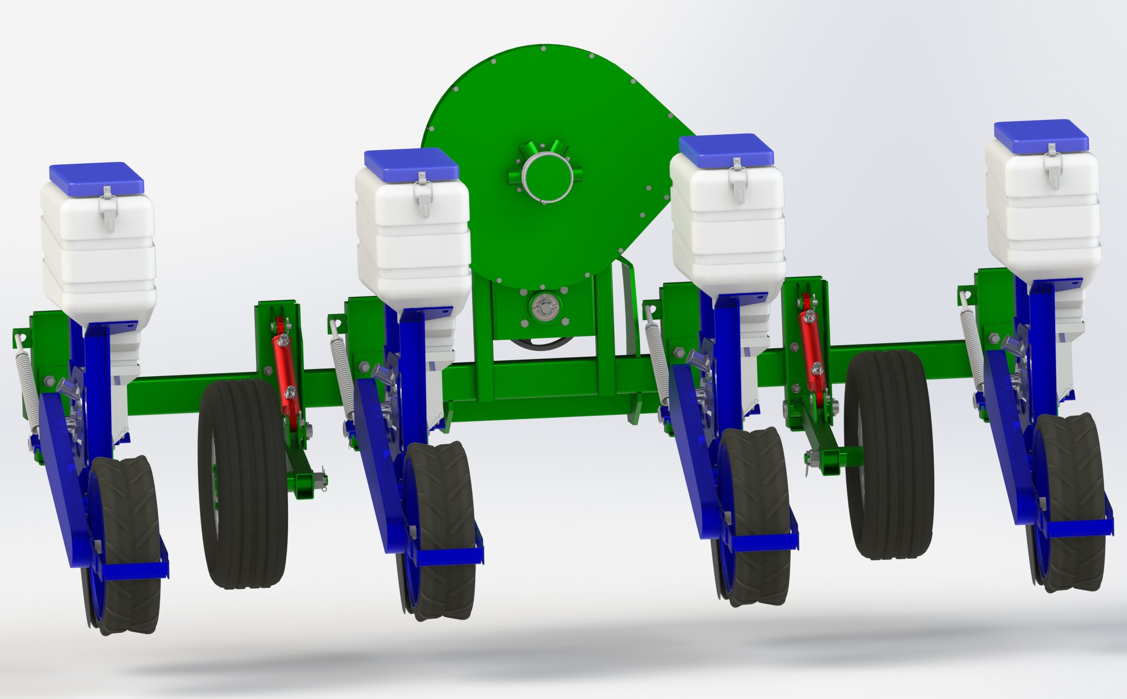
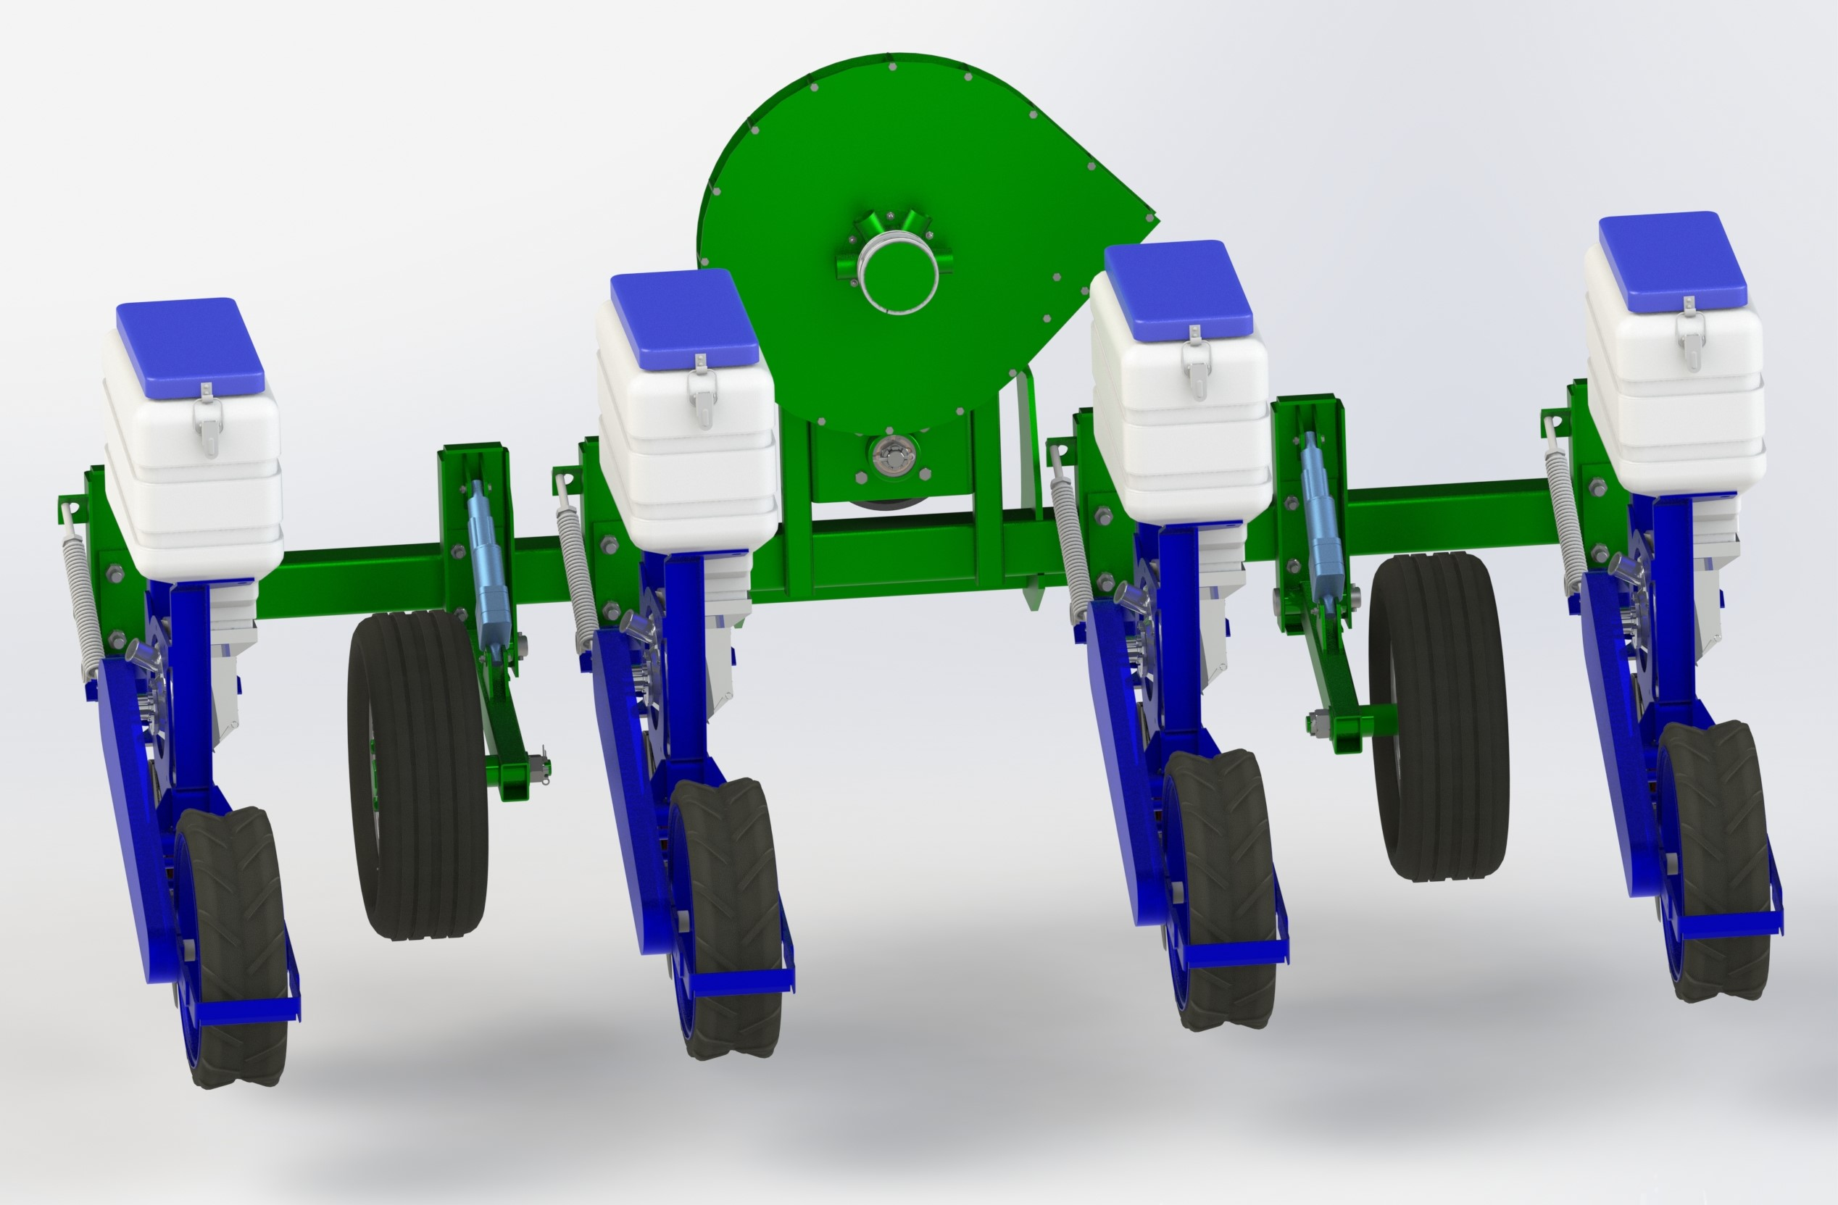
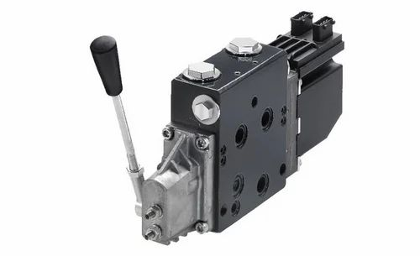
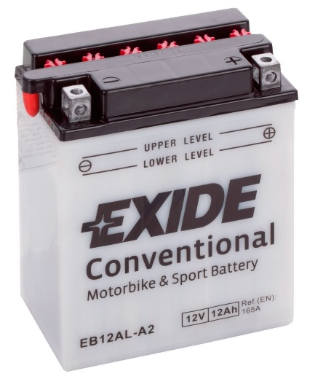
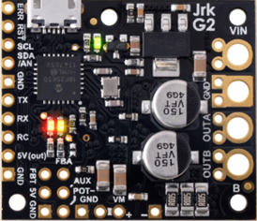
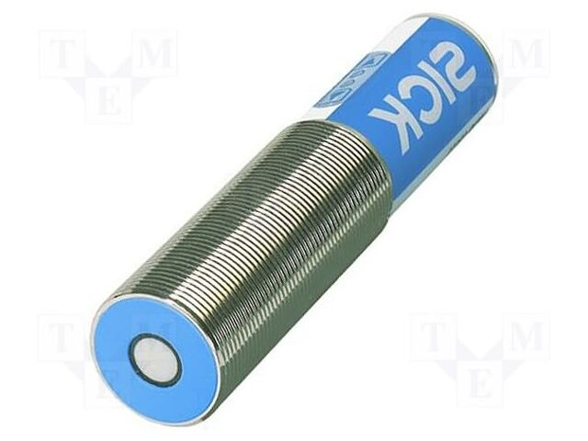
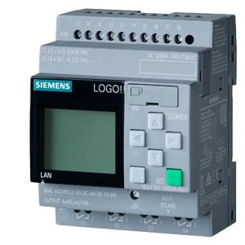
CONFERINȚA NAȚIONALĂ “ANIVERSAREA ICAR”
Ediția IV – 29 mai 2025
STUDY ON OPTIMIZING THE PERFORMANCE OF ROW CROP SEEDERS
Autors: Marin Eugen, Vlăduț Nicolae-Valentin, Matache Mihai-Gabriel, Cujbescu Dan-Iulian,
Cristea Mario, Ionescu Alexandru
INTRODUCTION:
The utilization of row crop planters (corn, sunflower) in contemporary agriculture is imperative, as they facilitate precise seed distribution, optimize row spacing, and promote the cultivation of uniform crops, thereby fostering high and efficient yields [14].
Recent research endeavours have culminated in the formulation of intelligent seeding systems that leverage artificial intelligence and optimisation algorithms to dynamically adjust seeding depth in real time.
Utilising advanced sensors, electronic control systems and data analytics, the company provides solutions that optimise resource utilisation and enhance crop yield.
MATERIAL AND METHOD
The research undertaken for the design of an intelligent control and monitoring system for the sowing depth was conducted on a seeder equipped with sowing sections procured from S.C. Mecanică Ceahlău S.A. Piatra Neamţ. The sowing sections are mounted to the frame bar by means of a system of articulated bars and a plate that is fixed to the square bar with two clamps. The sowing sections are equipped with a seed hopper, a pneumatic distribution device, a skid coulter, a zero-pressure tire compaction wheel and a chain transmission mechanism. The compaction wheel shaft is capable of mounting four sprockets (z=9, z=10, z=11, z=16), while the distributor shaft can accommodate two sprockets (z=22, z=30). The configuration of the seeder ensures the accurate and consistent sowing of grains at regular intervals. This is facilitated by the pneumatic-mechanical distributor, which enables precise distribution, and the uniformity of the sowing depth is ensured by the left and right support wheels, which are supported on the frame bar by means of arms. The seed distributor transmission and the tamping wheel, equipped with a 0-pressure tire and a V-profile, ensure the conditions for optimal sowing.
RESULTS AND DISCUSSION
As illustrated in Figure 1, the equipment for sowing weedy plants comprises two support wheels, each equipped with a hydraulic cylinder type CS00503220..
Figure 2 presents a schematic illustration of the apparatus employed for the cultivation of weedy vegetation, consisting of the left and right support wheels, with each being equipped with a linear electric actuator designated LACT4P-12V-20.
The automation of the CS00503220 hydraulic cylinder for seeding depth control encompasses the following components:
1. The Danfoss PVG 32 proportional hydraulic distributor is a device that regulates the oil flow to the cylinder depending on the signal received from the control unit
2. The Temposonics MH magnetostrictive cylinder position sensor is a device that measures the position of the cylinder piston and transmits a signal to the control unit.
3. The distance sensor (ultrasonic/laser) quantifies the actual distance between the sowing unit and the ground, compensating for unevenness. The SICK UM30-213113 sensor is a viable option, manufactured by SICK AG, a German company specialising in industrial sensors, automation and measurement systems.
4. The Siemens LOGO! PLC electronic control unit (ECU), which receives the signal from the position sensor and controls the proportional valve to adjust the cylinder position.
The automation of the linear electric actuator (Concentric LACT4P-12V-20) for seeding depth control comprises the following components:
1. The Pololu Jrk G2 18v19 Pololu Jrk G2 18v19 actuator controller (fig. 19), which controls the direction and speed of movement. This actuator has an internal potentiometer, which measures the exact position of its stroke and transmits the signal to the controller .
2. Siemens LOGO! PLC control unit (fig.15), which processes the sensor data and controls the actuator.
3. Power supply with motorcycle battery the Exide 12V 12Ah, EB12AL-A2. Exide 12V 12Ah motorcycle battery, which provides the power for the actuator and controller.
Fig 1. Row crop seeding machine equipped with a left support wheel and a right support wheel, each fitted with a hydraulic cylinder type CS00503220
Fig 2. Row crop seeding machine equipped with a left support wheel and a right support wheel, each fitted with a linear electric actuator type LACT4P-12V-20
Hydraulic distributor
Position sensor
Distance sensor
PLC electronic control unit
Actuator controller
Battery the Exide 12V 12Ah
CONCLUSIONS
1. Ensuring a constant planting depth in crops of grass crops such as maize and sunflowers is essential for uniform emergence, whereas an incorrect depth can lead to uneven crop growth. If seeds are placed too close to the surface (below 3 cm), they risk drying out quickly in arid soil. When seeds are placed at the optimum depth (4-6 cm), they benefit from optimal contact with the soil, which ensures rapid and uniform germination. If the seeds are placed too deep (over 7 cm), sprouting is delayed and uneven, as the seeds use more energy to reach the surface.
2. The utilization of a hydraulic cylinder or electric linear actuator seed depth adjustment system has been demonstrated to be advantageous for a number of individuals and entities within the agricultural sector. These include farmers seeking to enhance the accuracy of their seeding operations, equipment manufacturers developing advanced technologies, machine operators seeking greater control, and agricultural researchers studying seeding efficiency. The integration of this technology has been demonstrated to enhance productivity, reduce financial expenditure and safeguard the environment.
ACKNOWLEDGEMENTS
The results presented in this article were obtained with the support of MADR through the "Sectoral Plan - ADER 2026", financing contract no. 25.1.2 / 14.07.2023, ADER project 25.1.2. Tehnologie inovativă de prelucrare minimă a terenului agricol adaptată la schimbările climatice actuale – TEHCONS.

