Slide 1
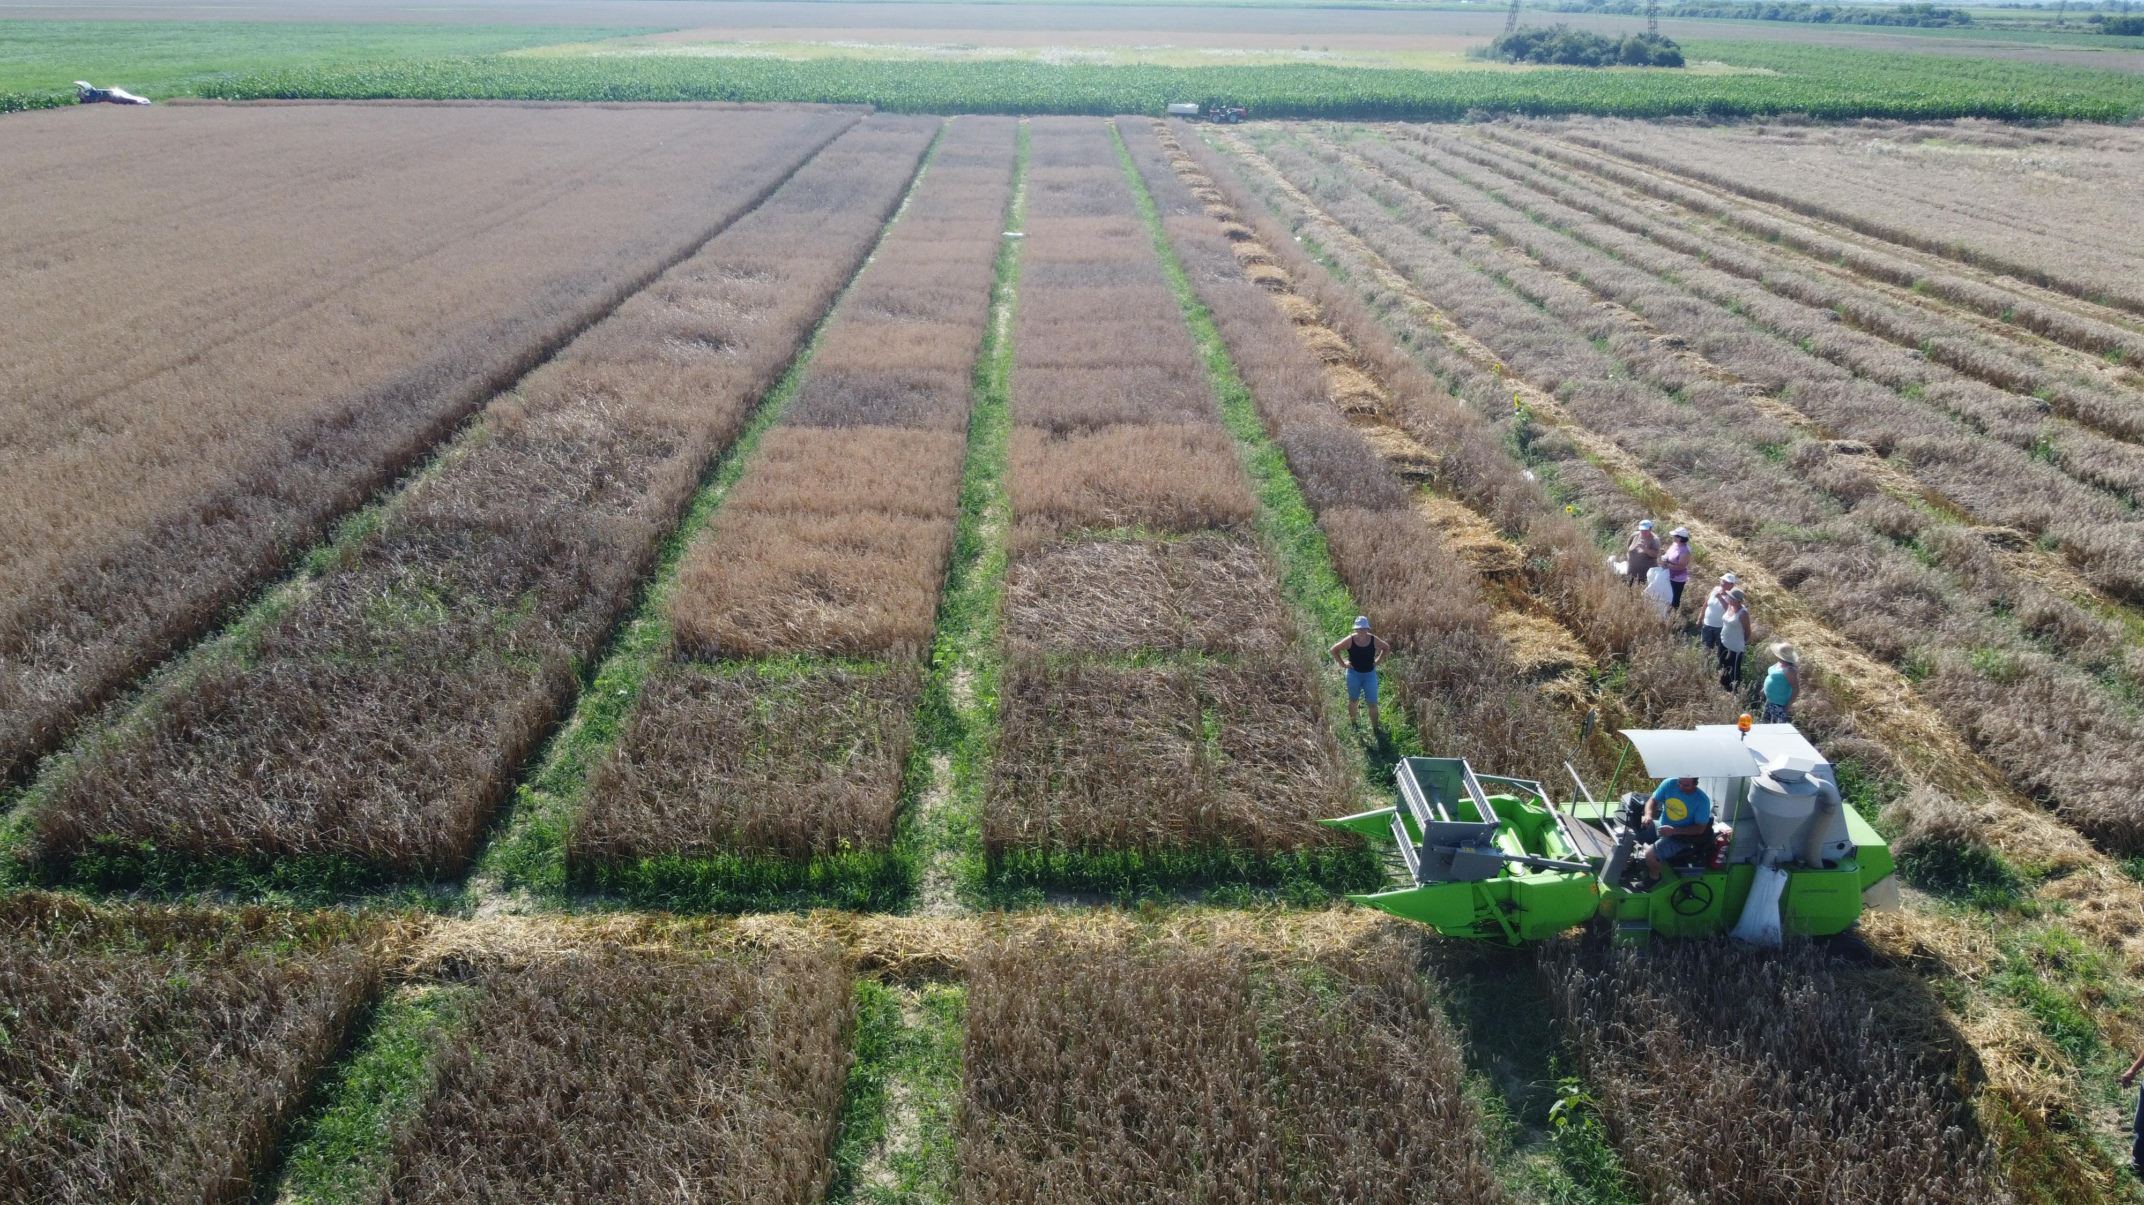
CONFERINȚA NAȚIONALĂ “ANIVERSAREA ICAR”
Ediția IV – 29 mai 2025
RESEARCH ON THE EFFICIENCY OF PHYTOSANITARY TREATMENTS AT DIFFERENT PHENOLOGICAL STAGES FOR CONTROLING PATHOGENS IN WHEAT CROPS
Autori: ÁCS Peter-Balázs, ANDRAȘ Beniamin-Emanuel, MONDICI Susana, GOGA Nicolae
INTRODUCERE:
Wheat (Triticum aestivum L.) is a cornerstone of global agriculture, serving as a primary food source for a significant portion of the world's population. However, its cultivation is continually challenged by a myriad of fungal pathogens that can severely compromise both yield and grain quality. Effective disease management is thus pivotal to ensure food security and the economic viability of wheat production
MATERIAL ŞI METODA DE LUCRU
This experiment involved the application of a complex fungicide to the wheat crop at different phenological stages. The objective was to cover the three critical phenophases of wheat—tillering, booting, and heading—as well as their combinations: tillering + booting; tillering + booting + heading; tillering + heading; booting + heading, in order to determine the most optimal technology for achieving both high-quality and high-quantity yields.
Nr. Crt. | Application phenophase | Fungicide | Doze L/ha | Application date
1 | tillering (BBCH 29-30) | Ortiva Top (200 g/l azoxistrobin 125 g/l difenoconazol) | 0,5 | 08.04.2024
2 | tillering+booting | Ortiva | 0,5
3 | tillering+heading | Ortiva | 0,5
4 | tillering+booting+heading | Ortiva | 0,5
5 | booting (BBCH 39-40) | Ortiva | 0,5 | 23.04.2024
6 | booting+heading | Ortiva | 0,5
7 | heading (BBCH 49-50) | Ortiva | 0,5 | 13.05.2025
8 | control | Netratat | - | -
REZULTATE OBŢINUTE
Variant | Yield (kg/ha) | % | Difference | Signification
Control | 5500,25 | 100,0 | 0,00 | Ct.
tillering | 6250,25 | 113,6 | 750,00 | *
tillering+booting | 6547,25 | 119,0 | 1047,00 | **
tillering+heading | 6125,25 | 111,4 | 625,00 | -
Tillering+booting+heading | 6469,25 | 117,6 | 969,00 | **
booting | 6359,75 | 115,6 | 859,50 | *
booting+heading | 6344,00 | 115,3 | 843,75 | *
heading | 5593,75 | 101,7 | 93,50 | -
Very low levels of powdery mildew and rust were recorded in all treated variants, especially those applied early. Only the heading treatment and untreated control showed high rust severity (14.3–14.5%) and slight powdery mildew presence
LSD (p 5%) 668,21
LSD (p 1%) 909,16
LSD (p 0.1%) 1227,20
The influence of fungicide treatment timing on yield, as determined by the analysis of variance of differences, shows that the booting + tillering and booting + tillering + heading phenophases are the most important, resulting in statistically significant yield differences.
Under conditions where climatic factors had a limited impact on spike diseases (such as fusarium head blight), treatments applied only at heading or in the tillering + heading variant did not lead to significant yield differences.
Nr. | Variant | Yield increase over the control (kg/ha) | Value (lei) | Expenses/ha (lei) | Profit/ha (lei)
1 | tillering | 750 | 900 | 312 | 588
2 | tillering+booting | 1047 | 1256,4 | 624 | 632,4
3 | tillering+heading | 625 | 750 | 624 | 126
4 | Tillering+booting+heading | 969 | 1162,8 | 936 | 226,8
5 | booting | 860 | 1031,4 | 312 | 719,4
6 | booting+heading | 844 | 1012,5 | 624 | 388,5
7 | heading | 94 | 112,2 | 312 | -199,8
Prețul grâului din 2024 (lei/kg) |  |  |  | 1,2 | RON
Cheltuieli cu aplicarea tratamentelor (lei/ha) |  |  |  | 120 | RON
Fungicid Ortiva Top 0,6l/ha (lei/ha) |  |  |  | 192 | RON
The highest profit, amounting to 719.4 RON/ha, was obtained with a single treatment at booting, followed by the tillering + booting variant with a profit of 632.4 RON/ha.
In contrast, the variant with a single treatment applied only at heading (heading) did not result in a profit; instead, it led to a reduction in income of -199.8 RON/ha.
It is important to note that this outcome occurred under climatic conditions less favorable for spike diseases.
CONCLUZII
Timing of fungicide application has a decisive impact on both disease control and yield performance in wheat. The application of treatments in multiple phenological stages, particularly tillering + booting + heading, significantly reduced the severity of foliar pathogens such as Septoria tritici, Puccinia spp., and Erysiphe graminis.
The tillering + booting treatment combination proved to be the most economically efficient, offering both high disease suppression and a 19% yield increase over the untreated control. It generated a profit of 632.4 RON/ha, second only to the booting-only treatment (719.4 RON/ha).
Treatments applied only at heading were the least effective in disease control and did not result in a profitable yield under the climatic conditions of the 2023–2024 growing season, showing a negative economic return.
Regarding grain quality, early and combined applications positively influenced key traits:
Statistical analyses (ANOVA and Duncan's test) confirmed the significance of treatment timing, with booting-inclusive variants forming a distinct group with the highest yields and quality parameters.
In years with low fusarium pressure, treatments at heading alone are not justified economically. However, in wetter years, especially during heading, Fusarium head blight risks may shift the optimal timing, necessitating site- and season-specific strategies.

